Slide 1
CompTIA Network+ Certification
1.2 Ethernet

Slide 2
Understand the properties of transmission media, data signaling, and media access control
Describe the features of IEEE 802.3 (Ethernet)
Describe the properties of MAC addressing and ARP
Understand the use of packet sniffers/protocol analyzers to capture and examine network traffic
Notes:
The number in the bottom right corner of the slides refers back to the page where this topic starts in the course book.

Slide 3
Transmission Media
Carry signals using parts of the electromagnetic spectrum
  Electrical circuits
  Light waves
  Radio waves
Cabled media (bounded)
  Copper (electrical)
  Fiber optic (light waves)
Wireless media (unbounded)
  Radio waves

Slide 4
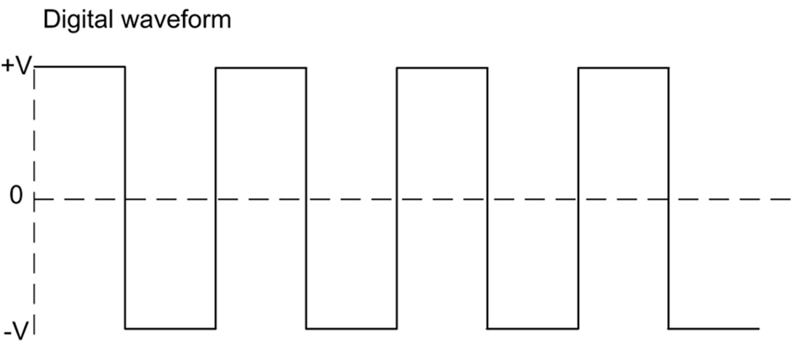
Signaling and Modulation
Digital data – discrete binary values
Digital signaling
  Line coding (discrete pulses)
  e.g high (1) versus low (0) voltage on wire (actual schemes are more complex)
Analog sampling
  Sampling analog information for transport over digital channels
  Nyquist theorem

Slide 5
Bandwidth, Baud, and Bit Rate
Bandwidth
  Range of frequencies available
  Baseband transmission
    Uses whole bandwidth of media
  Multiplexing – time or frequency division
  Channel capacity
    Cycles per second measured in Hertz (Hz)
    Multiples – Megahertz (MHz) and Gigahertz (GHz)
  Data rate
Baud rate versus bit rate
  Baud rate in hertz
  Bit rate in bits per second (bps)
  Encoding schemes increase bit rate compared to baud

Slide 6
Distance
Attenuation
  Loss of signal strength measured in deciBels (dB)
  Ratio of signal strength at source to signal strength at destination
Noise
  Stray or unwanted signals interfering with intended signal
  Signal to Noise Ratio (SNR)

Slide 7
Media Types
Copper cable
  Low voltage electrical circuit
  Twisted pair and coaxial (coax) types
  Subject to high attenuation and interference
Fiber optic cable
  Light signals
  Less susceptible to attenuation and interference
Wireless radio
  RF (Radio Frequencies) waves propagating between sending and reception antennas
  Limitations on RF usage and power output affect range
  Industrial, Scientific, and Medical (ISM) frequency bands (2.4 GHz and 5 GHz)
  Susceptible to interference

Slide 8
Media Access Control
Contention
Collision domain
Carrier Sense Multiple Access
  CSMA/CD (Collision Detection)
  CSMA/CA (Collision Avoidance)
Switched networks
Half and full duplex

Slide 9
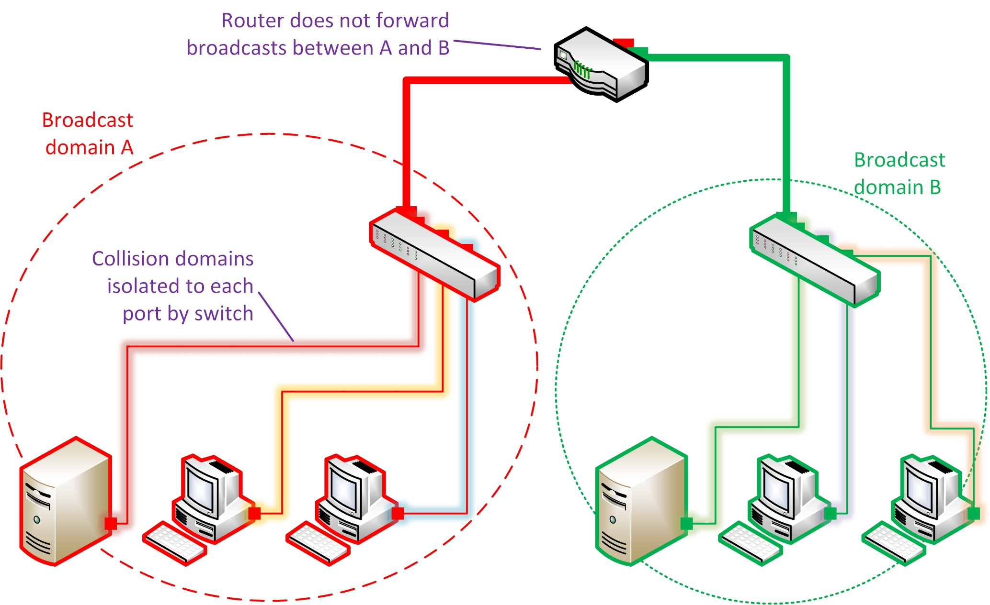
Broadcast Domains

Slide 10
Ethernet Frames (1)
Ethernet
  Principal wired LAN technology
  Logical bus topology (but typically physical star)
Preamble
Addressing
  Destination and source Media Access Control (MAC) addresses
  48-bit (6 byte)

Slide 11
Ethernet Frames (2)
Frame length and Maximum Transmission Unit (MTU)
Frame types
Error checking
  Cyclic Redundancy Check (CRC)/Frame Check Sequence (FCS)
  No retransmission or error correction

Slide 12
Ethernet Deployment Standards
xBASE-y
  Bit rate
  Baseband transmission
  Media type
10BASE-T
  Physical star twisted pair network
  Initially used hubs and bridges (half duplex and collisions)

Slide 13
Fast Ethernet
100BASE-x (“Fast Ethernet”)
  100BASE-TX (Twisted pair)
  100BASE-FX (Fiber optic)
Hubs and bridges increasingly replaced by switches
Autonegotiation of link properties

Slide 14
Gigabit Ethernet
Mainstream technology for office/campus access networks
Twisted pair
  1000BASE-T (utilizes all 4 wire pairs)
  1000BASE-TX (specifies 2-pair transmissions - not widely used)
Fiber optic
  1000BASE-SX for LANs
  1000BASE-LX for WANs
Uses switches only

Slide 15
10 Gigabit Ethernet (10GbE)
Expensive equipment compared to Gigabit Ethernet
Deployed in data centers and Storage Area Networks (SAN)
Used in public data networks (Metro Ethernet)
10GBASE-T (local area copper)
10GBASE-SR (local area fiber)
10GBASE-LR/10GBASE-ER (wide area fiber)

Slide 16
MAC Addressing (1)
Layer 2 addressing scheme defined for IEEE 802 standards
IEEE refer to Extended Unique Identifier (EUI)
MAC address format
  48-bit (6 byte)
  EUI-48 is represented by 12 hex digits (0-9,A-F)
  00:60:8c:12:3a:bc

Slide 17
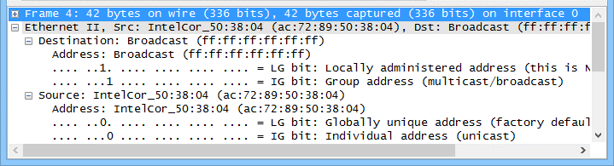
MAC Addressing (2)
Organizationally Unique Identifier (OUI)/Burned-in Address
Locally administered addresses (U/L bit)
Individual/multicast (I/G bit)

Slide 18
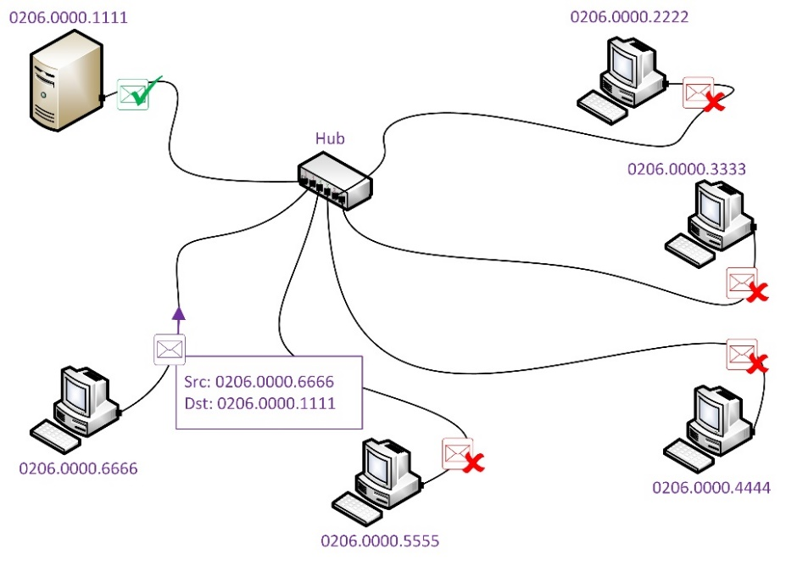
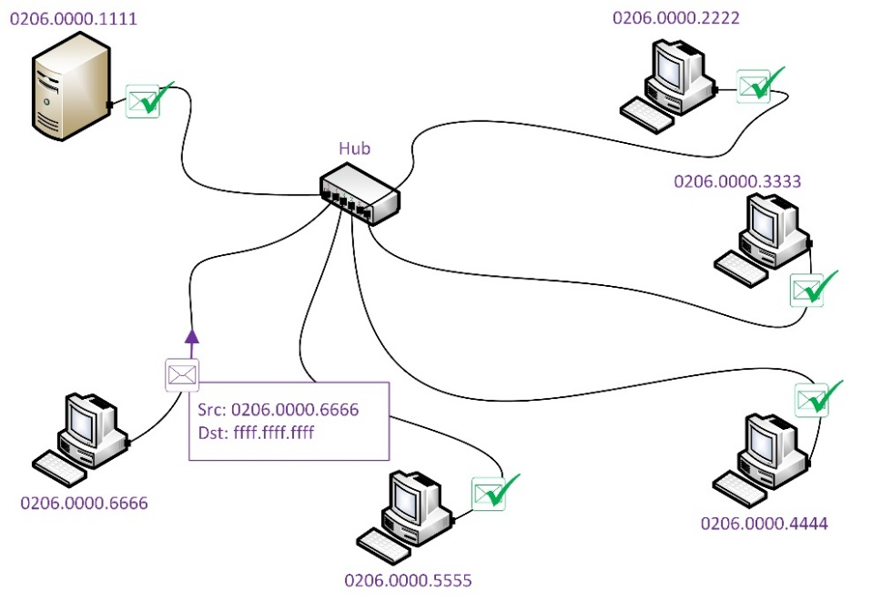
Unicast and Broadcast
Unicast – the frame is directed to a single destination interface
In shared Ethernet, all interfaces receive the frame, but ignore it if it is not addressed to them
Broadcast – the frame is directed at every interface in the same broadcast domain
Uses the MAC address ff:ff:ff:ff:ff:ff

Slide 19
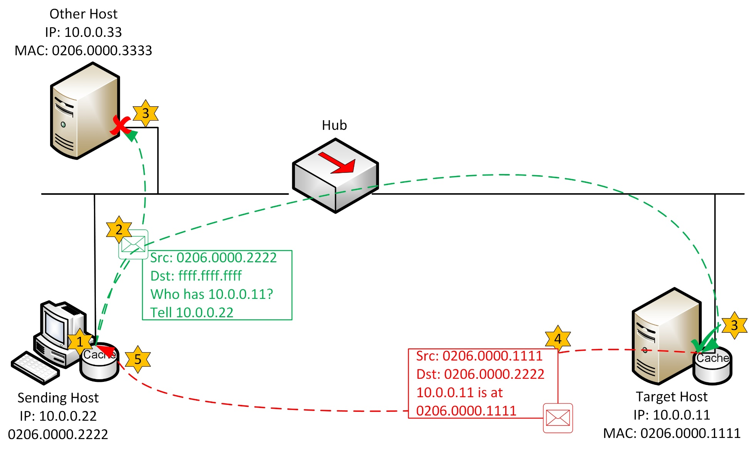
Local Address Resolution

Slide 20
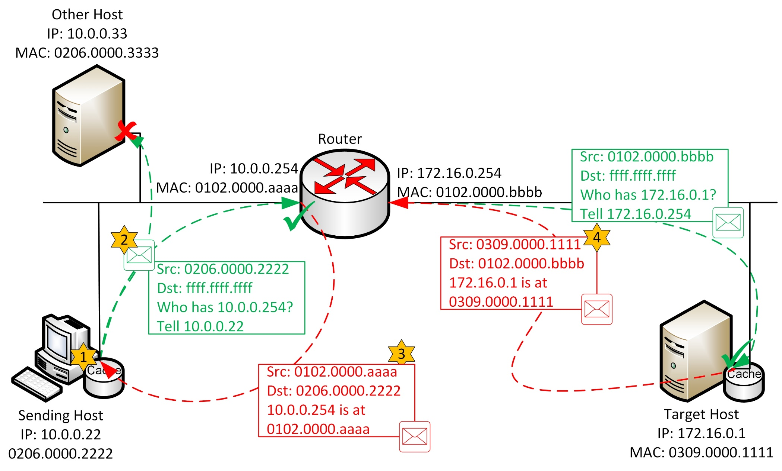
Remote Address Resolution

Slide 21
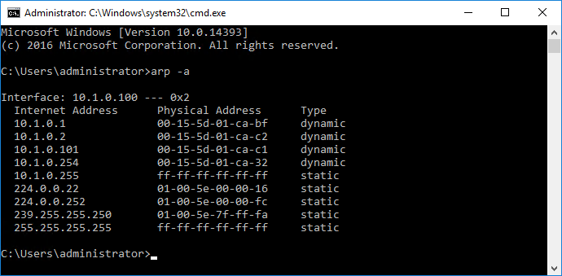
ARP Cache and arp Utility
Hardware addresses are cached to reduce broadcasts
arp utility
  arp –a or arp –g views the ARP cache contents
  arp -s IPAddress MACAddress adds an entry to the ARP cache
  arp –d * deletes all entries in the ARP cache
Used with permission from Microsoft

Slide 22
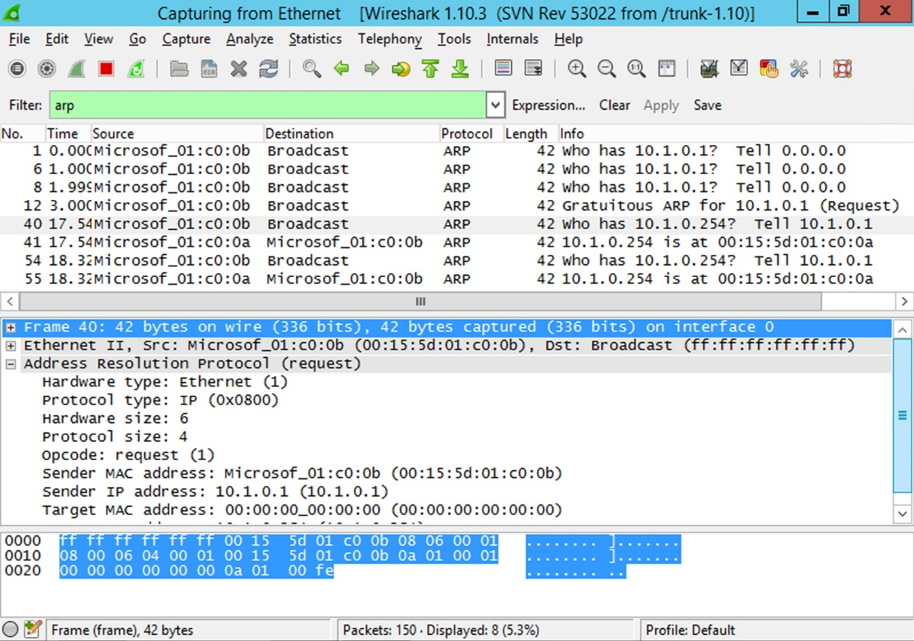
Packet Sniffers

Slide 23
tcpdump
Command line packet capture for Linux
  tcpdump –i eth0
Switches (read and write from file, verbose ouput)
Filter expressions
  Type
  Direction
  Protocol
Boolean operators and parentheses

Slide 24
Transmission media and physical and data link technologies can be distinguished by a number of factors, including modulation scheme, bandwidth, media type, and access control method.
Most LAN products are based on IEEE 802.3 (Ethernet).
Ethernet includes specifications for a range of speeds (10/100 Mbps and 1/10 Gbps) using different media (principally copper twisted pair and fiber optic).
Addressing schemes apply at layer 2 (MAC) and layer 3 (Network/IP). Layer 2 MAC addresses (48-bit) are mapped to Layer 3 IPv4 addresses (32-bit) by ARP.
Packet sniffers allow for the capture of frames sent to and received by a network node or over a network link.
Notes:
What is attenuation? The loss of signal strength that occurs as the signal travels through the media.
Why might the baud rate be different from the bit rate? Baud is the number of symbols measured in Hertz; bit rate is the amount of information, measured in bits per second. A signaling technique might encode more than one bit per symbol.
With CSMA/CD, what will happen if a computer has data to transmit and there is already data on the cable? The computer will wait until the cable is clear to transmit the data.
What is an MTU? Maximum Transmission Unit - the amount of data that a frame payload can carry.
True or false? The CRC mechanism in Ethernet allows for the retransmission of damaged frames. False. The CRC only indicates that a frame may be corrupt.
True or false? A computer with a 10BASE-T Ethernet adapter cannot be joined to a 100BASE-T network. False - Fast Ethernet is backwards-compatible with 10BASE-T (and Gigabit Ethernet is backwards-compatible with Fast Ethernet).
You want to use fiber optic cabling to support 1 Gigabit Ethernet in a LAN. Which Ethernet standard should you use? 1000BASE-SX.
What is an I/G bit? Determines whether a frame is addressed to a single node (0) or group (1). The latter is used for multicast and broadcast.
If a mapping for a local destination host is not found in a source host ARP cache, how does the source host send an ARP request? As a broadcast to all local hosts.
If a packet is addressed to a remote network, what destination MAC address will the sending node use? The MAC address of the default gateway.
True or false? The arp utility allows you to discover another host's MAC address. Partially false - while that is the function of the Address Resolution Protocol, the arp utility is used to inspect the arp cache table, which may or may not contain the other host's address. A standard means to ensure the MAC address is cached is to ping the destination address first (the basis of the arping utility).
On a switched network, what configuration changes must be made to allow a host to sniff unicast traffic from all hosts connected to a switch? The network adapter must be put in p-mode (promiscuous mode) and the switch must be configured to mirror traffic to the sniffer's port.
Write the command to use tcpdump to capture traffic from the IP address 172.16.16.254 on the interface eth0 and output the results to the file router.pcap: tcpdump -I eth0 -w 'router.pcap' src host 172.16.16.254

Slide 25
Lab 2 / Configuring Ethernet Networking
Notes:
Note that there are three sets of labs available to use with this course:
Classroom labs that you set up and run yourself (refer to the separate "Labs" book and setup guide on the instructor resource support site).
Learn On Demand (LOD) hosted classroom labs accessed via a browser but following the same general sequence and steps as the classroom lab book.
Self-study Online Labs from Practice Labs accessed by students online - these labs are intended for use by students studying independently and are different from the classroom and hosted classroom labs. If you are using Practice Labs online labs in the classroom, you must specify this at the time of purchase so that the appropriate bandwidth is provisioned in advance. Please ensure that the student PCs meet the requirements for accessing the Self-study Online Labs series. You can obtain a setup guide at gtsgo.to/nf1rc
The sequence of classroom and hosted classroom labs is shown on this slide and in the margins of your instructor edition and in the course timetable. You should guide the students to complete each lab.
If you are not using the classroom or LOD hosted classroom labs you should delete this slide.

