Slide 1
CompTIA Network+ Certification
1.3 Hubs, Bridges, and Switches

Slide 2
Install and configure hubs, bridges, and switches
Understand the use of spanning tree to prevent switching loops

Slide 3
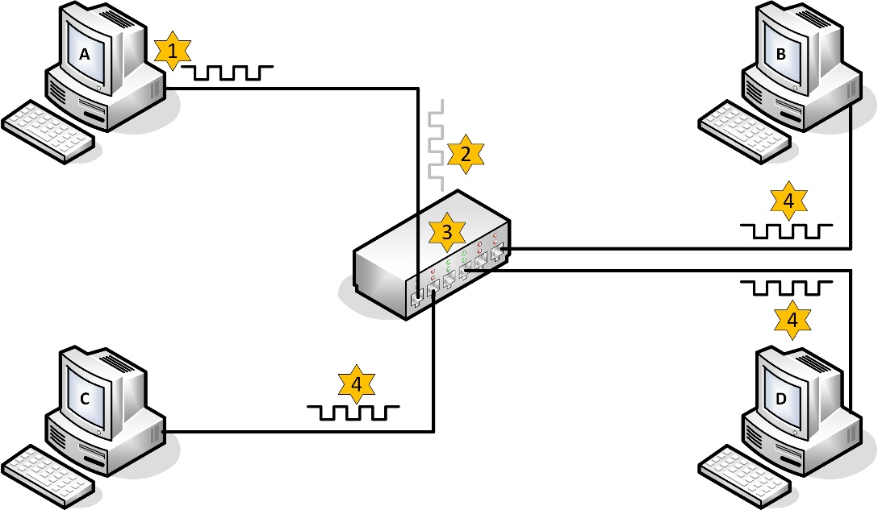
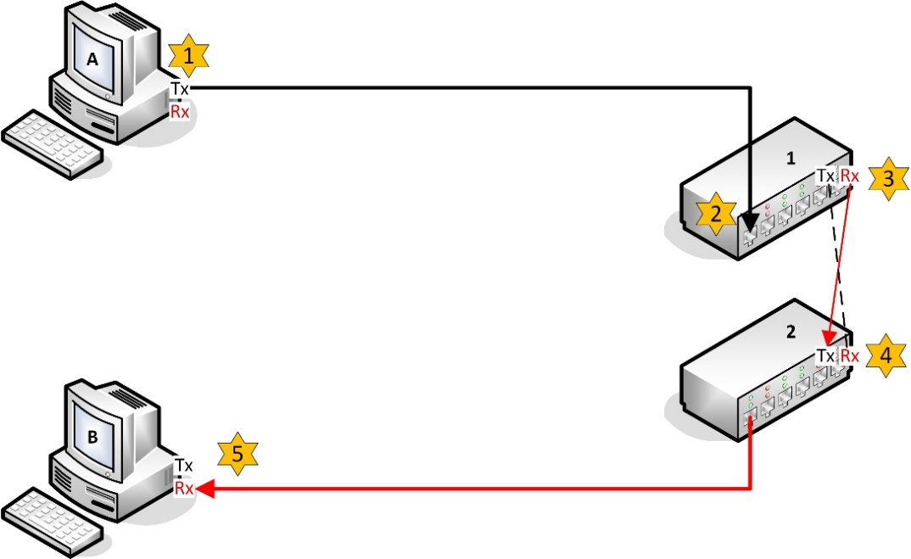
Hubs
Basis of shared Ethernet (physical star – logical bus)
Multiport repeater
  Regenerate and repeat an incoming transmission over all ports (except the source port)
  All ports in same collision domain
Crossover cable to connect hubs and provide more network ports
Hubs are now only used in special circumstances

Slide 4
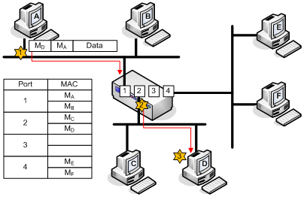
Bridges
Legacy Ethernet devices used to segment networks and reduce contention
Operate at data link layer
Segments either side of a bridge are in separate collision domains but the same broadcast domain
Can also join segments using different media (e.g. coax to twisted-pair)

Slide 5
Switches (1)
Basis of switched Ethernet
Replaced hubs and bridges
Microsegmentation
  Switch establishes point-to-point links between nodes
  The collision domain is reduced to the link between a single node and the switch (i.e. NO collisions are possible if port is configured for full duplex)

Slide 6
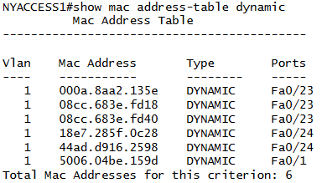
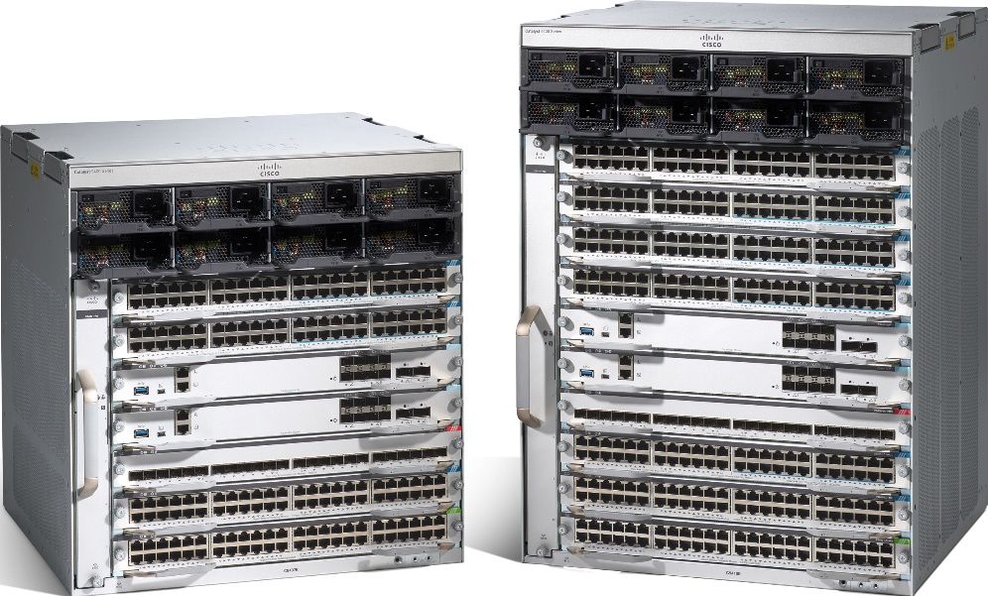
Switches (2)
MAC address table/Content Addressable Memory (CAM)
Wide range of devices for residential or Small Office Home Office (SOHO) up to enterprise use
Image © and Courtesy of Cisco Systems, Inc. Unauthorized use not permitted

Slide 7
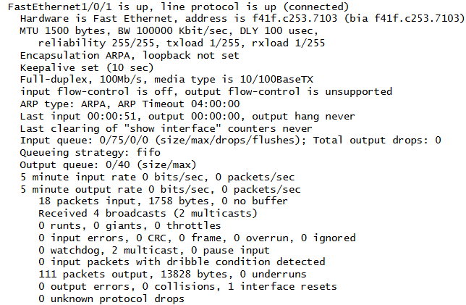
Switch Interface Configuration
Speed and duplex mode
Autonegotiation – switch and adapter negotiate connection parameters (speed/duplex)
IP address assignment

Slide 8
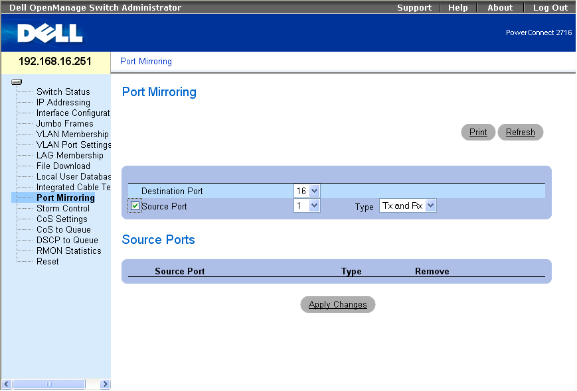
Port Mirroring
Switch doesn’t allow sniffing across ports
Port mirroring copies traffic to monitor port
Used for
  Network monitoring
  Intrusion Detection System (IDS)
  Testing and debugging
Remote mirroring tools allow copies to destination port on a different switch

Slide 9
Spanning Tree Protocol (STP)
Multiple paths between switches (or bridges) provides fault tolerance
But if there are multiple paths between switches broadcast traffic can loop and be rebroadcast by each switch
Spanning tree prevents switching loops by designating a single active path from any one device to the one designated as the root bridge
IEEE 802.1D MAC Bridges standard
Standard refers to bridges but STP is mostly implemented on switch appliances these days

Slide 10
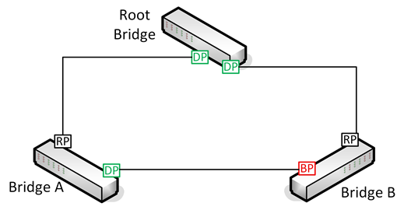
Topology Change Notifications
Root bridge at top of hierarchy
Devices exchange Bridge Protocol Data Units (BPDU) to determine topology
Network is converged when all bridge ports are blocking or forwarding
Rapid STP (RSTP)/IEEE 802.1w reduces outages

Slide 11
Flooding
Switch copies unicast traffic to every port
Occurs when switch is trying to learn MAC addresses
Topology changes can cause excessive flooding
Configure port fast to prevent hosts/access ports causing topology changes

Slide 12
Filtering STP Traffic
Disable spanning tree
BPDU guard disables port
  Prevents users attaching a switch (or malware spoofing STP traffic) to an access port
  Reduces misconfiguration problems
BPDU filter drops STP traffic
  Port could become loop
  Used between switching domains
Root guard prevents attached device becoming root

Slide 13
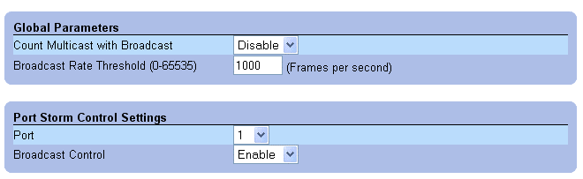
Broadcast Storms and Flood Guards
Switching loops can be catastrophic as there is no Time To Live (TTL) to expire a frame
Broadcast storms occur when switches keep receiving the same broadcasts and re-broadcast them continually
“Classic” cause is to bridge two ports with a misplaced patch cord
Storm control settings can mitigate this
Ensure unused ports are disabled

Slide 14
Power over Ethernet (PoE)
Supplies electrical power to devices over Ethernet cable
Suitable for IP phones, wireless access points, thin clients, IP cameras, etc
802.3af – 13W
802.3at – 25W (PoE+)
Supplying device (e.g. switch) is Power Sourcing Equipment
  PoE switch is an end-span
  Power injector is a mid-span
  Mode A (phantom power) and Mode B

Slide 15
Designing a Switch Topology

Slide 16
Hubs are legacy devices used as the network concentrator to implement a star topology (a multiport repeater). Hubs work at layer 1
Bridges could be deployed with hubs to divide a network into smaller collision domains, reducing the effect of contention. Bridges work at layer 2
Hubs and bridges have been replaced by layer 2 switches in almost all networks. These principally work to eliminate the effect of collisions (each port is a separate collision domain and switches can have 10s of ports, unlike bridges) but can also come with many advanced features
The Spanning Tree Protocol is used to prevent loops in a switched network with multiple paths. If broadcast traffic is put in a loop, it will cause a "broadcast storm" as there is no means of "expiring" layer 2 frames
Notes:
True or false? Devices can only transmit on an Ethernet network when it is free and the opportunity to transmit becomes less frequent as more devices are added. Also the probability of collisions increases. These problems can be overcome by installing a hub. False. The description of the problem is true but the solution isn't (use a switch).
True or false? A bridge does not forward broadcast or multicast traffic. False. Ports on a bridge are in the same broadcast domain.
What is microsegmentation? Each switch port creates a separate collision domain for each attached host, essentially eliminating the effect of collisions on network performance.
How does a switch keep track of the hardware addresses of hosts connected to its ports? It uses a table stored in Content Addressable Memory (CAM).
What is happening if a switch is flooding? It is sending frames out on all ports. This typically happens when it is learning MAC addresses.
True or false? Switch ports should normally be set to autonegotiate speed and duplex settings. True; speed/duplex setting only very rarely needs to be manually configured on modern networks.
What is the function of STP? Spanning Tree Protocol prevents switching loops (where broadcast traffic is continually looped around a switched network with redundant links between switches).
Under STP, if a host port is working as normal, what state is it in? Forwarding.
What mechanisms protect the switching infrastructure from malicious STP traffic? Configuration settins such as BPDU Guard and BPDU Filter prevent hosts from injecting Bridge Protocol Data Units (BPDU) into the network. Root guard prevents devices from attempting to become root.
What is PoE? Power over Ethernet - an IEEE specification for delivering power to devices from switch ports over network cabling.

