Slide 1
CompTIA Network+ Certification
1.5 Policies and Best Practices

Slide 2
Summarize safe working practices and policies
Understand the importance of incident response policy
Identify appropriate policies to ensure data security, effective privilege management, and employee use of computer and network systems
Notes:
The number in the bottom right corner of the slides refers back to the page where this topic starts in the course book.

Slide 3
Procedures and Standards
Policy
Standard
Procedure/Standard Operating Procedures (SOP)/Internal Operating Procedures
Best practice

Slide 4
Safety Procedures
Tool safety
  Electrical safety
  Physical hazards
Electrical safety
  Grounding
Fire safety
  Building layout and emergency alert system
  Escape plans, routes, and drills
Lifting equipment
Material Safety Data Sheet (MSDS)
ElectroStatic Discharge (ESD)

Slide 5
Incident Response Policies (1)
Procedures and guidelines for dealing with security incidents
Different goals
  Re-establish a secure working system
  Preserve evidence of the incident with the aim of prosecuting the perpetrators
  Prevent reoccurrence of the incident

Slide 6
Incident Response Policies (2)
Computer Security Incident Response Team (CSIRT)
  Reporting procedures
  Response procedures
  Incident response roles
First Responder

Slide 7
NDA and PUA
Non-Disclosure Agreement (NDA)
  Legal basis for protecting information assets
  Used in employment contracts and between companies
Privileged User Agreement (PUA)
  Governs way users with “powerful” accounts exercise privileges
  Sets Rules of Behavior
  Complementary with separation of duties policies
  Least privilege, dual accounts, shared authority, auditing, mandatory vacations, job rotation, ...

Slide 8
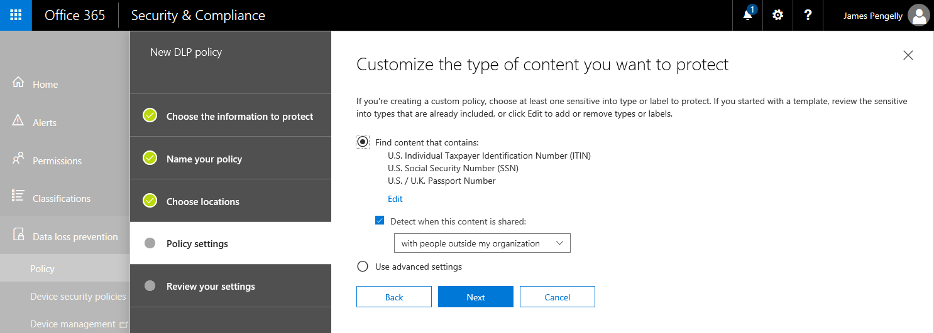
PII and DLP
Personally Identifiable Information (PII)
  Data that could identify or locate the owner or be used to commit identity fraud
  PII must be stored and processed in authorized ways only
Data Loss Prevention (DLP) software can help to manage and protect confidential information such as PII
Used with permission from Microsoft

Slide 9
International Export Controls
Rules governing transfer of technologies and information across border
Software and tools with potential dual use classification
  Export Administration Regulations (EAR)
  International Traffic in Arms Regulations (ITAR)
Data protection rules and regulations

Slide 10
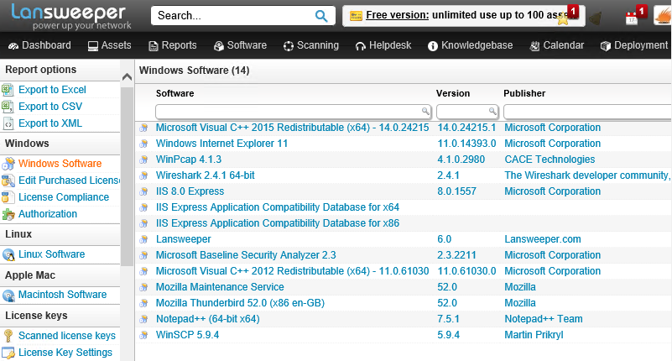
Licensing Restrictions
Software license management and usage auditing
  Identifying unlicensed and unauthorized software
  Identifying per-seat or per-user compliance
  Preparing for vendor audits
  Ensuring compliance with the terms of open source licensing

Slide 11
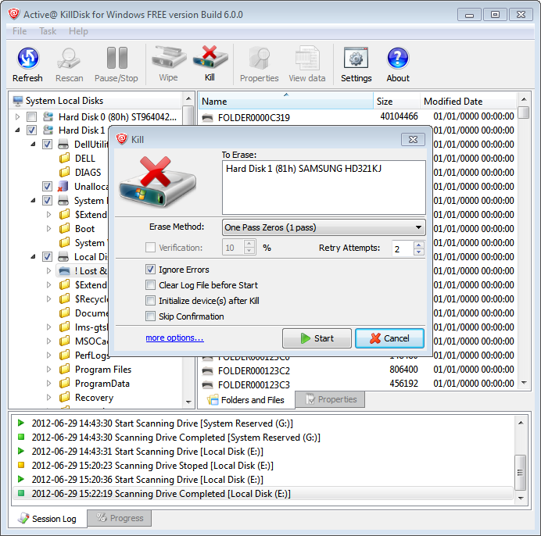
System Lifecycle/Asset Disposal
Ensure secure disposal or archive of information
  Migrating data from one system to another
  Transferring data between media/devices
  Secure disposal of paper records
Secure disposal of electronic data remnants
  Overwriting/disk wiping
  Pulverizing/degaussing
  Disk encryption

Slide 12
Password Policy
Complexity rules
  Length
  Character combinations
User (bad) practice
  Remembering passwords
  Storing/writing down passwords
  Re-using passwords
History and aging
  Change passwords periodically

Slide 13
Employee Policies (1)
Human Resources (HR)
  Recruitment (hiring)
  Operation (working)
  Termination/separation (firing or retiring)
Privilege management, data handling, and incident response
Disciplinary measures
Onboarding/background checks
Offboarding/exit interview

Slide 14
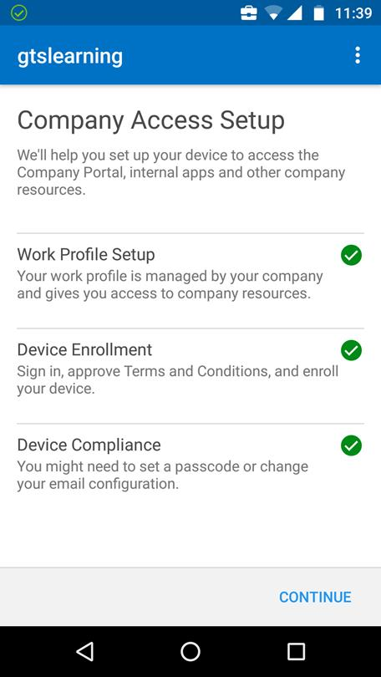
Employee Policies (2)
Acceptable Use Policy (AUP)
Network policies
Bring Your Own Device (BYOD)
  BYOD versus corporate owned
  Mobile Device Management (MDM)/Enterprise Mobility Management (EMM)
    Network enrolment
    Manage device functions
    Install and monitor corporate apps and data

Slide 15
Remote Access Policies
Ensure remote devices and network connections do not create vulnerabilities
  Malware protection and patching of remote hosts
  Protection of credentials
  Protection for data processed off-site
  Treat remote hosts and networks as untrusted

Slide 16
Policies, procedures, and agreements provide clarity and set expectations for employees and contractors.
Be aware of the safety considerations when performing network maintenance and installation.
Make sure you understand the use of policies to govern privilege and data management and employee use of IT systems.
Notes:
What is the difference between policy and best practice? Policy establishes definite rules while best practice is "fuzzier" and might be demonstrated through examples or scenarios rather than explicit rules.
What are the main elements of fire safety procedures? Fire/smoke detection and alarms plus safe escape routes from the building and emergency drills/procedures.
True or false? An ESD wrist strap is designed to provide a personal ground to protect a technician from electrocution when working on energized electrical devices. False - a safety or utility ground is a pathway for electricity to flow in the event of a short so that it is less likely to electrocute someone touching a "live" bit of metal but the technician should NEVER be part of this grounding path. An ESD (ElectroStatic Discharge) ground equalizes the electrical potential between surfaces to reduce the chance of damage to components. Such wrist straps should have working resistors to prevent any dangerous amount of current from flowing through them but they are not safety devices.
How is the person who first receives notification of a potential security incident designated? First Responder.
How does the principle of least privilege apply to privileged users? Privileges can be allocated by role/domain rather than creating all-powerful "superusers". Holders should only logon to privileged accounts to perform specific tasks. The accounts should be subject to auditing and oversight.
True or false? DLP technology can assist with managing PII. True - Data Loss Prevention (DLP) software can be configured to identify Personally Identifiable Information (PII) strings or fields and prevent transfer of such data by unauthorized mechanisms or formats.
What technology provides data security assurance during the asset disposal phase of system lifecycle? Hard drive/media sanitation, such as encryption or disk overwriting.
What are the main elements of password policy? Ensuring strong password selection and preventing sharing of passwords. You might also mention password aging/changing passwords regularly.
What configuration request would be implemented by IT services during employee onboarding? Account creation, issuance of user credentials, and allocation of permissions/roles.
What type of policy governs use of a VPN? Remote access policy.

