Slide 1
CompTIA Network+ Certification
2.1 Internet Protocol

Slide 2
Describe the format of IPv4 packets and addresses
Understand the operation of a subnet mask and the basics of IP routing
Use the ipconfig/ifconfig/ip tools to verify the IP configuration
Describe the operation of ICMP and use the ping utility
Notes:
The number in the bottom right corner of the slides refers back to the page where this topic starts in the course book.

Slide 3
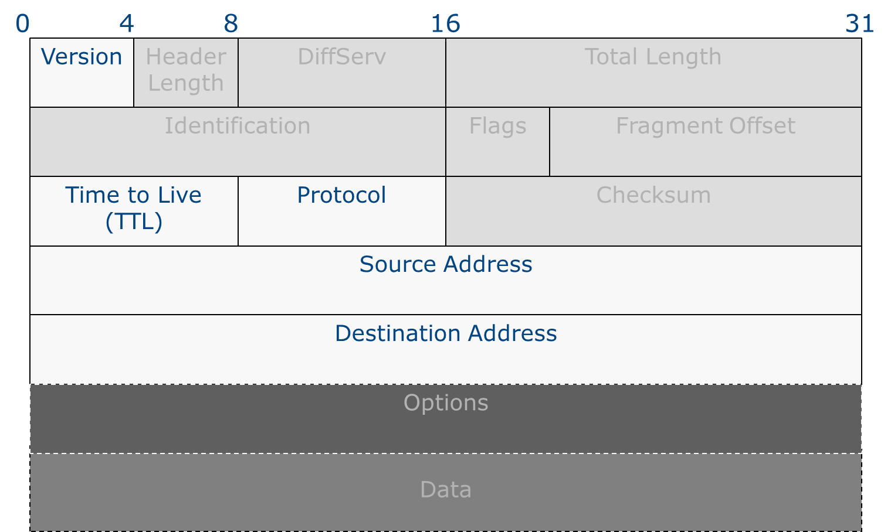
IPv4 Packet Structure (1)

Slide 4
IPv4 Packet Structure (2)
Protocol field
DiffServ field
Time To Live (TTL) field
ID/flag/fragment offset

Slide 5
IPv4 Address Structure
IP address represents
  The network number (network ID) - this number is common to all hosts on the same network
  The host number (host ID) - this unique number identifies a host on a particular network
32-bit binary value
  11000110001010010001000000001001
Expressed in 8-bit octets
  11000110 00101001 00010000 00001001
Converted to dotted decimal notation for entry into configuration dialogs
  198.41.16.9

Slide 6
Binary/Decimal Conversion
Number bases
  Place value
  Base 10 (Decimal)
  Base 2 (Binary)
Converting between binary and decimal

Slide 7
Subnet Masks
IP address represents both a network ID and host ID
A mask is applied to identify the network and host portions
A “1” in the mask means corresponding bit in the address is part of the network ID
“1”s in mask must be contiguous
  11111111 11110000 00000000 00000000 – VALID
  11111111 00000000 11110000 00000000 - INVALID

Slide 8
Masking an IP Address (ANDing)
To work out a network ID, given an address and mask in decimal, convert to binary and back

Slide 9
Routing Decision
Local network
Remote network

Slide 10
IP Routing Basics
Default gateway
Routing decision
Route selection/route table
Fragmentation

Slide 11
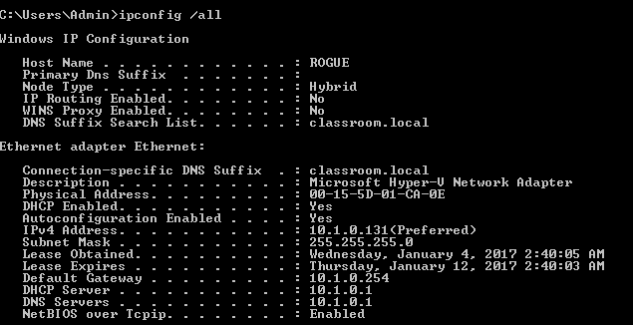
ipconfig
Used with permission from Microsoft

Slide 12
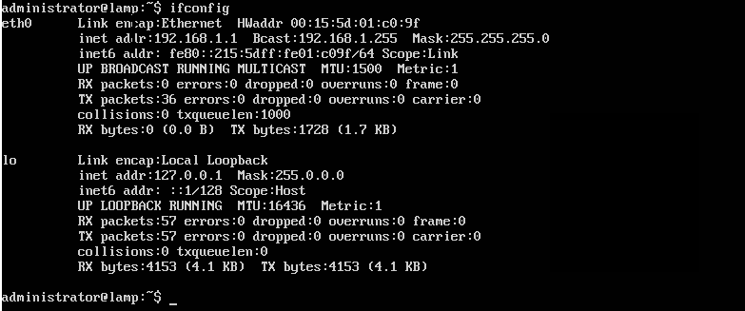
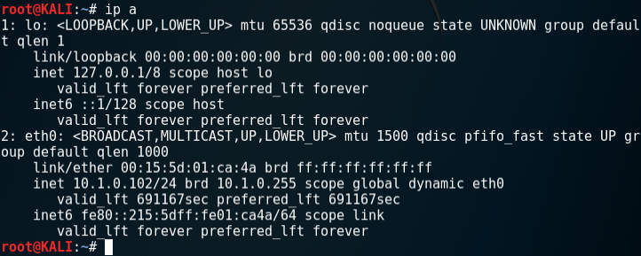
Ifconfig and ip

Slide 13
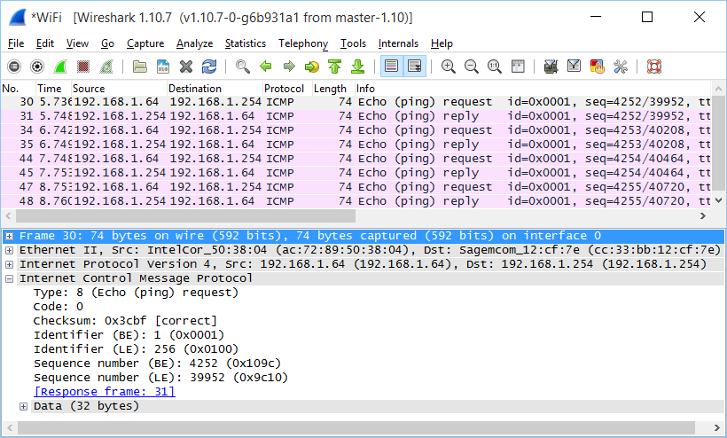
Internet Control Message Protocol (ICMP)
Message types
  Echo request/reply
  Destination unreachable
  Time exceeded
  Redirect

Slide 14
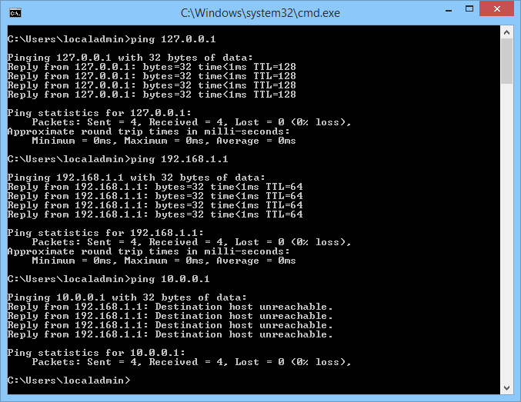
ping
ping IPAddress | HostName
Reply from, round trip time and packet loss
  Detect whether a link is slow or experiences packet loss
  Use tracert to identify where on the route there is a problem
Destination unreachable
  No route to host
  Check IP configuration
  Check router (default gateway)
No reply/timed out
  Host/interface is down
  Host cannot route reply
  Firewall
Used with permission from Microsoft

Slide 15
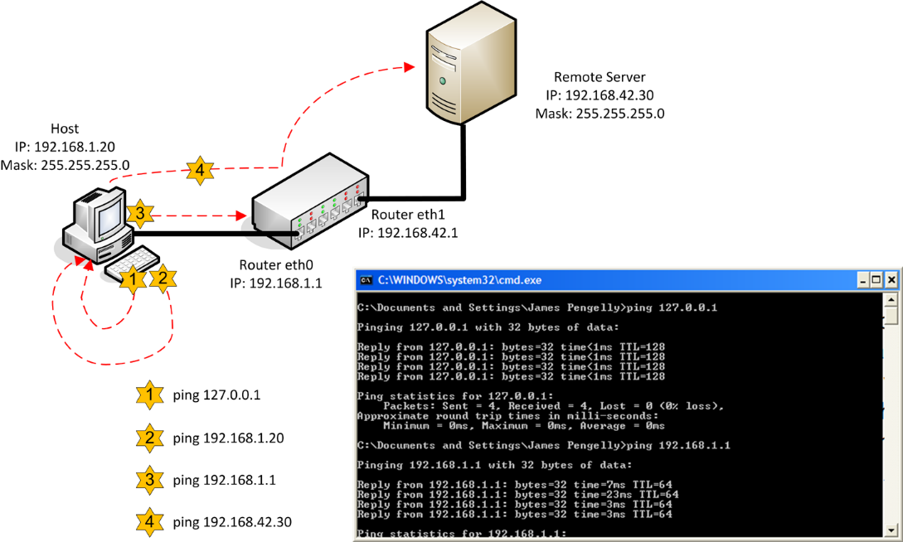
Interpreting ping Output
Ping the loopback address (ping 127.0.0.1)
Ping the host’s IP address
Ping the IP address of the default gateway
Ping the IP address of a remote host
Used with permission from Microsoft

Slide 16
Windows ping Switches
Time to Live –i
Timeout –w
Force IPv4 (-4) or IPv6 (-6) when using host names
Resolve host names (-a)
Run continuously (-t)

Slide 17
The Internet Protocol provides layer 3 addressing, allowing for logically distinct networks.
IPv4 clients are configured with a 32-bit IP address and subnet mask - the subnet mask defines the network and host ID portions of the IP address.
An IPv4 address is expressed using dotted decimal notation. The netmask can either be expressed using dotted decimal or as a network prefix (slash notation).
Hosts with the same network ID transmit packets locally (using ARP). A packet addressed to a host with a different network ID must be sent via a router.
ipconfig/ifconfig is used for various troubleshooting and configuration tasks - there are differences between the Windows and Linux versions.
ICMP delivers status message and allows for connectivity testing (ping utility).
Notes:
What is the function of the protocol field in an IPv4 header? Indicates the protocol type of the payload. This would typically be TCP or UDP but could be something else (ICMP or GRE for instance).
Convert the decimal value "72" into binary. 1001000.
Convert the binary value "11110010" to decimal. 242.
Once installed, how would you check the TCP/IP configuration? Run ipconfig or ifconfig.
True or false? A router will not forward a packet when the TTL field is zero. True.
Which of the protocols included with TCP/IP reports messages and errors regarding packet delivery? Internet Control Message Protocol (ICMP).
True or false? Receiving an echo reply ICMP message indicates that the link between two hosts is operational. True.
True or false? The ipconfig utility can be used to empty the DNS cache. True (though this functionality is not available in ifconfig).
If you have a workstation that cannot connect to a server, what is the first test you could perform to establish whether the cabling is OK? ping another local system.
On a UNIX host, which TCP/IP parameters must be defined for the host to be able to communicate with hosts on a remote network? IP Address, Subnet Mask, Default Gateway (address of the router).

Slide 18
Lab 3 / Configuring IPv4 Networking
Notes:
Note that there are three sets of labs available to use with this course:
Classroom labs that you set up and run yourself (refer to the separate "Labs" book and setup guide on the instructor resource support site).
Learn On Demand (LOD) hosted classroom labs accessed via a browser but following the same general sequence and steps as the classroom lab book.
Self-study Online Labs from Practice Labs accessed by students online - these labs are intended for use by students studying independently and are different from the classroom and hosted classroom labs. If you are using Practice Labs online labs in the classroom, you must specify this at the time of purchase so that the appropriate bandwidth is provisioned in advance. Please ensure that the student PCs meet the requirements for accessing the Self-study Online Labs series. You can obtain a setup guide at gtsgo.to/nf1rc
The sequence of classroom and hosted classroom labs is shown on this slide and in the margins of your instructor edition and in the course timetable. You should guide the students to complete each lab.
If you are not using the classroom or LOD hosted classroom labs you should delete this slide.

