Slide 1
CompTIA Network+ Certification
3.2 TCP and UDP

Slide 2
Describe the functions of TCP and UDP and the characteristics of connection-oriented versus connectionless protocols
Identify "well-known" ports
Use netstat and Nmap to identify open connections and services
Use a protocol analyzer to monitor network traffic
Notes:
The number in the bottom right corner of the slides refers back to the page where this topic starts in the course book.

Slide 3
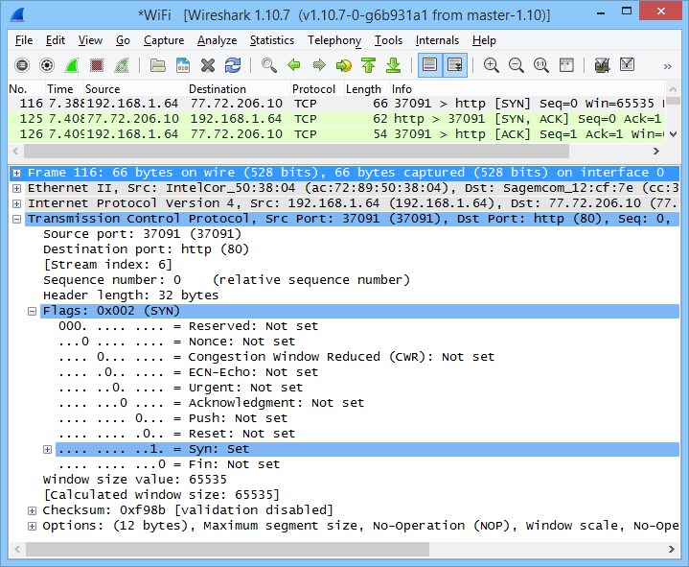
Transmission Control Protocol (TCP)
Connection-oriented, guaranteed delivery
3-way handshake
  SYN
  SYN/ACK
  ACK
Periodic acknowledgements to ensure reliability

Slide 4
TCP Segment Header
0
4
8
16
32
Source Port
Destination Port
Sequence Number
Acknowledgement Number
Length (Data Offset)
Reserved
Flags
Window
Checksum
Urgent Pointer
Options
Data

Slide 5
Flow Control and Teardown
Flow control
  Receiving host sets receive window to tell sender how many segments it can process
  Reducing the receive window allows receiver to tell sender “slow down”
  The sender uses sliding window to work out how many segments it can send without waiting for ACKs
Connection “teardown
  Client sends a FIN segment to the server and enters FIN-WAIT1 state
  Server responds with an ACK segment and enters CLOSE-WAIT state
  Client receives ACK and enters FIN-WAIT2 state; server sends its own FIN segment and goes to LAST-ACK state
  Client responds with ACK and enters TIME-WAIT; after a defined period, the client closes its connection.
  Server closes connection when it receives the ACK from client
Connection reset (RST)

Slide 6
User Datagram Protocol (UDP)
Connectionless, non-guaranteed delivery
Lightweight header
0
4
8
16
32
Source Port
Destination Port
Length
Checksum
Data

Slide 7
TCP and UDP Ports
Well-known application ports (0-1023)
TCP/UDP
Port + IP = Socket

Slide 8
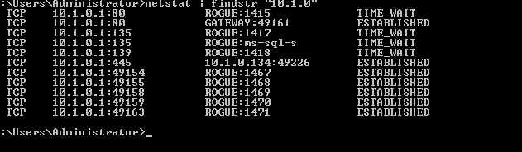
netstat on Windows
Used with permission from Microsoft

Slide 9
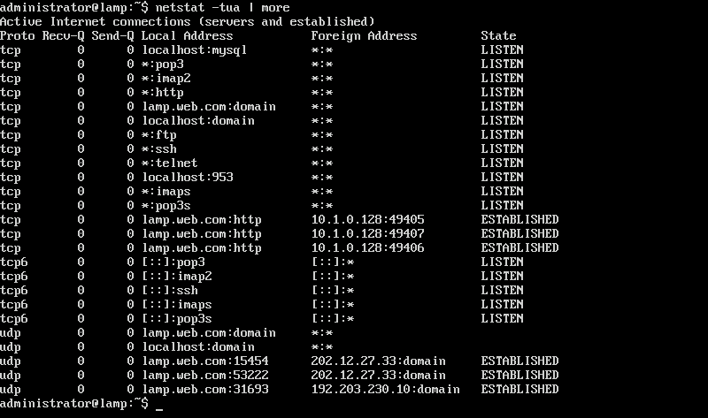
netstat on Linux

Slide 10
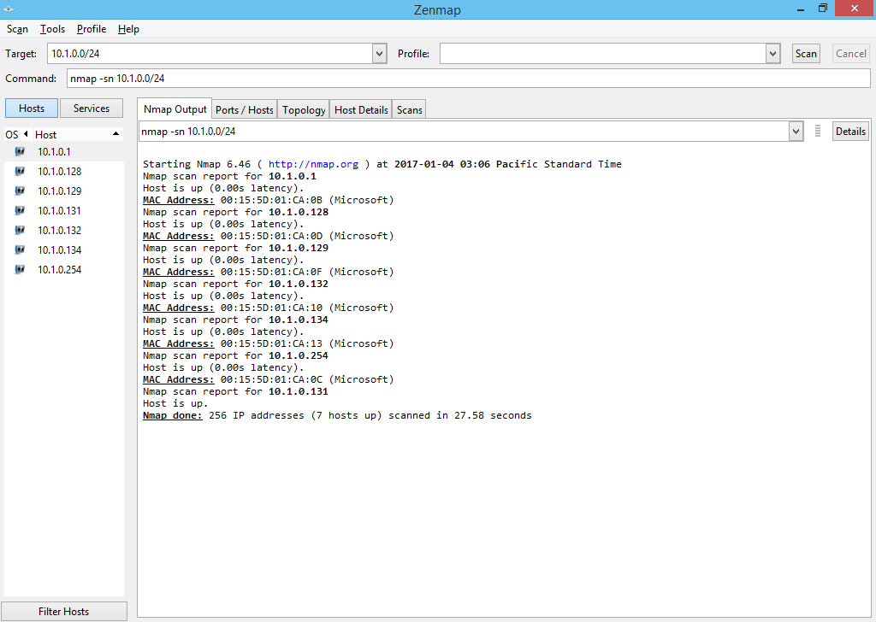
Nmap Host Discovery

Slide 11
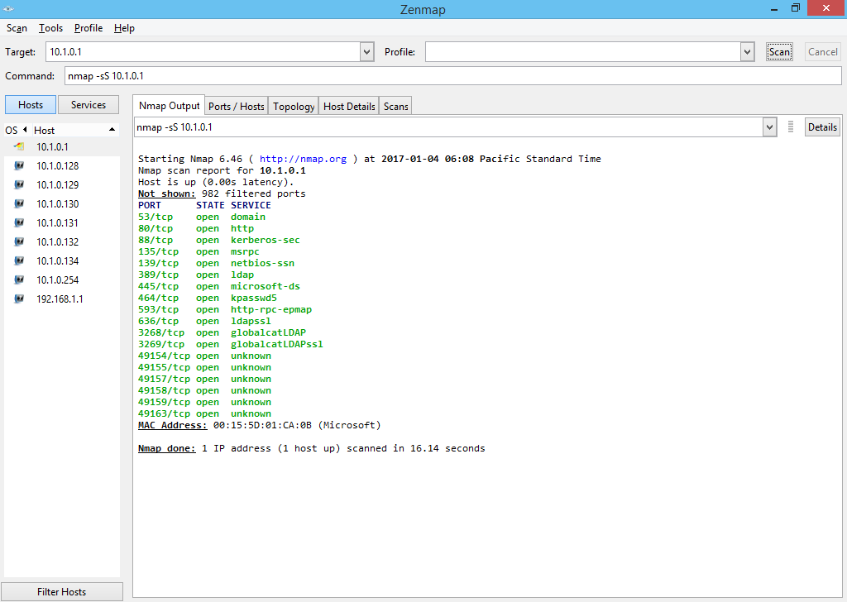
Nmap Port Scanning

Slide 12
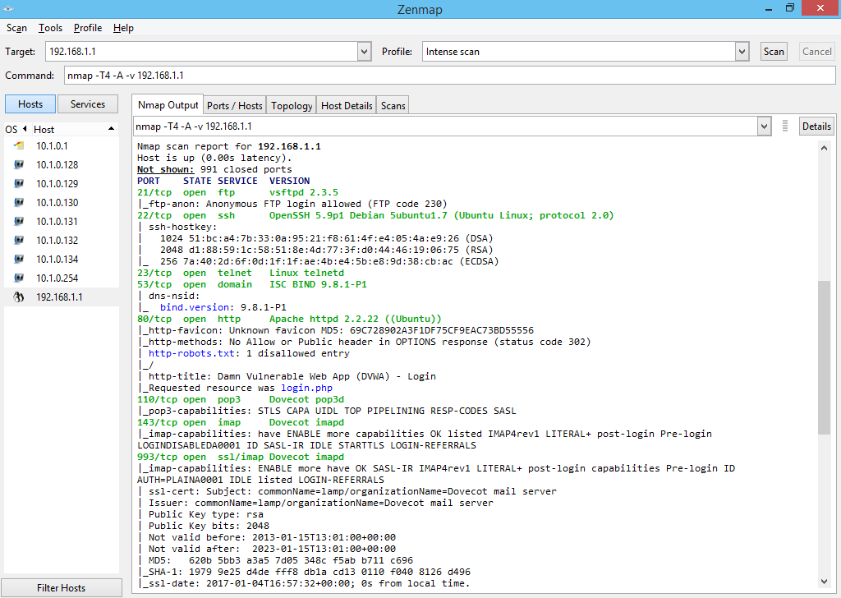
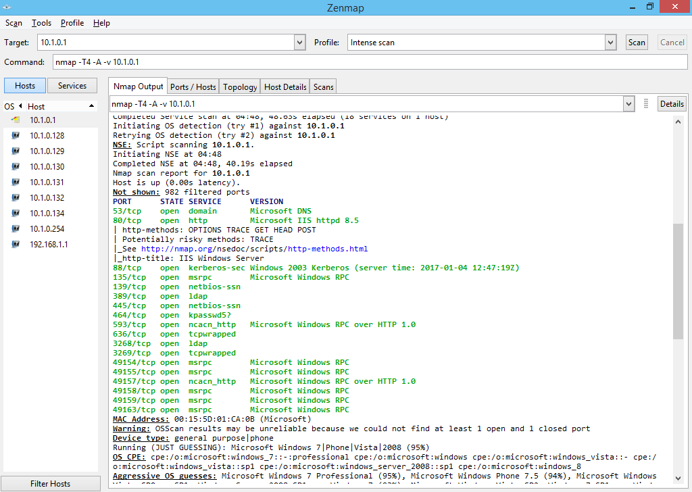
Nmap OS and Service Fingerprinting

Slide 13
Protocol Analyzers
Live capture or open saved capture file
Decode a captured frame to reveal its contents in a readable format
Identify the most active hosts on the network
Isolate hosts producing erroneous packets
Identify malicious or unauthorized use of the network
Filter traffic and capture packets meeting certain criteria
Baselining
Generate frames and transmit them onto the network to test network devices and cabling
Monitor bandwidth utilization
Trigger alarms

Slide 14
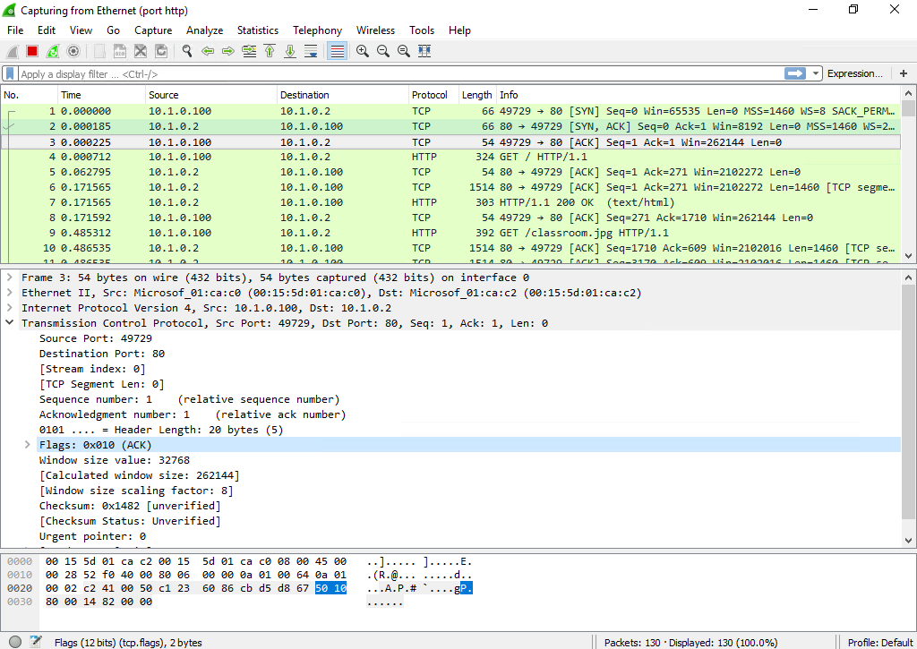
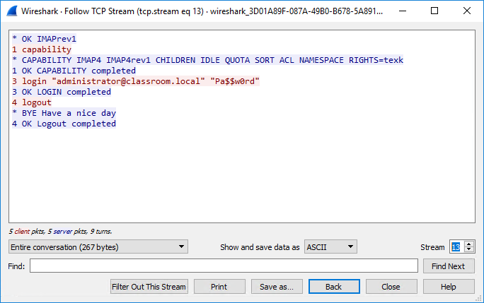
Wireshark

Slide 15
TCP provides connection-oriented, guaranteed delivery while UDP provides connectionless, non-guaranteed delivery.
TCP and UDP client and server processes use numbered ports. Well-known server ports up to 1023 and registered ports through to 49,151 are maintained by IANA.
netstat can be used to investigate listening and active connections on the local machine while Nmap is widely used for probing networks and hosts remotely.
Protocol analysis is critical to network monitoring and troubleshooting.
Notes:
Why would a developer choose to use unreliable delivery over reliable, connection oriented delivery? When speed is more important than reliability.
What is the purpose of the Window field in a TCP segment? Used for flow control (indicates the amount of data that the host can receive before sending another acknowledgement).
If the client is in the TIME-WAIT state, is the connection with the server still open? Not normally - the server closes the connection when it receives the ACK from the client; if this packet is lost the server connection may still be open.
What are the sizes of TCP and UDP headers? TCP is 20 bytes (or more) while UDP is 8 bytes.
A function of TCP is to handle flow control. What is the purpose of the flow control function? Flow control makes sure the sender does not inundate the receiver with data packets.
True or false? User Datagram Protocol (UDP), like TCP, uses flow control in the sending of data packets. False.
Which ports are closely associated with web applications? TCP ports 80 (HTTP) and 443 (HTTPS[ecure]).
A security consultant tells you that the headers used by your organization's database server should be changed. Why might she recommend this? The headers may reveal information about the way the database server is configured to a banner grabbing attack.
If you wanted to investigate connections on your machine, which utility would you use? netstat.
You need to audit services made publicly available on a web server. What command-line tool could you use? Nmap is an ideal tool for scanning remote hosts to discover which ports they have open and the applications or services running them.
You need to analyze the information saved in a .pcap file. What type of command-line tool or other utility is best-suited to this task? This type of file will contain a network packet capture. You could use a command-line tool such as tcpdump to display the contents but a graphical tool such as Wireshark will make analysis easier.

Slide 16
Lab 8 / TCP and Port Scanning
Notes:
Note that there are three sets of labs available to use with this course:
Classroom labs that you set up and run yourself (refer to the separate "Labs" book and setup guide on the instructor resource support site).
Learn On Demand (LOD) hosted classroom labs accessed via a browser but following the same general sequence and steps as the classroom lab book.
Self-study Online Labs from Practice Labs accessed by students online - these labs are intended for use by students studying independently and are different from the classroom and hosted classroom labs. If you are using Practice Labs online labs in the classroom, you must specify this at the time of purchase so that the appropriate bandwidth is provisioned in advance. Please ensure that the student PCs meet the requirements for accessing the Self-study Online Labs series. You can obtain a setup guide at gtsgo.to/nf1rc
The sequence of classroom and hosted classroom labs is shown on this slide and in the margins of your instructor edition and in the course timetable. You should guide the students to complete each lab.
If you are not using the classroom or LOD hosted classroom labs you should delete this slide.

