Slide 1
CompTIA Network+ Certification
3.4 Monitoring and Scanning

Slide 2
Use network monitoring utilities and load/throughput testers to identify performance and connectivity issues
Collect and analyze system, history, and event logs plus interface monitoring metrics using technologies such as SNMP and SIEM
Use software tools to scan for vulnerabilities and update/patch network appliances and hosts
Notes:
The number in the bottom right corner of the slides refers back to the page where this topic starts in the course book.

Slide 3
Performance Monitoring
Proactive performance monitoring allows targeted investment in upgrades and minimizes impact on users
Establishing and reviewing baselines
Basis for comparison
When to update
  Hardware or software upgrade
  Reconfiguration of network
  Installation of new devices/services
  Changed user access volume or patterns
  Changed server role

Slide 4
Thresholds and Bottlenecks
Thresholds
  When to trigger an alert
Bottlenecks
  “Pinch points” that cause whole system to underperform
  Underperforming device or link
  Overactive user or application
  Poorly scheduled application (e.g. updating service)

Slide 5
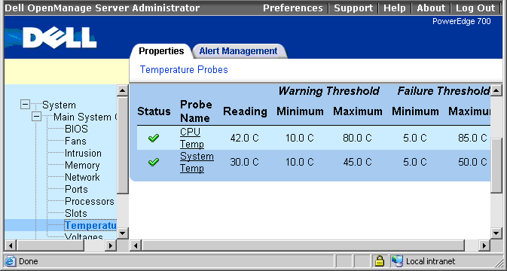
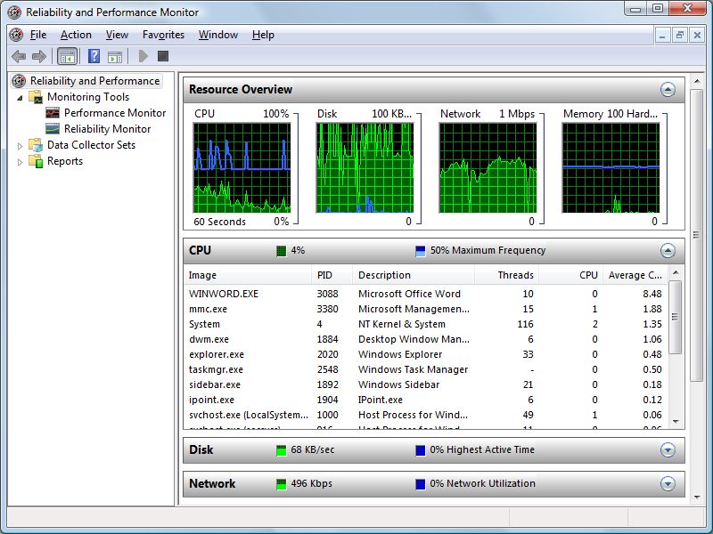
Network Monitoring Utilities (1)
Health/service status
Performance monitor
Packet flow monitoring
  NetFlow, sFlow, jFlow
  Traffic flow defined by packets sharing same characteristics
Used with permission from Microsoft

Slide 6
Network Monitoring Utilities (2)
Top talkers/listeners
Load/throughput testers
  Stress tests
  Identify “goodput”
Speed test sites
  Broadband speed checkers
  Test website performance/monitor availability

Slide 7
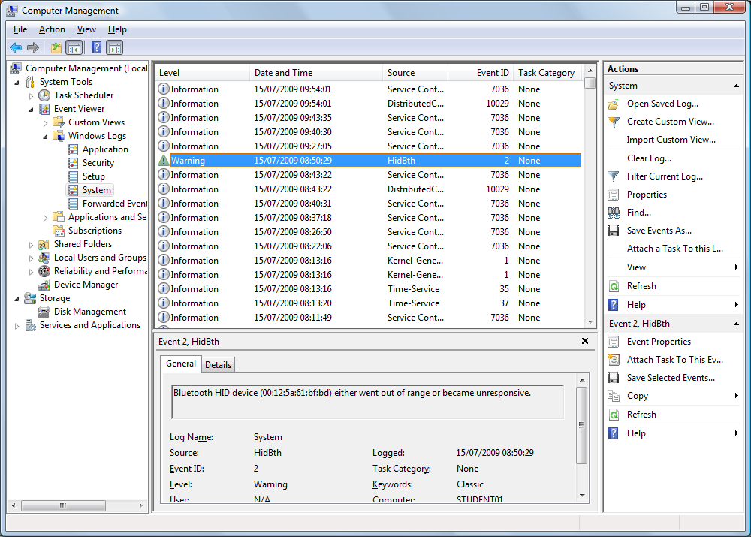
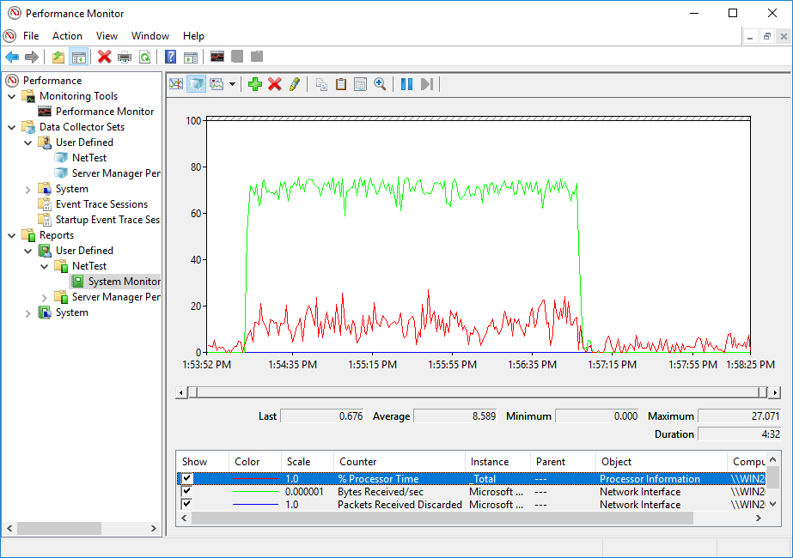
Logs and Event Management (1)
Log types
  System
  Event
  History
  Performance
Used with permission from Microsoft

Slide 8
Logs and Event Management (2)
Log management
  Storage considerations
  Data rollup and resolution
  Security and integrity
Alerts and alarms
  Email
  SMS

Slide 9
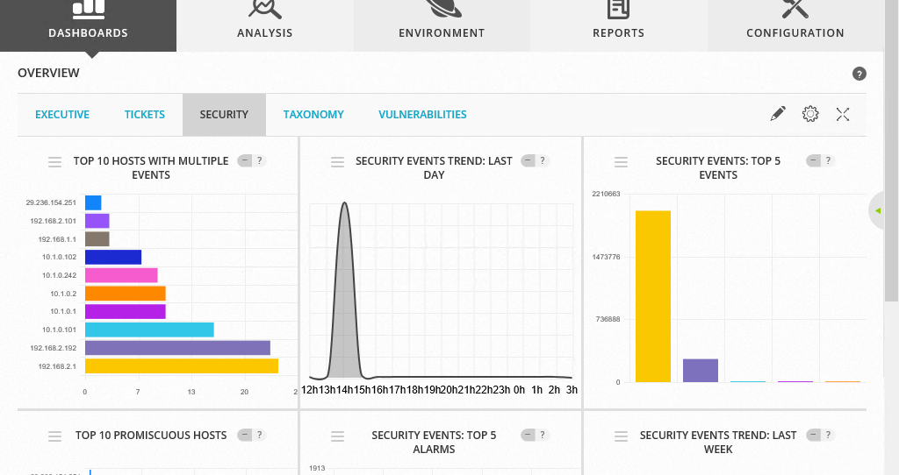
Logs and Event Management (3)
SYSLOG
Security Information and Event Management (SIEM)
  Aggregation
  Correlation
  Alerting/reporting

Slide 10
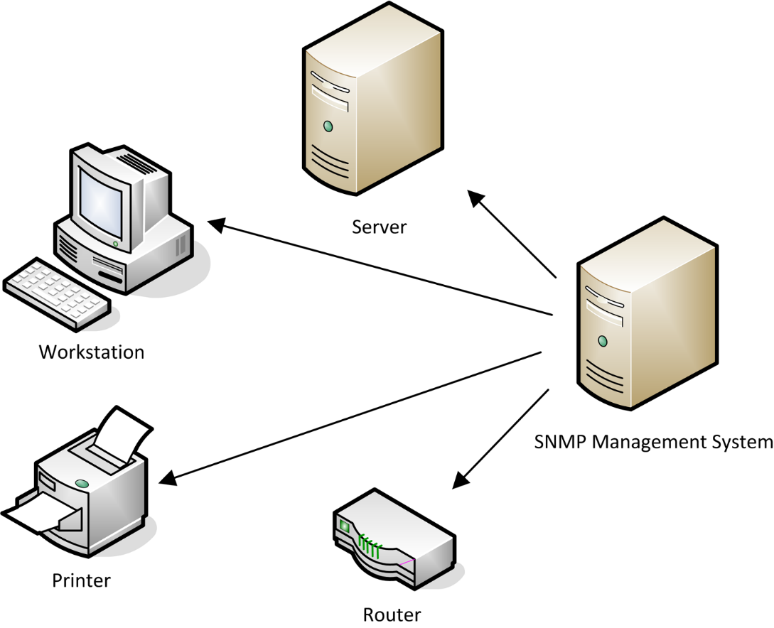
SNMP
Simple Network Management Protocol (SNMP)
Agents
Management Information Base (MIB)
Management software
  Get
  Trap
  Walk

Slide 11
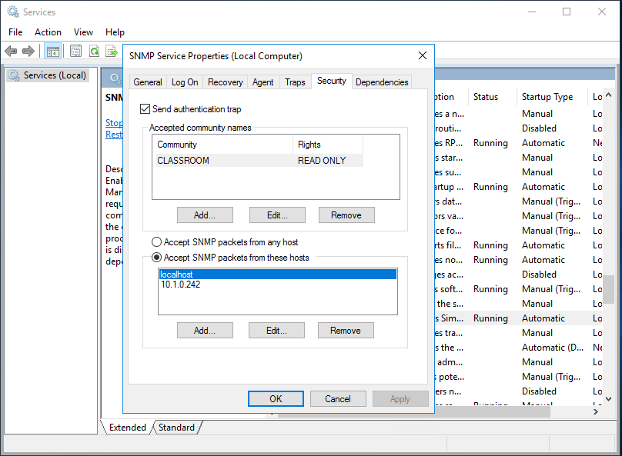
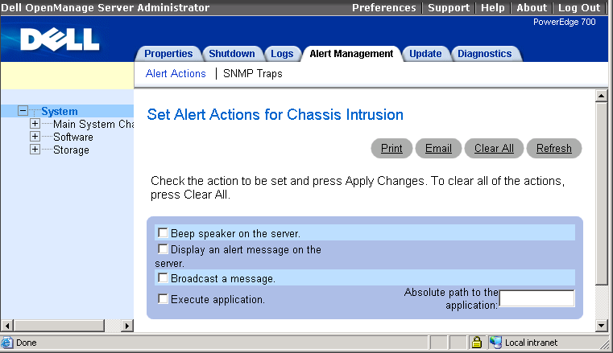
Configuring SNMP
Agent properties
  Community name
  Read/only or read/write access
  Traps
Used with permission from Microsoft

Slide 12
SNMP Security
SNMPv1 and v2 use plaintext transmissions
Access Control List (ACL)
SNMPv3 supports strong authentication and encryption

Slide 13
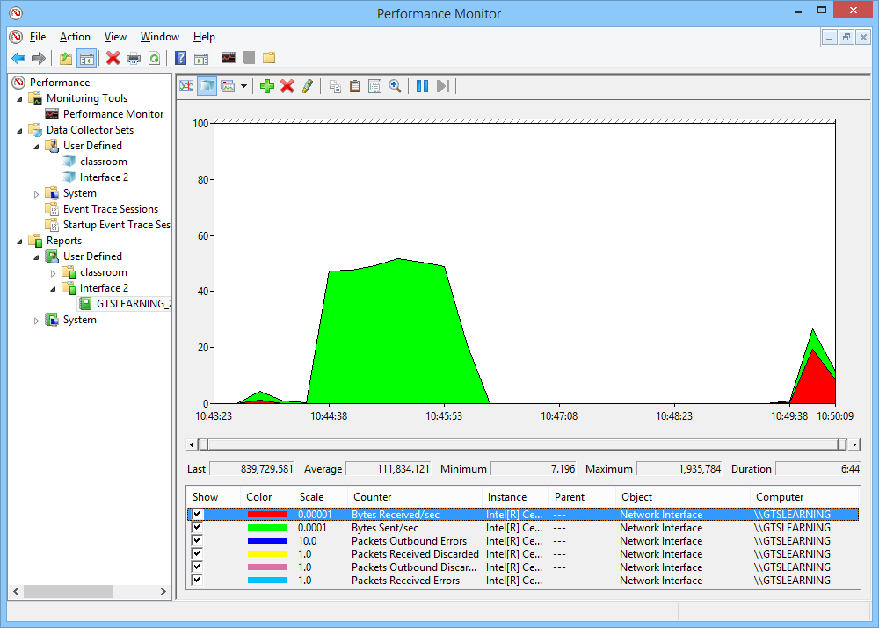
Analyzing Performance Metrics
Trends
Graphing
Server and appliance monitoring
  Bandwidth
  Network device CPU and memory
  Storage

Slide 14
Interface Monitoring Metrics
Link status
Resets
Speed
Duplex
Utilization
Errors
Discards/drops
Retransmissions

Slide 15
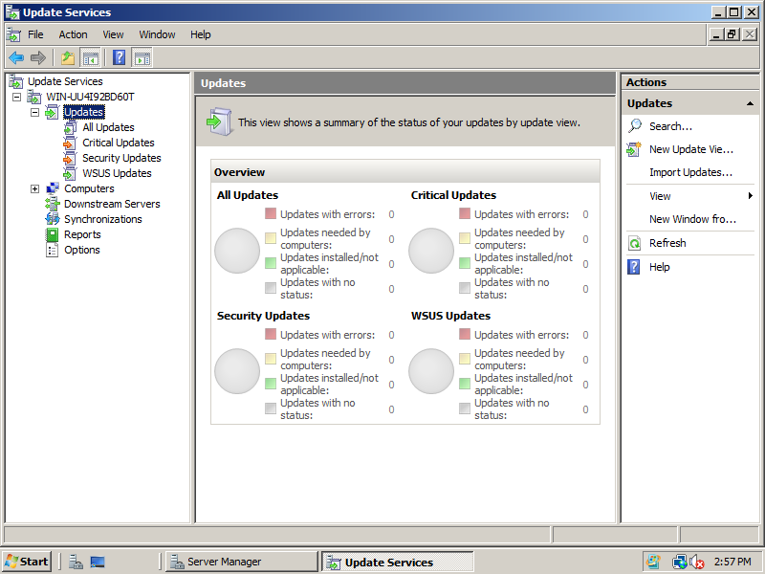
Patch Management
Update policies
OS/software and vulnerability updates
  OS updates, patches, hotfixes, and service packs
  Vulnerability patches
  Application updates

Slide 16
Upgrading Firmware and Driver Updates
Driver versus firmware
Firmware is not patched as such – replace with image supporting required fixes
Downgrading/rollback (configuration backup)

Slide 17
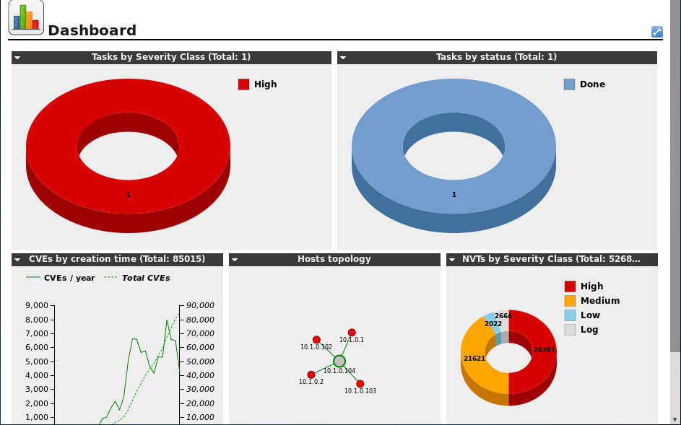
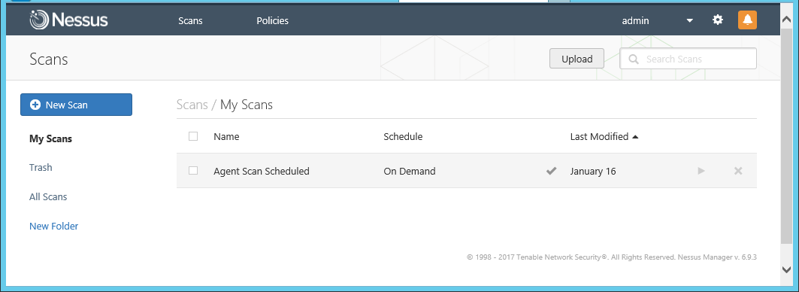
Vulnerability Scanning (1)
Automate detection of vulnerabilities
  Missing patches
  Configuration errors
Deploy as host software or appliance
Tenable Nessus
OpenVAS

Slide 18
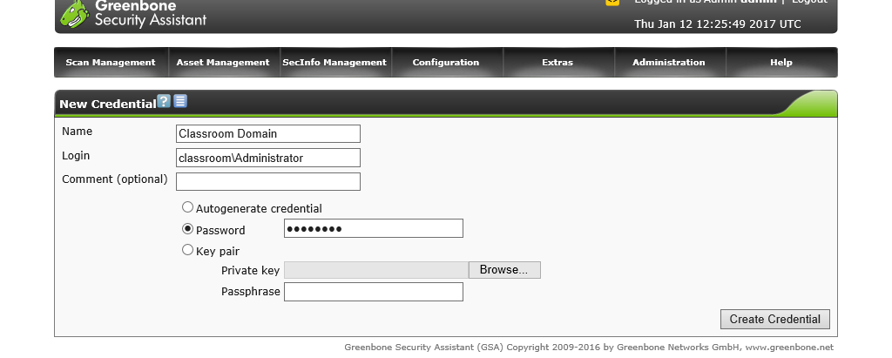
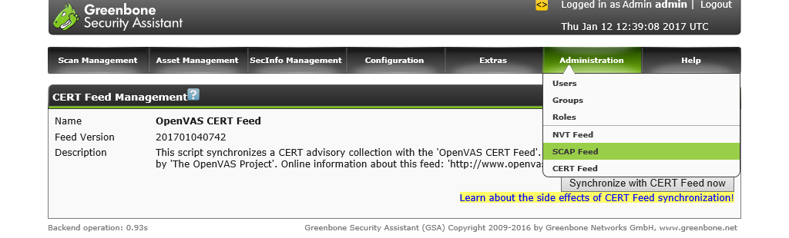
Vulnerability Scanning (2)
Non-credentialed versus credentialed scanning
Vulnerability test/feed/plugin updates

Slide 19
Documenting baselines and establishing thresholds underpins effective performance monitoring and alerting.
Load and throughput testing can be used to determine whether a network is meeting its performance goals or deviating from its baseline.
Analysis of logs and device and interface metrics can identify faults and bottlenecks. Logs and performance information can be aggregated by SIEM.
SNMP is used to monitor and manage network devices from a central location.
Make sure you know how to interpret network interface metrics, such as error rate and utilization.
Understand the use of vulnerability scanners and the importance of patch management procedures, covering network infrastructure devices as well as host servers and clients.
Notes:
Gathering systems' statistics regularly allows systems administrators to identify bottlenecks. Why do they want to do this? To identify resource usage problems before they critically affect performance.
What would be the purpose of configuring thresholds in network monitoring software? The software could produce an alert if network performance did not meet any given metric.
What is a "top listener" in terms of network monitoring? An interface that receives the most incoming traffic.
What is the purpose of a port scanner? It reveals the ports open on a server and consequently what high-level protocols it is running. It can also show how many client connections are open and how much bandwidth each port is consuming.
What sort of log would you inspect if you wanted to track web server access attempts? History/security/audit log.
What is the function of SIEM? Security Information and Event Management (SIEM) is designed to consolidate security alerts from firewalls, anti-malware, intrusion detection, audit logs, and so on.
You suspect that a network application is generating faulty packets. What interface metric(s) might help you to diagnose the problem? Monitoring errors and discards/drops would help to prove the cause of the problem.
How does an SNMP agent report an event to the management system? Via a trap.
How would a router appliance be patched to protect against a specific vulnerability described in a security advisory? This type of OS does not support patching of individual files so the whole OS has to be replaced with a new version. Vendors keep track of which version first addresses a specific security advisory.
What type of information is updated when a scanner receives a new set of "feeds" or "plugins"? These contain the scripts or identifiers used to detect whether a host is vulnerable to a specific security advisory.

Slide 20
Lab 10 / Performance Testing and Monitoring
Notes:
Note that there are three sets of labs available to use with this course:
Classroom labs that you set up and run yourself (refer to the separate "Labs" book and setup guide on the instructor resource support site).
Learn On Demand (LOD) hosted classroom labs accessed via a browser but following the same general sequence and steps as the classroom lab book.
Self-study Online Labs from Practice Labs accessed by students online - these labs are intended for use by students studying independently and are different from the classroom and hosted classroom labs. If you are using Practice Labs online labs in the classroom, you must specify this at the time of purchase so that the appropriate bandwidth is provisioned in advance. Please ensure that the student PCs meet the requirements for accessing the Self-study Online Labs series. You can obtain a setup guide at gtsgo.to/nf1rc
The sequence of classroom and hosted classroom labs is shown on this slide and in the margins of your instructor edition and in the course timetable. You should guide the students to complete each lab.
If you are not using the classroom or LOD hosted classroom labs you should delete this slide.

