Slide 1
CompTIA Network+ Certification
3.5 Network Troubleshooting

Slide 2
Use effective troubleshooting procedures, following the CompTIA troubleshooting model
Troubleshoot common connectivity scenarios
Troubleshoot problems in networking infrastructure
Troubleshoot problems with network services, such as DHCP and DNS
Notes:
The number in the bottom right corner of the slides refers back to the page where this topic starts in the course book.

Slide 3
Troubleshooting Procedures
Purpose of troubleshooting
Problem management
CompTIA Network+ Troubleshooting Model
  Identify the problem
  Establish a theory of probable cause
  Test the theory to determine cause
  Establish a plan of action to resolve the problem and identify potential effects
  Implement the solution or escalate as necessary
  Verify full system functionality and if applicable implement preventive measures
  Document findings, actions and outcomes

Slide 4
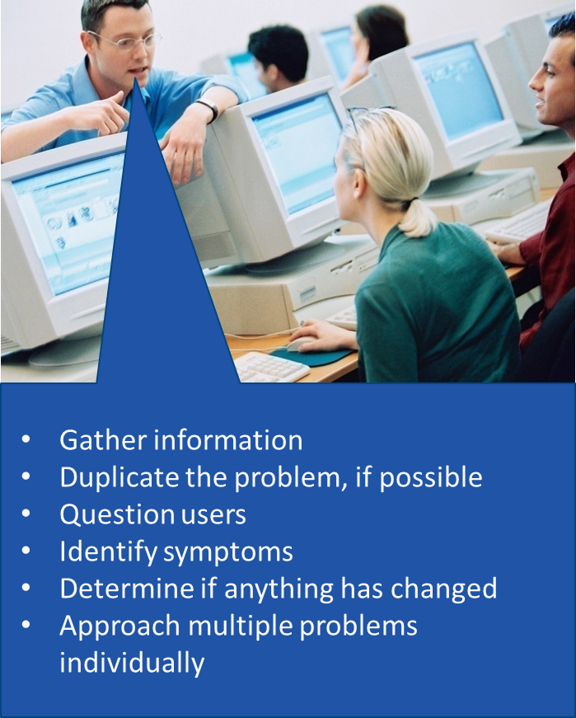
Identify the Problem
Analyze the system and environment
Question the user
  Open questions invite explanations
  Closed questions invite Yes/No/Fixed answers
Try to reproduce the problem
Logs/change documentation
Check with other technicians
Approaching multiple problems
  Are problems related?
  If not, one problem per ticket

Slide 5
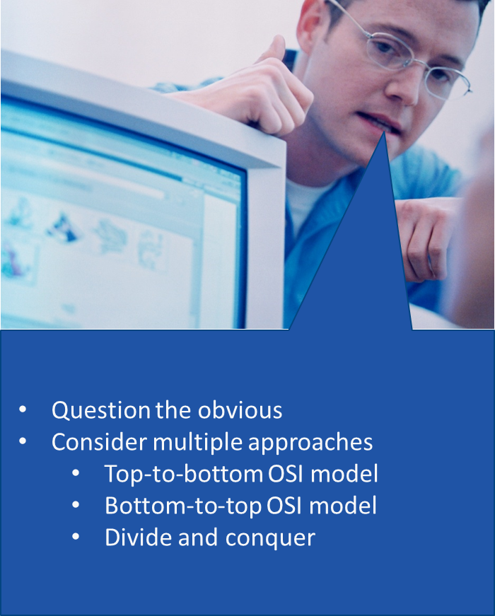
Establish a Probable Cause
Establish theory from known symptoms
Be prepared to change approach
“Question the obvious” approach
  Try easy solutions
  How should it work?
Functional approach
  Top-to-bottom/bottom-to-top layer-by-layer
  Divide and conquer

Slide 6
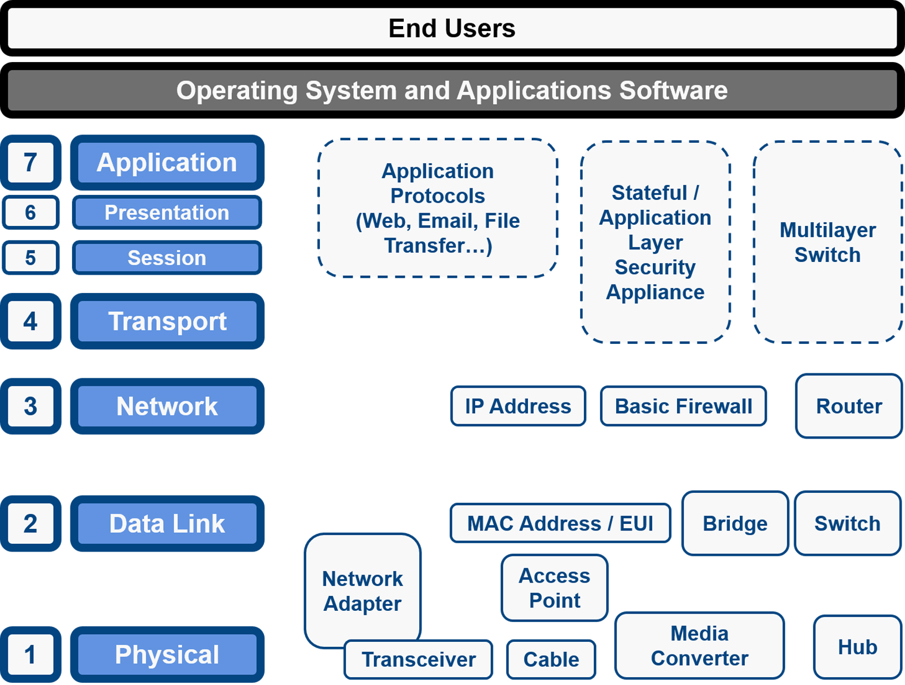
OSI Model/Divide & Conquer

Slide 7
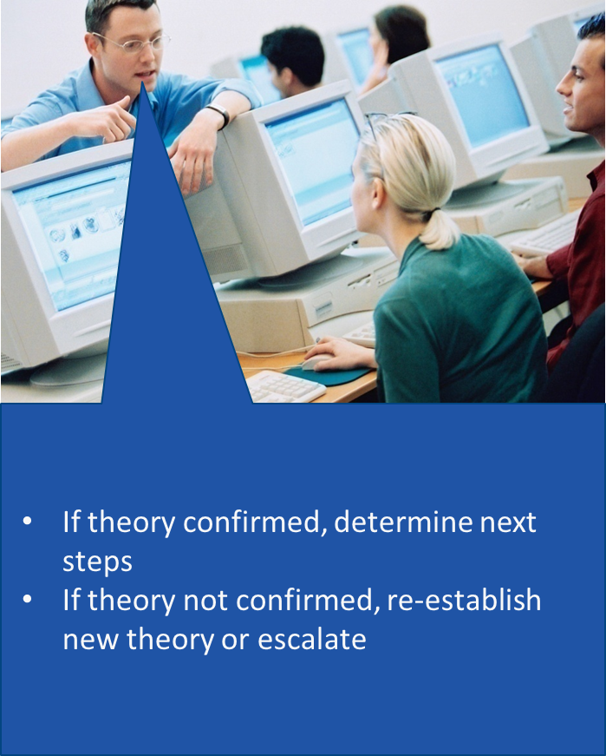
Test the Theory
Isolate the problem to a single component or system
Run tests to prove the theory
Escalate if necessary
  Problem too difficult
  Warranty/supplier issue
  Scope too large
  Customer issues

Slide 8
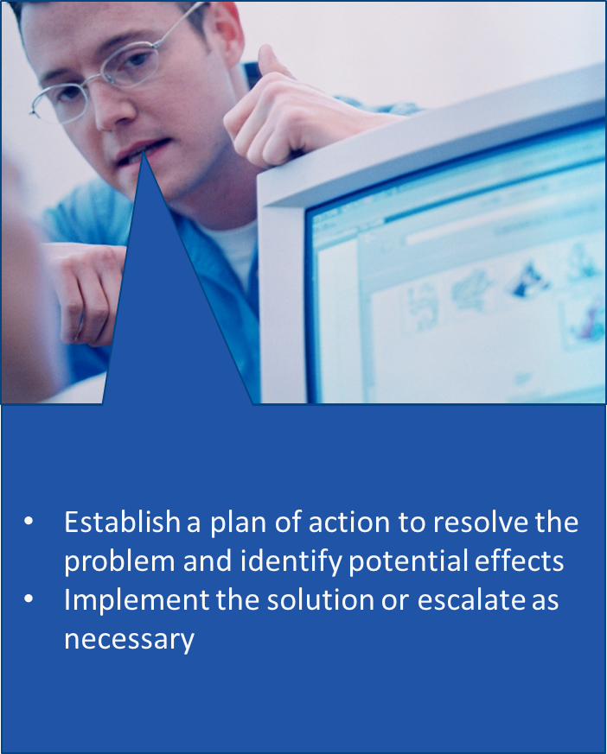
Establish a Plan of Action
Plan changes carefully
Try to anticipate effects
Typical options
  Repair
  Replace
  Ignore
Implement the solution
  Authorization (is escalation required?)
  Notification and scheduling
  Change control

Slide 9
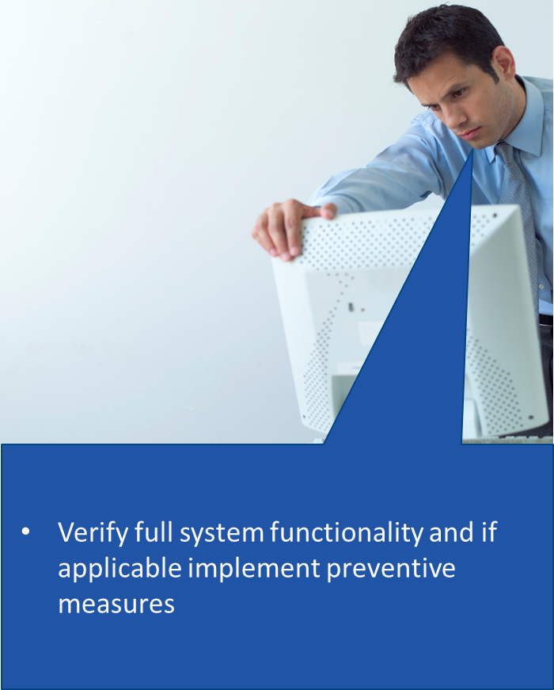
Verify System Functionality
Consider impact on overall system functionality
Test that the problem is fixed AND that the system functions normally
Identify preventive measures that will prevent the problem from reoccurring

Slide 10
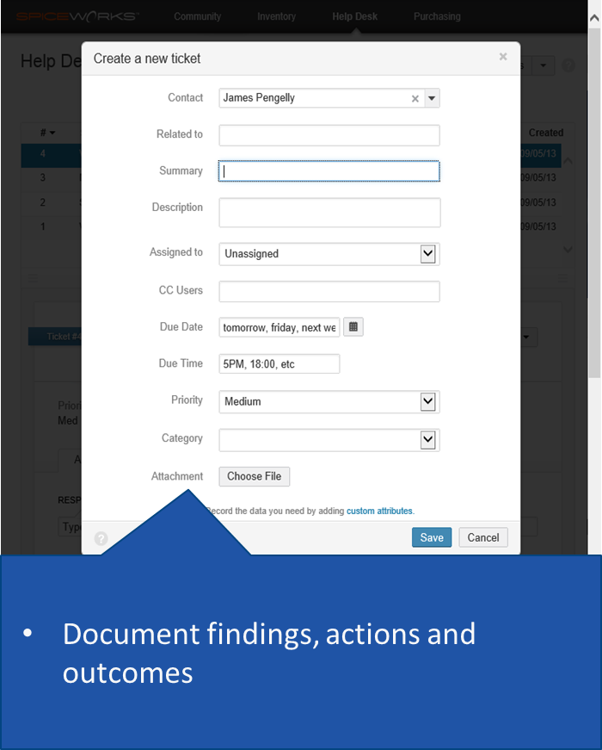
Document Findings, Actions, Outcomes
Ticket system
Categorize problems and identify trends
Add known issues to a knowledge base
Complete notes fields professionally

Slide 11
End-to-End Connectivity
Star-wired Topologies
  If one system is affected, then check the link from switch to host for that system
  If more than one system is affected, check the backbone wiring between switches or the switch itself
Backbones
  Question of determining which hosts can see which other hosts
Mesh Topologies
  Difficult to troubleshoot because all hosts have connections to all others
  If host A and B can communicate using three routes and they used to have four routes, then troubleshoot the fourth route – there may be a wiring problem there.

Slide 12
Power Failures and Anomalies
Power anomalies
  Surge/spike
  Brownout
Power failure/blackout
UPS
Standby power (generator)
Power monitoring

Slide 13
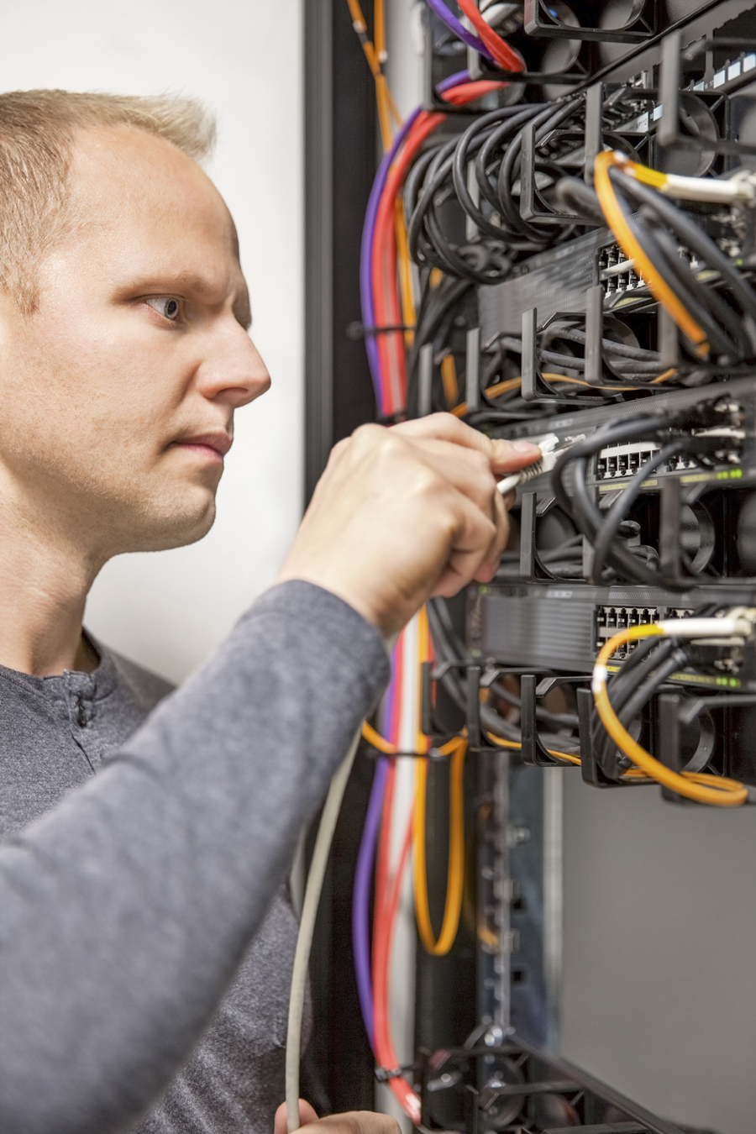
Cable Failures
Test link with ping
Verify patch cord
Loopback on host and switch port
Test permanent link
Interference sources
Image by Kjetil Kolbjornsrud © 123rf.com

Slide 14
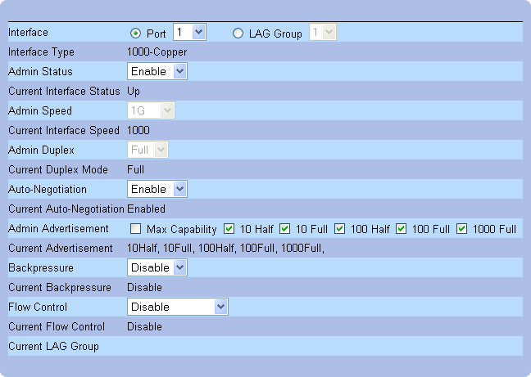
Network Adapters
Hardware failure or driver problem
  Monitor for interface errors
Interface configuration
  Speed/duplex mismatch
NIC teaming misconfiguration
  Active-active vs active-passive
  Incorrect port assignment
  Multicast or broadcast heartbeat probes blocked
  Incompatible switch

Slide 15
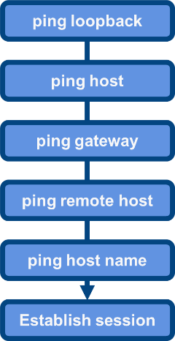
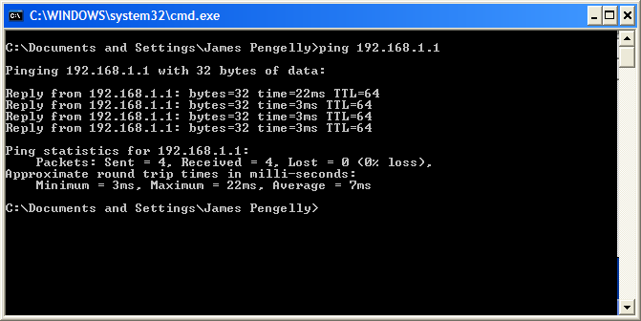
Troubleshooting Addressing Issues (1)
Check configuration (ipconfig/ifconfig)
  IP address
  Subnet mask
  Default gateway
  Static or DHCP assigned?
ping
  Loopback
  Discover neighbors (check ARP cache)
  Remote host
Used with permission from Microsoft

Slide 16
Troubleshooting Addressing Issues (2)
Incorrect gateway
  Check IP of default gateway
  Check link to default gateway
Duplicate IP addresses
  Identify MAC addresses used via ARP cache or packet trace
Duplicate MAC address
  ARP spoofing attack?
  Identify hosts use ARP cache or switch’s MAC address table

Slide 17
Switching and Routing Issues
More than one user affected?
Verify logical topology/network diagram
Hardware failure
Reboot
Firmware update
Swap out
Routing
  Check routing tables (route command)
  Identify whether firewalls could be blocking transmissions

Slide 18
DHCP Issues
Dynamic Host Configuration Protocol (DHCP)
  Server offline
  Address pool exhausted
  No DHCP relay
  Scopes misconfigured
  Scopes reconfigured – clients may have “expired” configuration
  Duplicate services (rogue DHCP)

Slide 19
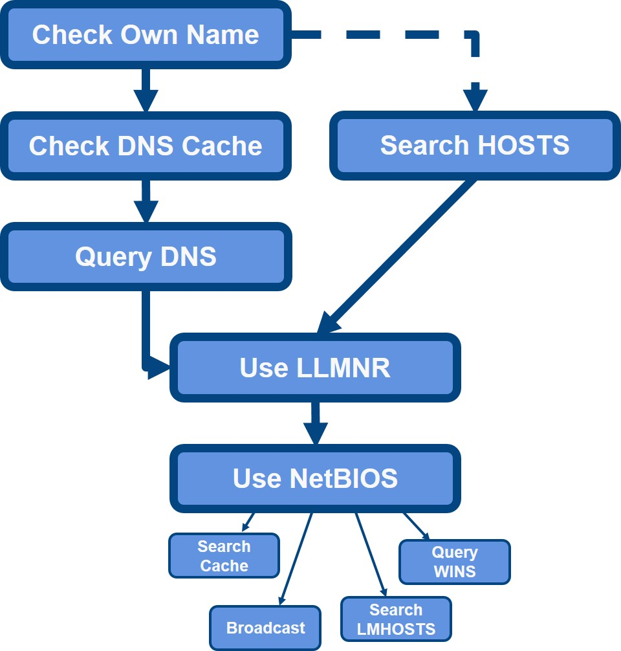
Name Resolution
Verify name resolution sequence
Test services with HOSTS
Check client’s DNS server address configuration
Check server availability

Slide 20
Misconfigured DNS
Suspect name resolution problem when link test by IP address works
Establish scope of problem – single client? subnet?
Verify client configuration
  DNS server and suffix
  Static assignment or DHCP
Use lookup tools to verify resource records on DNS server

Slide 21
Troubleshooting Services
Troubleshooting beyond basic connectivity issues...
Verify scope – is it a client problem or server one?
  Application/OS crash
  Hardware overutilization
  Broadcast storm
  Network congestion/Denial of Service (DoS)
  Firewall/Access Control List (ACL)/blocked port

Slide 22
Troubleshooting should be completed against a checklist of best practice actions (identify the problem, establish and test a theory, establish and implement an action plan, verify functionality, and document the solution).
Taking a layered approach can help to troubleshoot specific connectivity scenarios.
Learn the symptoms and causes of common connectivity and configuration issues.
Notes:
What are the two basic principles of identifying the cause of a problem? Find out if anything has changed and test one thing at a time.
After asking the three basic questions of anyone reporting a problem, what should you have determined? (Choose THREE):
Whether to look for recent change or an oversight in configuration – TRUE
Where to look for the problem – TRUE
The severity of the problem – TRUE
If the problem should be escalated - FALSE
In what sort of circumstances should you escalate a problem? If you cannot solve it yourself (though it won't be good for your career if you give up too easily). You might also escalate if you do not have authorization to perform the necessary changes or if the system is under some sort of warranty.
If you detect a significant increase in noise affecting a cable link, how would you go about determining the cause? Ask what has changed - it is likely that some equipment or power cabling has been installed near the data cable link.
When troubleshooting a cable link, which should you investigate first - the patch cord, permanent link, or network adapter? Patch cord - or possibly network adapter.
You have connected a new computer to a network port and cannot get a link. You have tested the adapter and cable and can confirm that there are no problems. No other users are experiencing problems. The old computer also experienced no problems. What cause would you suspect? Speed mismatch - check the autonegotiate settings on the adapter and port.
Users on a floor served by a single switch cannot get a network connection. What is the best first step? Reset the switch - if that works also investigate possible underlying causes, such as a malicious attack on the switch or poorly seated plug-in module.
You have pinged the router for the local subnet and confirmed that there is a valid link. The local host cannot access remote hosts however. No other users are experiencing problems. What do you think is the cause? The router is not configured as the default gateway (you can ping it but the host is not using it for routing).
Following maintenance on network switches, users in one department cannot access the company's internal web and email servers. You can demonstrate basic connectivity between the hosts and the servers by IP address. What might the problem be? It is likely that there is a problem with name resolution. Perhaps the network maintenance left the hosts unable to access a DNS server, possibly due to some VLAN assignment issue.
Users on a particular network segment have been experiencing poor performance. The cause has been identified as a "broadcast storm". What is often the cause of broadcast storms? Defective network card or switch, misconfiguration of STP, or the unauthorized or unplanned attachment of bridging devices that create a loop.
You are planning to reconfigure static and DHCP-assigned IP addresses across the network during scheduled downtime. What preliminary step should you take to minimize connectivity issues when the network is re-opened? Ensure that clients obtain a new DHCP lease, either by shortening the lease period in advance or by using a script to force clients to renew the lease at startup.

