Slide 1
CompTIA Network+ Certification
4.1 Applications and Services

Slide 2
Describe the functions of web application protocols and security mechanisms
Describe the functions of communications protocols, such as email and Unified Communications
Describe the basic elements of Quality of Service provision
Describe the functions and applications of packet shapers, load balancers, and multilayer switches
Notes:
The number in the bottom right corner of the slides refers back to the page where this topic starts in the course book.

Slide 3
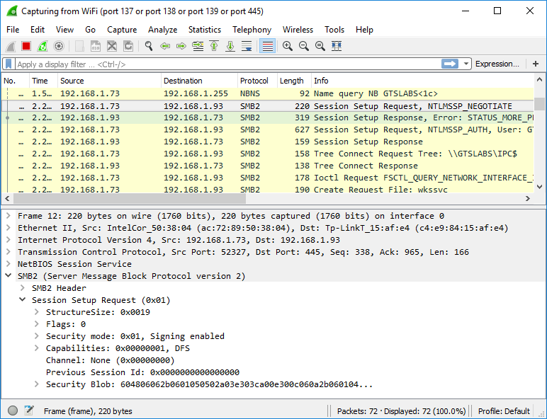
TCP/IP Services and SMB
Application layer provides the formats for data exchange – email, file transfer, web browsing...
Server Message Block (SMB)
  Underpins Windows File/Printer Sharing
  Supported on UNIX and Linux by the Samba package
  Runs over TCP port 445 or NetBIOS ports (137 – 139) on legacy hosts

Slide 4
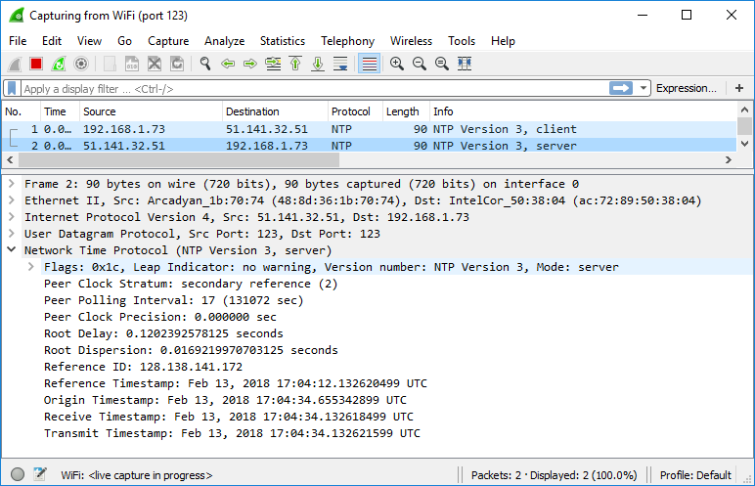
Network Time Protocol (NTP)
Time critical services
  Authentication
  Logging
  Task scheduling/backup
  ...
Network Time Protocol (NTP)
  Stratum 1 servers
  Stratum 2 servers
  Simple NTP (clients)
Diagnosing errors due to incorrect time

Slide 5
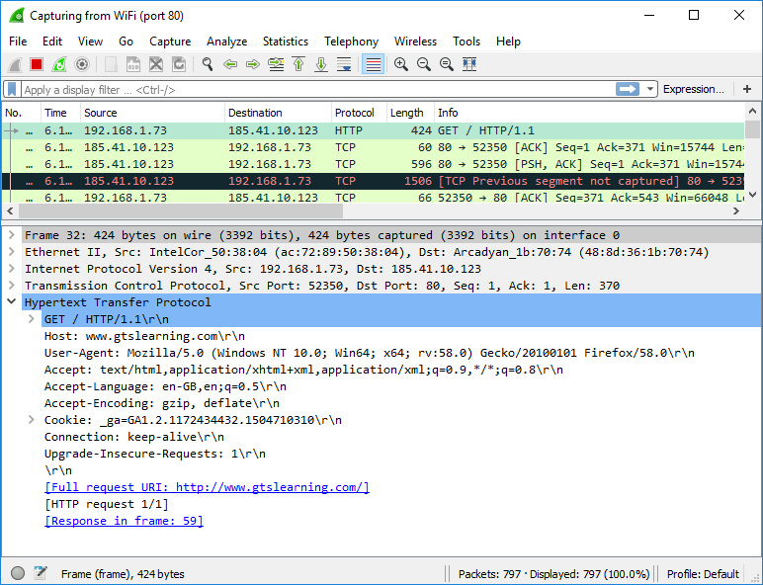
Web Services
HyperText Transfer Protocol (HTTP)
TCP port 80
Uniform Resource Locator (URL)
HyperText Markup Language (HTML)
Web server hosting types
  Dedicated server
  Virtual Private Server (VPS)
  Cloud hosting
  Shared hosting
Web server software
  Apache
  Microsoft Internet Information Server (IIS)
  nginx
  Apache Tomcat

Slide 6
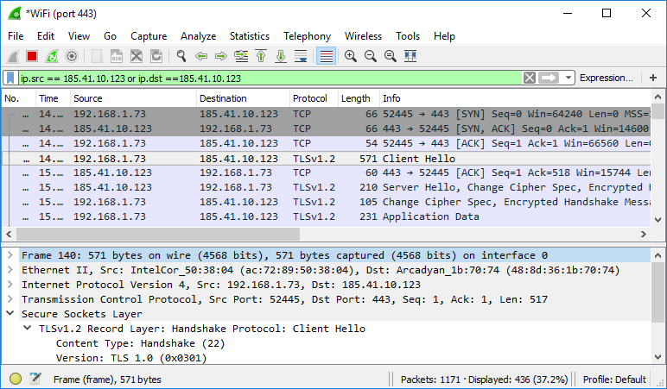
SSL/TLS
Secure Sockets Layer (SSL)/Transport Layer Security (TLS)
Works above transport layer and below application layer ... so session or presentation
Usually used to secure TCP protocols
  HTTPS
  SMTP
  IMAPS
  POPS
  ...
Can also be used with UDP, especially in VPN solutions (Datagram Transport Layer Security [DTLS])

Slide 7
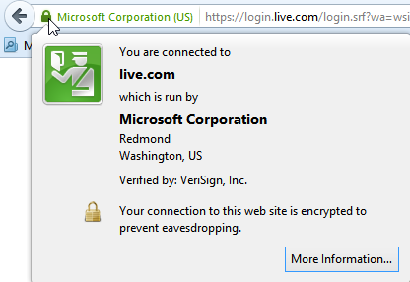
HTTPS
HTTP Secure (HTTPS) uses TLS to authenticate hosts and encrypt messages
Web server is installed with a digital certificate issued by a Certificate Authority trusted by both server and client
Asymmetric encryption used means any client can know public key without being able to intercept or impersonate server – only the linked private key can reverse the encryption
HTTPS uses TCP port 443 by default
Used with permission from Microsoft

Slide 8
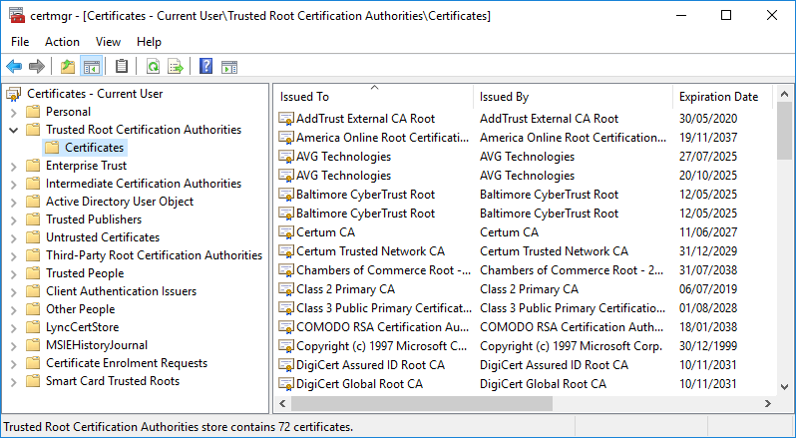
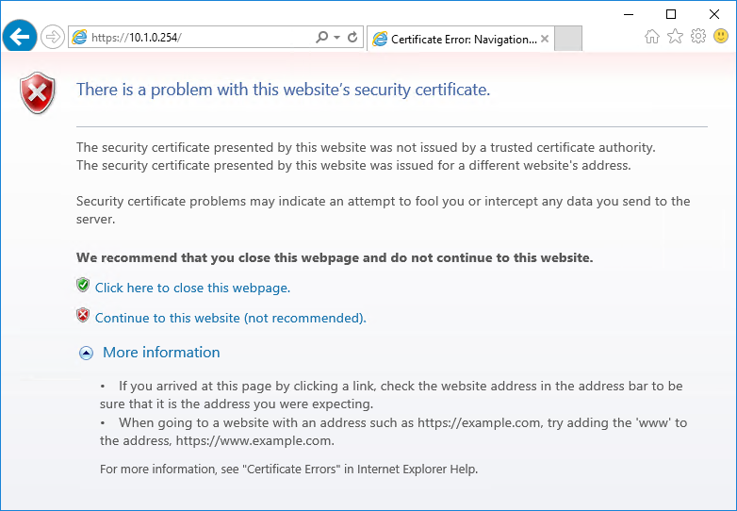
Troubleshooting Untrusted Certificates
Used with permission from Microsoft
Must be a trust relationship with server’s Certification Authority
Check Root Certificates store
Self-signed certificates
Subject name and key usage issues
Expired and revoked certificates (or CA certificates)
Time synchronization

Slide 9
Simple Mail Transfer Protocol (SMTP)
Server-to-server mail delivery
MX records
Non-delivery Report (NDR)
Connection security methods
  STARTTLS
  SMTPS
SMTP ports
  Port 25 - used for message relay between SMTP servers or Message Transfer Agents (MTA)
  Port 587 - used by mail clients (Message Submission Agents [MSA]) to submit messages for delivery by an SMTP server
  Port 465 - some providers and mail clients use this port for message submission over implicit TLS (SMTPS)

Slide 10
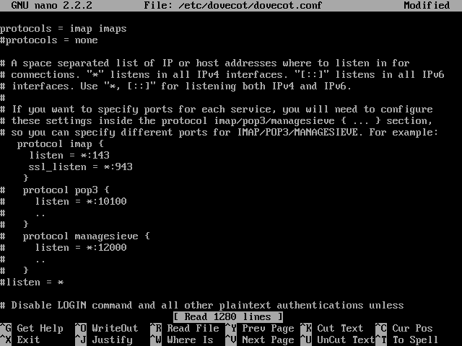
Email ( POP/IMAP)
Post Office Protocol (POP)/Internet Message Access Protocol (IMAP)
  Client-to-server
  Mailbox access
  POP: 110 (995 with SSL)
  IMAP: 143 (993 with SSL)

Slide 11
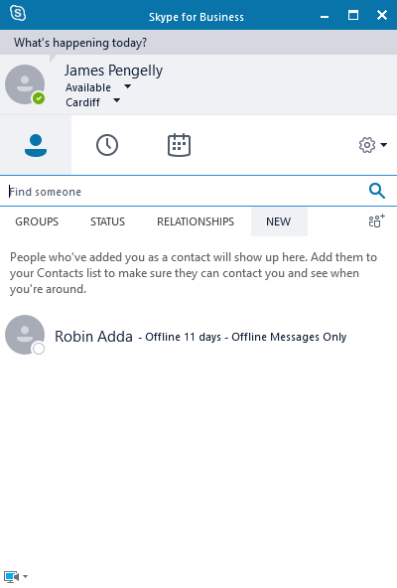
Voice Services
Voice over IP (VoIP)
Video TeleConferencing (VTC)
Real-time services
Unified Communications (UC)
  Messaging applications that combine multiple communications channels and technologies into a single platform
  UC servers centralize the presence information and coordinate the communication channels
  UC gateways provide interfaces between the various communications technologies
  UC devices provide end user access

Slide 12
Voice over IP and PBX
Voice over IP (VoIP)
  Transmitting voice calls as data packets
  Integration with landline and mobile networks through gateways
  Different ways of implementing but majority of modern IP telephony solutions use Session Initiation Protocol (SIP)
Private Branch Exchange (PBX)
  Legacy PBX terminates TDM lines from telecoms provider
  Allows internal phone system (extensions) and call features
  Hybrid and fully IP PBX integrate with VoIP
VoIP gateway
  Means of translating between the VoIP network and external voice networks, such as Public Switched Telephone Network (PSTN)
  Might be integrated with hybrid or IP PBX or interface with one
  Analog and digital types to match carrier lines

Slide 13
Real-time Services Protocols
Session control
  Establish, manage, and disestablish communications sessions
  User discovery (locating a user on the network)
  Availability advertising
Data transport
  Delivery of the actual video or voice information
Quality of Service (QoS)
  Ensures that voice or video communications are free from problems such as dropped packets, delay, or jitter

Slide 14
SIP and VoIP Endpoints
Session Initiation Protocol (SIP)
  User Agents
  User discovery (SIP URI)
  Peer-to-peer or client/server
  Ports 5060/5061 (TCP or UDP)
VoIP endpoints
  Software or handsets
  Can use normal data cabling but often assigned to separate VLAN for performance

Slide 15
RTP and RTCP
Real-time Transport Protocol (RTP)
  Delivery of media packets
  UDP to minimize overhead
  Sequencing and time-stamp in RTP header
RTP Control Protocol (RTCP)
  Monitor session and provide information to QoS
Default port pair
  RTP 5004 (even)
  RTCP 5005 (or next odd)

Slide 16
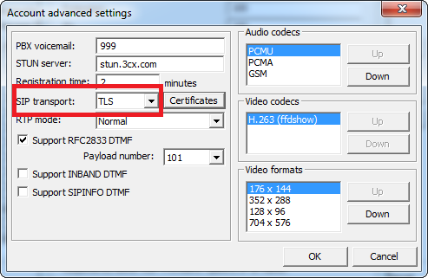
Secure SIP

Slide 17
H.323
Alternative session control protocol to SIP (and predates it)
Terminals and gatekeepers
TCP Port 1720

Slide 18
Quality of Service (1)
Real-time services versus bursty data applications
Latency
  Signal delay measured in milliseconds (ms)
  Particular problem for 2-way communications (voice calls)
Jitter
  Variation in delay

Slide 19
Quality of Service (2)
QoS identifies traffic streams for prioritization (as opposed to standard “best effort” delivery)
Differentiated Services (DiffServ)/IEEE 802.1p
  Tags traffic at layers 3 and 2
  6-byte DiffServ Code Point (DSCP) placed in Type of Service/Traffic Class IP header
  Can map to 802.1p 3-bit priority field in frame header
QoS versus CoS (Class of Service)
  Privilege real-time data over bursty data
  Class of Service tags data with priority type
  Quality of Service allows control over network link parameters
  Multiprotocol Label Switching (MPLS)

Slide 20
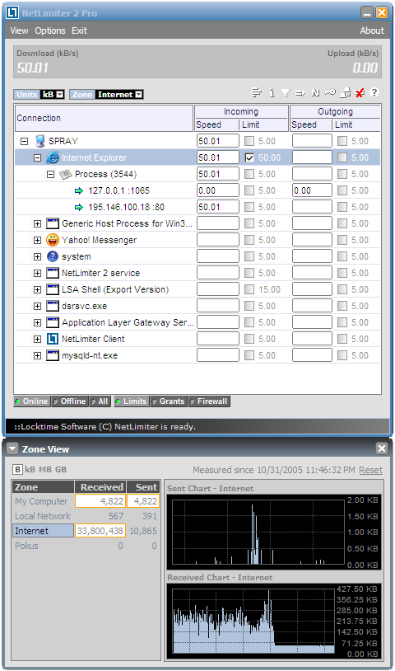
Traffic Shaping
Traffic policing enforces bandwidth limits
Traffic shaping
  Reserve link bandwidth
  Prioritize traffic
  Filter/deprioritize unwanted traffic

Slide 21
Load Balancing (1)
Bottlenecks
Load balancer distributes client requests across available server nodes in a "farm" or pool
Provides fault tolerance
Layer 4 load balancer - early instances of load balancers would base forwarding decisions on IP address and TCP/UDP port values (working at up to layer 4 in the OSI model
Layer 7 load balancer (content switch) - as web applications have become more complex, modern load balancers need to be able to make forwarding decisions based on application-level data
Other functions (TCP offload, SSL offload, caching, prioritization)

Slide 22
Load Balancing (2)
Virtual IP (VIP)
  The IP by which the load balanced service is advertised to external hosts
Round Robin DNS
Server load balancing technologies (Network Load Balancing [NLB])
Stateless versus stateful fault tolerance

Slide 23
Multilayer Switches
Layer 3 switching
  Dedicated router function
  Route once, switch many
  Fast, hardware-based
Load balancing and content switching
  Layer 4
  Layer 4-7 (content/web switch)
  Performance-rated for number of sessions supported

Slide 24
SMB implements file sharing on Windows networks while NTP provides time synchronization, which is critical to many applications and services.
Websites and applications use HTTP to transfer data and are accessed via URLs. Communications can be secured using SSL/TLS and digital certificates (HTTPS).
SMTP is used for mail delivery while POP and IMAP are means of accessing a mailbox on a remote server. Client access to these servers should be protected by connection security (SSL/TLS).
Real-time services such as VoIP and VTP use session protocols such as SIP along with data transfer protocols such as RTP.
Packet shaping and load balancing protocols and appliances allow a network to be tuned to support QoS for real-time services and provide high availability.
A multilayer switch can provide layer 3 routing and/or layer 4/7 content-based path selection.
Notes:
What is SNTP? Simple Network Time Protocol.
What must be installed on a server to use secure (HTTPS) connections? Digital certificate.
What happens if a message sent via SMTP cannot be delivered? The server generates a Non-Delivery Report (NDR) with an appropriate error code.
What protocol would enable a client to manage mail subfolders on a remote mail server? Internet Message Access Protocol (IMAP). Note that Post Office Protocol (POP3) allows download of mail messages not management of the remote inbox.
What is the function of a UC gateway? Unified Communications (UC) gateways provide interfaces between different messaging technologies, such as between VoIP and the ordinary telephone (PSTN) network.
True or false? SIP enables the location of User Agents via a specially formatted URI. True.
How is jitter mitigated by a VoIP application? By buffering packets.
How many different traffic classes can be defined by 802.1q/p? The field is 3-bit, allowing up to 8 values. 7 is reserved for network infrastructure (routing table updates), 6-5 for 2-way communications, 4-1 for streaming multimedia, and 0 for "ordinary" best-effort delivery.
How does a traffic shaper benefit real-time data applications? A traffic shaper can reserve bandwidth so that a real-time data application is guaranteed QoS (in terms of latency and jitter).
What would be a typical scenario for implementing a content switch? Using the switch as an interface for a web server farm. The switch performs load balancing by connecting clients to different servers depending on traffic conditions and policies.

Slide 25
Lab 11 / Configuring Application Protocols
Notes:
Note that there are three sets of labs available to use with this course:
Classroom labs that you set up and run yourself (refer to the separate "Labs" book and setup guide on the instructor resource support site).
Learn On Demand (LOD) hosted classroom labs accessed via a browser but following the same general sequence and steps as the classroom lab book.
Self-study Online Labs from Practice Labs accessed by students online - these labs are intended for use by students studying independently and are different from the classroom and hosted classroom labs. If you are using Practice Labs online labs in the classroom, you must specify this at the time of purchase so that the appropriate bandwidth is provisioned in advance. Please ensure that the student PCs meet the requirements for accessing the Self-study Online Labs series. You can obtain a setup guide at gtsgo.to/nf1rc
The sequence of classroom and hosted classroom labs is shown on this slide and in the margins of your instructor edition and in the course timetable. You should guide the students to complete each lab.
If you are not using the classroom or LOD hosted classroom labs you should delete this slide.

