Slide 1
CompTIA Network+ Certification
4.3 Network Security Design

Slide 2
Understand basic security principles, such as vulnerabilities, exploits, threats, and risk
Describe network attacks, such as sniffing, spoofing, Man-in-the-Middle, DNS poisoning, and Denial of Service
Implement secure network topologies using segmentation and DMZ
Describe the purposes and functions of Virtual LANs (VLAN) and Network Address Translation (NAT)
Use policies and technologies to implement device and service hardening
Notes:
The number in the bottom right corner of the slides refers back to the page where this topic starts in the course book.

Slide 3
CIA Triad
Protecting data assets and ensuring business continuity by making network systems and hosts resilient to different kinds of attack
Properties of secure information processing
  Confidentiality
  Integrity
  Availability
Role of security policies
  Security controls
  Hardening

Slide 4
Exploits versus Vulnerabilities
Vulnerability - a weakness that could be triggered accidentally or exploited intentionally to cause a security breach
Threat - the potential for a threat agent or threat actor to "exercise" a vulnerability
Exploit - a specific means of using a vulnerability to gain control of a system or damage it in some way
Risk - the likelihood and impact (or consequence) of a actor exercising a vulnerability
Types of vulnerability
  Misconfiguration or poor practice
  Faults in software or firmware
Types of exploit
  Bypass security system or cause software crash
  Run arbitrary code (such as malware)
  Zero day exploits

Slide 5
Common Networking Attacks
Understanding types of attacker and motivations
Network reconnaissance (footprinting, fingerprinting, sniffing)
  Discover how the network and its security systems are configured
  Port scanning for useful information
  Probe server to analyze responses to identify application/version/possible configuration
Denial of Service
Spoofing and packet/protocol abuse
Man-in-the-Middle Attack

Slide 6
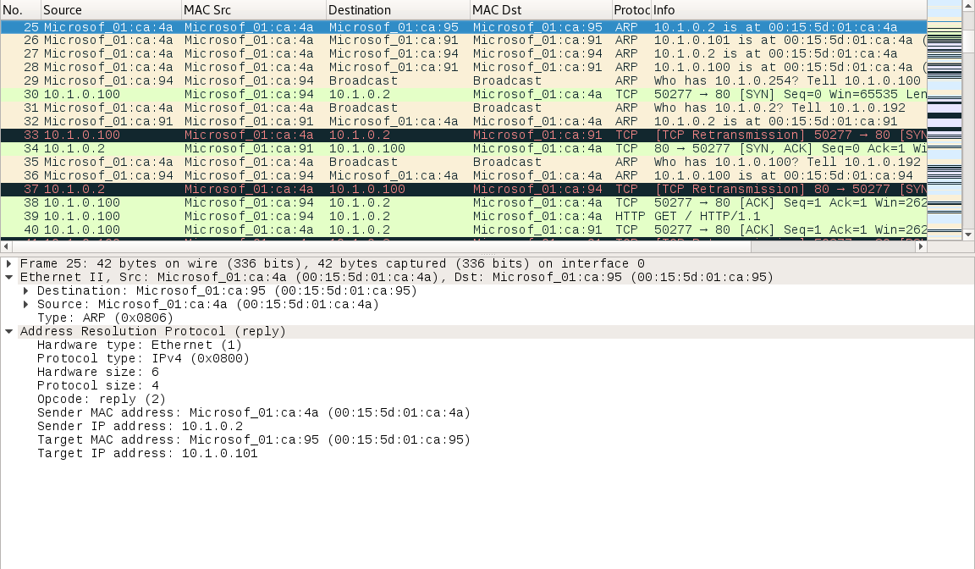
ARP Poisoning
Poison ARP cache of targets by sending spoofed ARP replies
Allows attacker to intercept and monitor (and possibly modify) traffic

Slide 7
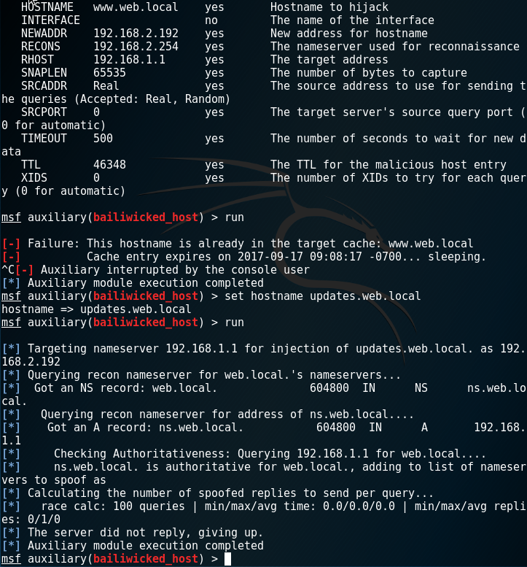
DNS Poisoning
Compromise name resolution to intercept traffic
Client cache poisoning
Intercepting DNS queries
DNS server cache poisoning

Slide 8
Network Segmentation
Segment network by creating zones with different security/access configurations
“Containers” can be created using Virtual LAN (VLAN), subnets, Virtual Private Networks (VPN), or host virtualization
Traffic between “containers” subject to Access Control Lists (ACL), typically enforced by firewalls
Air gapped network or host

Slide 9
Demilitarized Zones (DMZ)
Zones contain hosts with similar security configuration and requirements
Zones can represent any security policy but Internet-facing Demilitarized Zones (DMZ) are particularly important
Internet hosts should not be allowed uncontrolled access to LAN (connect only through firewalls, proxies, VPNs, etc)
Perimeter network hosts are semi-trusted because there is access from the Internet
Perimeter network should not store data assets

Slide 10
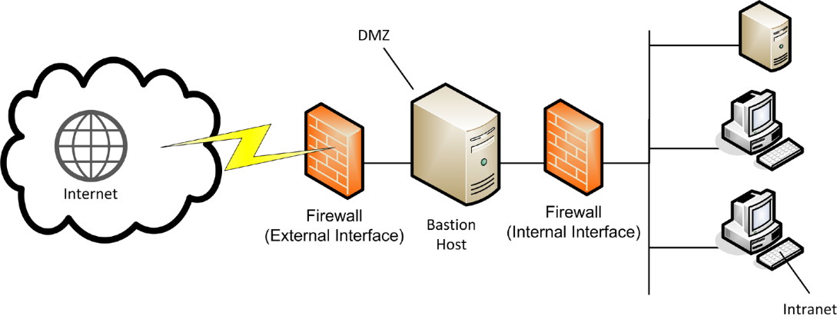
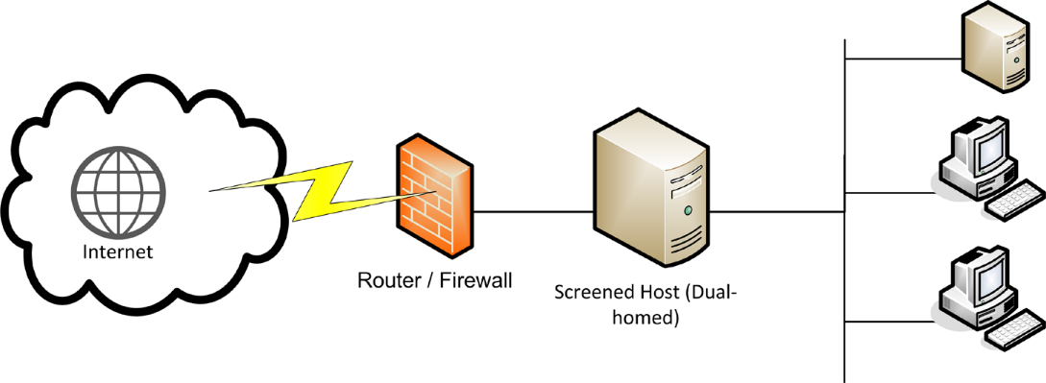
DMZ Design
Screened subnet
3-legged firewall

Slide 11
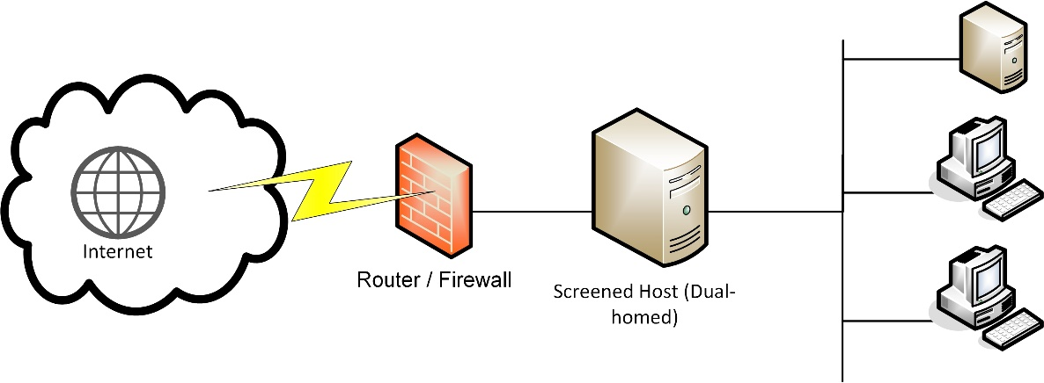
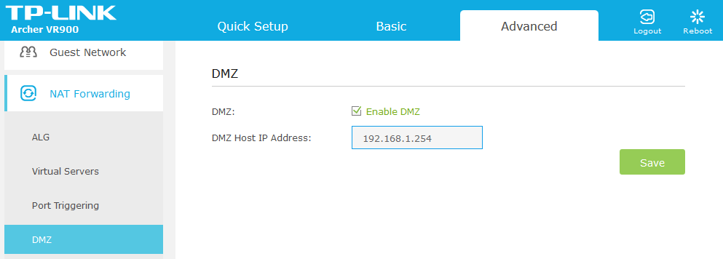
Screened Host and SOHO DMZ
Screened host
  Small network may use a single proxy for Internet access
SOHO DMZ
  SOHO routers implement a different kind of DMZ
  Allows access to a LAN host through firewall

Slide 12
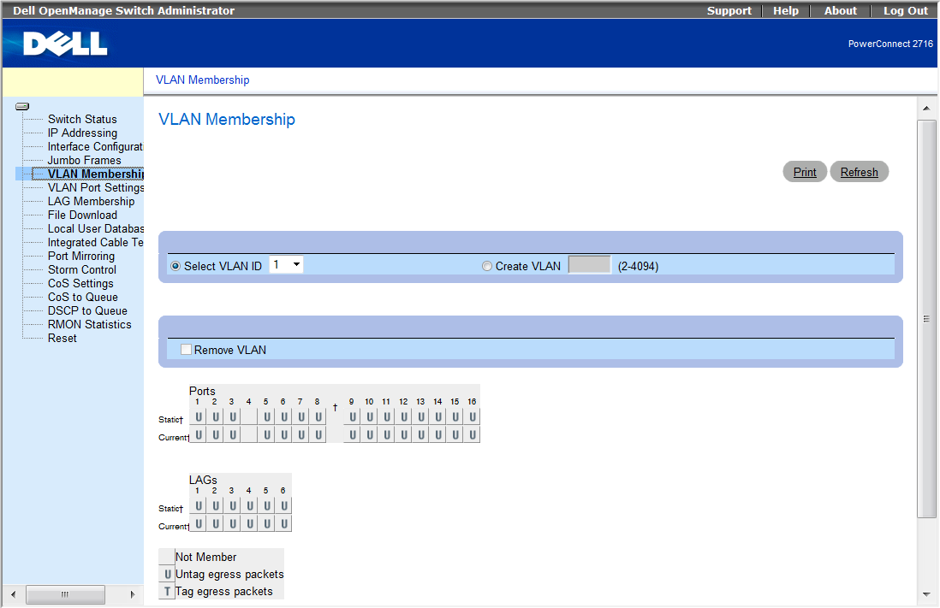
Virtual LANs (VLAN)
Create separate broadcast domains
VLAN assignment
  Static (port-based)
  Dynamic (assign by host MAC, IP, authentication, etc)
Create zones for security/administration
Traffic between VLANs must be routed
Layer 3 switches

Slide 13
Troubleshooting VLAN Assignments
Check configuration on switch
Check VLAN membership
Check services available to VLAN
  Routing
  DHCP/DHCP relay/IP helper
  DNS
  Authentication/network applications

Slide 14
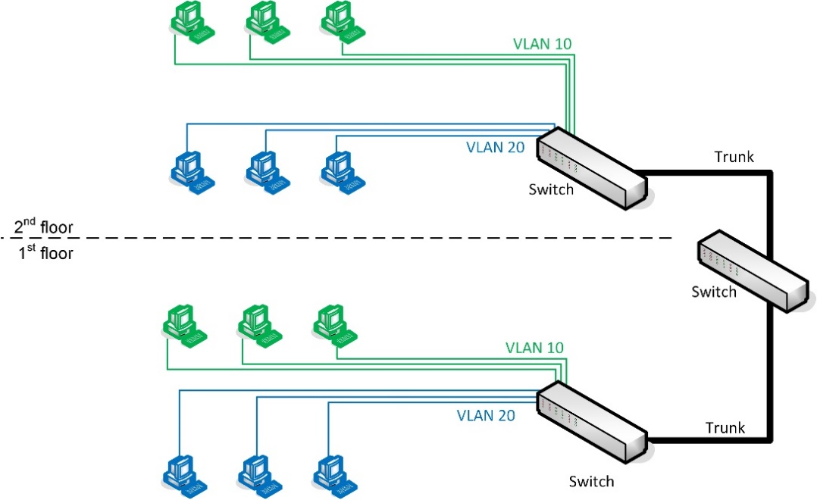
Trunking and 802.1Q
Trunks are connections between switches (or switches and routers)
Frames transported over trunk must be tagged with appropriate VLAN ID
IEEE 802.1Q VLAN tagging

Slide 15
Access Ports (Tag and Untag VLAN)
Untagged (access) ports are associated with a single VLAN only
  If a frame is addressed to a port in the same VLAN on the same switch, no tag will need to be added to the frame
  If the frame needs to be transported over a trunk link, the switch adds the relevant 802.1Q tag to identify the VLAN then forwards the frame over the trunk port
  If the switch receives an 802.1Q tagged frame on an access port, it will strip the tag before forwarding it
Tagged ports are used for trunks and can carry 802.1Q tagged frames associated with multiple VLANs

Slide 16
Default VLAN and Native VLAN
Default VLAN
  All ports start in VLAN 1 by default
  Default VLAN ID cannot be changed
  Leave unused or reserve for inter-switch protocol traffic
  Ensure unused ports are not assigned to VLAN 1
    Disable unused ports
    Assign unused ports to “black hole” VLAN
Native VLAN
  Used for untagged traffic on trunk ports (to and from legacy devices)
  Configure native VLAN with some other ID than 1 for security
  Native VLAN ID is assigned per-port – use same ID on ports on either side of trunk link
VLAN hopping/double tagging
  Specially craft VLAN tags so that switch strips outer and forwards to inner
  Can only be exploited in quite specific circumstances
  Configure native VLAN to exclude user access

Slide 17
VLAN Trunking Protocol (VTP)
Propagate VLAN configurations
Management domains
  VTP server (accepts modifications)
  VTP client
Pruning
Spanning tree and VLANs

Slide 18
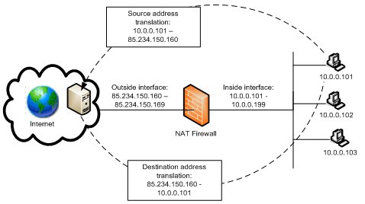
Network Address Translation
Basic NAT
  1:1 mapping between public and private address
Dynamic NAT
  Private addresses are mapped from a pool of public addresses

Slide 19
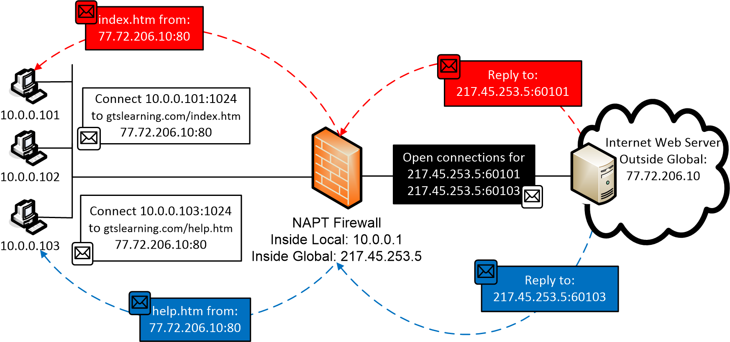
Port Address Translation (PAT)
“NAT overloading”
  Network Address Port Translation (NAPT)
  One-to-many NAT
Multiple private addresses mapped to one public address
Connections identified by high-level ports

Slide 20
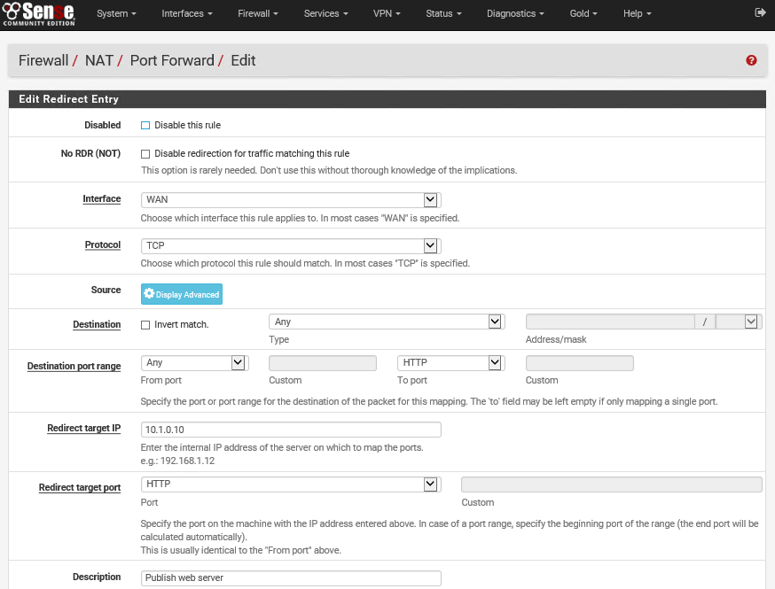
Destination NAT (DNAT)
Port forwarding
Maps Internet requests for ports on public IP to private IP on LAN
Solution for Internet access to servers/gaming/VoIP on SOHO network

Slide 21
Device Hardening
Hardening means applying a secure configuration to each network host or appliance
Changing default credentials
Avoiding common passwords
Backdoor/default account
Disabling unnecessary services
Disabling unused IP ports
Closing unused device ports

Slide 22
Using Secure Protocols
Risks of using unsecure protocols
Unsecure protocols and alternatives
  Telnet – use Secure Shell (SSH) or IPsec
  HTTP – use HTTP over SSL/TLS (HTTPS)
  SLIP (Serial Line Internet Protocol) – replace or use IPsec
  FTP/T(rivial)FTP – use SSH or TLS
  SNMPv1 and v2 – upgrade to v3 or use IPsec

Slide 23
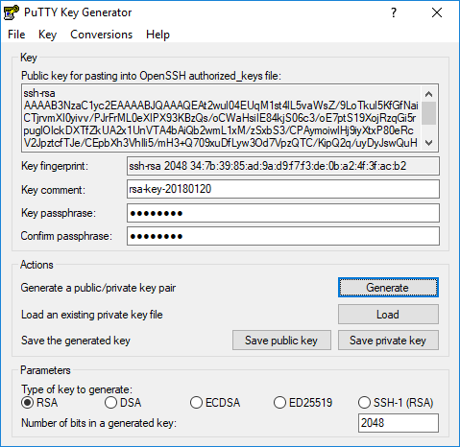
Generating New Keys
Managing host private key
  SSH
  HTTPS
SSH host/user public keys
  Allow non-interactive logon
  Remove keys if user or remote management host should no longer be permitted access

Slide 24
File Hashing
Cryptographic hash or file signature (Hashed Message Authentication Code) verifies integrity of files
Compare hashes manually or verify HMAC with publisher’s public key
Utilities
  certutil
  File Checksum Integrity Verifier
  md5sum | sha1sum | sha256sum | sha512sum
  gpg

Slide 25
Honeypots/Honeynets
Analyze and identify attacks
Act as decoys
Internet-connected hosts used for research
Decoy or “early warning” systems on LAN

Slide 26
Penetration Testing
Ethical hacking or “pen test”
  Verify threat
  Find ways to bypass security controls
  Find ways to remove or disable controls
  Exploit vulnerabilities to prove threat exists (“pwned”)
Using third party pen testers

Slide 27
The main network attack strategies can be characterized as footprinting (port scanning and eavesdropping), Man-in-the-Middle, spoofing, DNS poisoning, and DoS.
Firewalls and addressing schemes can be used to segment a network by implementing a system of security zones. A DMZ is an Internet-facing area of the network outside the firewall protecting the LAN.
VLANs can be used to aggregate and subdivide networks into a different logical topology and enforce security zones. Each VLAN is a separate broadcast domain.
NAT is a means of translating private internal network addresses to one or more public addresses.
Devices and services should be hardened to reduce the network "attack surface".
Notes:
Apart from software crashes, what is a possible effect of a software exploit? Allows the attacker to execute code on the system.
What type of activity is often a prelude to a full-scale network attack? Footprinting - obtaining information about the network and security system. This might be done by port scanning, eavesdropping, or social engineering.
What is the usual goal of an ARP spoofing attack? To redirect traffic to the attacker's machine by masquerading as the subnet's default gateway. This allows the attacker to eavesdrop on traffic or perform a Man-in-the-Middle attack.
What means might an attacker use to redirect traffic to a fake site by abusing DNS name resolution? By injecting false mappings into the client cache or into the server cache or by getting the client to use a rogue DNS resolver.
What is the purpose of a DMZ? To provide services such as web and email that require Internet connectivity without allowing access to the private network from the Internet.
How can a DMZ be implemented? Either using two firewalls (external and internal) as a screened subnet or using a triple-homed firewall (one with three network interfaces).
What methods can be used to allocate a particular host to a VLAN? The simplest is by connection port but this can also be configured by MAC address, IP address, or user authentication.
When connecting an ordinary client workstation to a switch and assigning it to a VLAN, should the switch port be tagged or untagged? Untagged - this means the switch handles VLAN assignment.
What is a trunk port? A port used to connect switches. This allows hosts connected to different switches to communicate and to configure VLANs across multiple switches.
What distinguishes port address translation from static NAT? Static NAT establishes a 1:1 mapping between a public and private address. PAT uses port numbers to share one or more public addresses between many privately addressed hosts.
Other than completely disabling the protocol, how could you mitigate the risk posed by an open port? Using a firewall to block the port on segments of the network where the protocol should not be in use or restricting use of the port to authorized hosts.
What type of security audit performs active testing of security controls? A penetration test (pen test). A vulnerability assessment is one that use passive testing techniques.

