Slide 1
CompTIA Network+ Certification
4.4 Network Security Appliances

Slide 2
Deploy and configure a firewall and troubleshoot security issues using tools such as iptables
Understand the uses for advanced security devices, such as IDS, UTM, and NGFW
Understand different types of DDoS attacks
Notes:
The number in the bottom right corner of the slides refers back to the page where this topic starts in the course book.

Slide 3
Types of Firewall
Restricts traffic allowed on network
Used to implement security zones
Configured with access control rules
Network firewall
Host firewall
Level of operation (OSI layer)

Slide 4
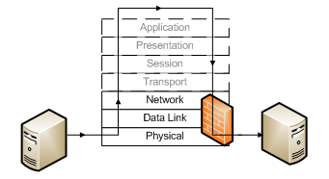
Packet Filtering Firewall
Inspect headers of individual packets at layer 3 (and a bit of 4)
  Source and destination IP address
  Protocol ID/type (TCP, UDP, ICMP, routing protocols, and so on)
  Source and destination port numbers (TCP or UDP application type)
Inbound, outbound, or both
Rule-based Access Control (ACL)

Slide 5
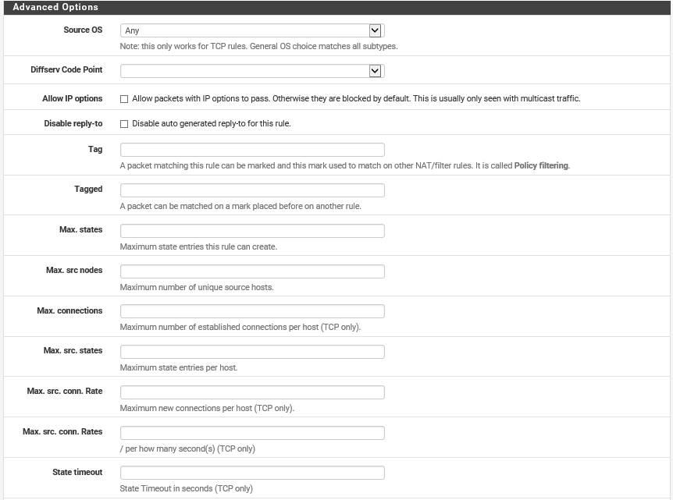
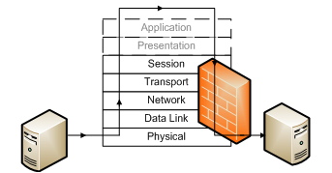
Stateful Inspection Firewall
Stateful inspection (context-aware)
  Can examine TCP headers
  State table
  (Can also apply packet filtering rules)
Better protection against DoS (flood guard)

Slide 6
NGFW/Layer 7 Firewalls
“Stateful Multilayer Inspection” or “Deep Packet Inspection”
Can examine packet payload and monitor connections (stateful)
Requires filter for each application type

Slide 7
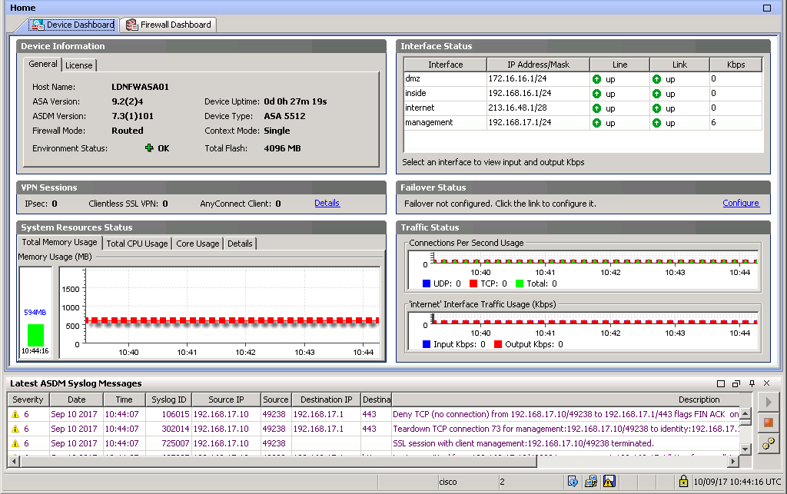
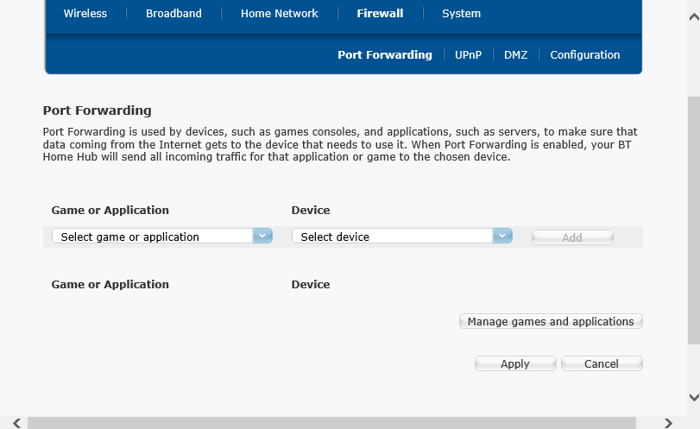
Deploying a Firewall (1)
Network firewalls
Deployed to protect a network segment
Appliance firewall
Router firewall
L3 Switch
SOHO router firewall
NOS firewall

Slide 8
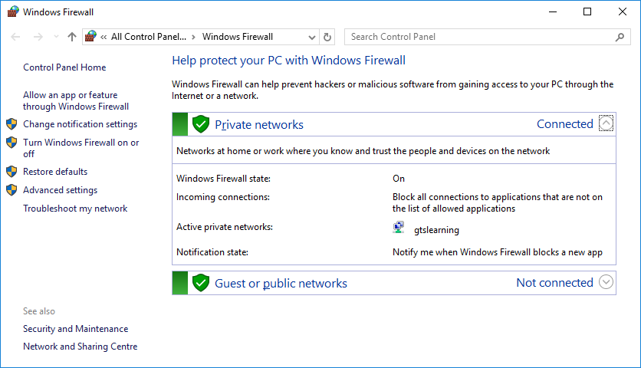
Deploying a Firewall (2)
Application firewall
Personal firewall (host-based)
  Protects single host
  Windows Firewall
  Can perform packet filtering and control which processes can use the network interface
  Vulnerable to tampering
Used with permission from Microsoft

Slide 9
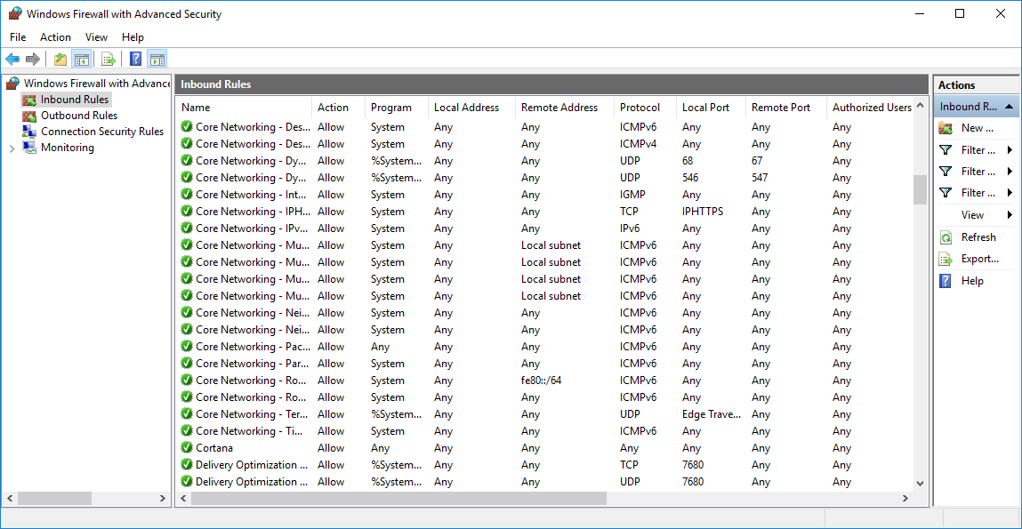
Configuring a Firewall
Least access
Rules processed top-to-bottom (most specific first)
Each rule either blocks or allows according to parameters (tuples)
  Outbound traffic
  Inbound traffic
Last rule blocks all other traffic (implicit deny)
Used with permission from Microsoft

Slide 10
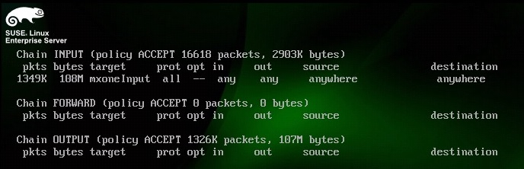
iptables
Firewall chains (direction or type of traffic)
  INPUT
  OUTPUT
  FORWARD
Ruleset applied to each chain to accept or drop traffic matching IP address or port number (or other criteria)

Slide 11
Troubleshooting Firewalls/ACLs
Authorized application blocked
  Blocked TCP or UDP port
  Blocked IP address or network
  Test from inside and outside firewall
  Inspect firewall log
Unauthorized application not blocked

Slide 12
Proxies and Gateways
A router-type firewall forwards or blocks only
Proxies store and forward
  Breaks end-to-end connection between hosts
  Proxy opens the connection with the server on behalf of the client (or vice versa)
  Most stateful firewalls are implemented as proxies
  Most can also cache and pre-fetch content to improve performance
Non-transparent and transparent proxies

Slide 13
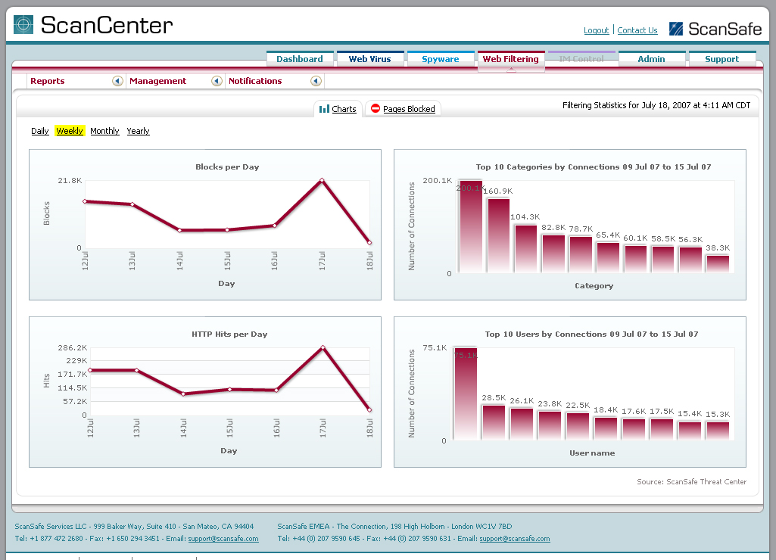
Internet Content Filters
Keyword/URL based filtering
Time-of-day/total usage restrictions
Personal software or Internet gateway/proxy
SSL inspection

Slide 14
Reverse Proxy Servers
Handles protocol-specific inbound traffic
“Publishes” LAN server to network perimeter
Offload processing and cache content

Slide 15
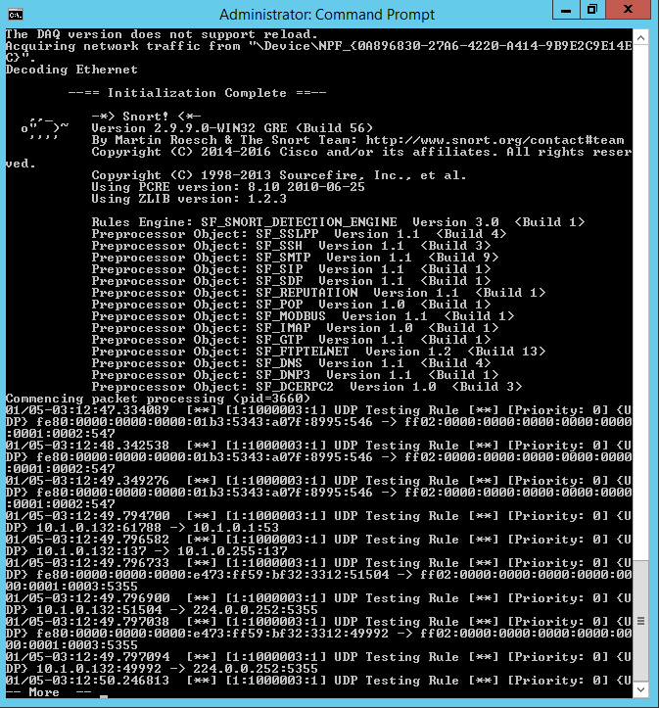
Intrusion Detection Systems
Real-time analysis of network traffic
Network IDS (NIDS)
  Sensor inside firewall
  Spanned port on switch
  Passive detection
  Limited prevention

Slide 16
Network-based IPS
Unified Threat Management
  Intrusion detection/prevention
  Malware scanning
  Firewall
  Traffic filtering
Intrusion Detection and Prevention Systems (IDP/IPS)
  Throttle bandwidth
  Reconfigure firewall
  Rewrite packets

Slide 17
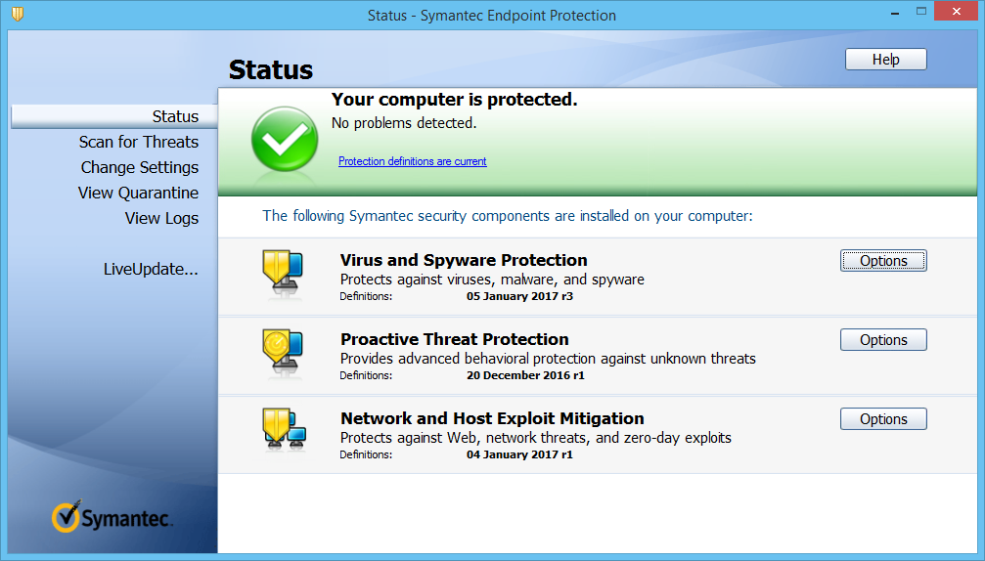
Host-based IDS (HIDS)
Monitor log files, system integrity, network interfaces, and process launches
Agent software running on a host
Management and alerting channel

Slide 18
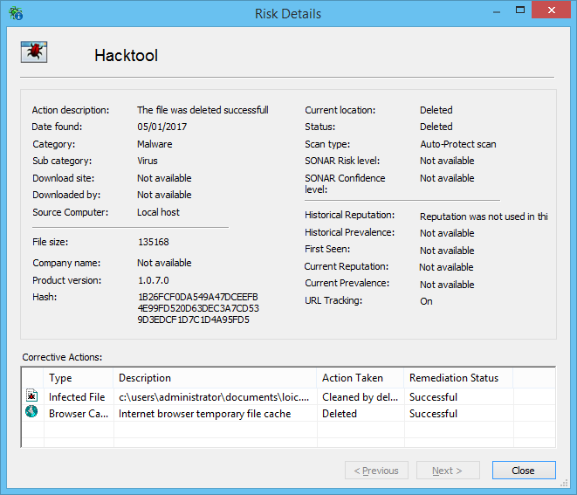
Signature Management
Signature-based
  Must be updated with latest definitions
  Many attacks do not conform to specific signatures
Behavior-based (statistical/profile)
  Train sensor to recognize baseline “normal” behavior
  Heuristics (learning from experience)
  Statistical model of behavior
  Tuning period
  High error rates
File Integrity Monitoring (FIM)

Slide 19
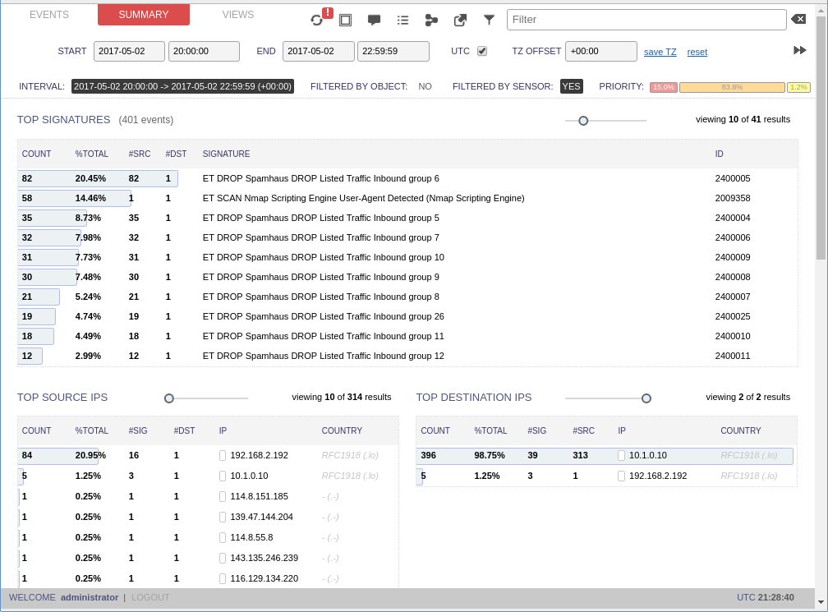
Denial of Service (1)
Any attack that causes a service to become unavailable to users
  Reconfigure a service
  Crash a server
  Cut power/network link
May be purely destructive or may allow attacker to spoof the legitimate service
Distributed Denial of Service
  Use malware installed on a botnet to overload a server with malicious requests
  Coordinated attack

Slide 20
Denial of Service (2)
Distributed Reflection DoS (DRDoS)
Amplified SYN flood
  Spoof victim's IP address and attempt to open connections with multiple servers
  Those servers direct their SYN/ACK responses to the victim
Smurf
  Ping amplifying network using victim IP
Bogus DNS/NTP queries
  Direct responses at victim
  Queries can be constructed to generate large response packets

Slide 21
Firewalls can operate at a number of layers, from simple packet filtering, through session control, to deep packet inspection (application). They can be implemented as appliances or software and deployed to protect network segments or individual hosts or applications.
Make sure you know the basic ways to use the iptables command.
IDS/IPS/UTM can monitor hosts and networks for known attack signatures or heuristic anomaly detection.
You should be able to distinguish types of DDoS attack.
Notes:
What parameters can a layer 3 firewall ruleset use? IP source and destination address, protocol type, and port number.
What is the default rule on a firewall? Deny anything not permitted by the preceding rules.
What OSI layer does an NGFW work at and why? OSI layer 7 (application) because the Next Generation FireWall (NGFW) is configured with application-specific filters that can parse the contents of protocols such as HTTP, SMTP, or FTP.
What type of software would you use to protect a web server against application-level attacks? Host-based or application-based firewall/intrusion protection system.
Using iptables, in which chain would you create rules to block all outgoing traffic not meeting certain exceptions? OUTPUT chain.
You are troubleshooting a connectivity problem with a network application server. Certain clients cannot connect to the service port. How could you rule out a network or remote client host firewall as the cause of the problem? Connect to or scan the service port from the same segment with no host firewall running.
Other than attempting to block access to sites based on content, what other security options might be offered by internet content filters? Blocking access based on time of day or total usage.
Why would you deploy a reverse proxy? To publish a web application without exposing the servers on the internal network to the Internet.
What sort of maintenance must be performed on signature-based monitoring software? Definition/signature updates.
Why are most network DoS attacks distributed? Most attacks depend on overwhelming the victim. This typically requires a large number of hosts.

Slide 22
Lab 12 / Configuring a NAT Firewall
Notes:
Note that there are three sets of labs available to use with this course:
Classroom labs that you set up and run yourself (refer to the separate "Labs" book and setup guide on the instructor resource support site).
Learn On Demand (LOD) hosted classroom labs accessed via a browser but following the same general sequence and steps as the classroom lab book.
Self-study Online Labs from Practice Labs accessed by students online - these labs are intended for use by students studying independently and are different from the classroom and hosted classroom labs. If you are using Practice Labs online labs in the classroom, you must specify this at the time of purchase so that the appropriate bandwidth is provisioned in advance. Please ensure that the student PCs meet the requirements for accessing the Self-study Online Labs series. You can obtain a setup guide at gtsgo.to/nf1rc
The sequence of classroom and hosted classroom labs is shown on this slide and in the margins of your instructor edition and in the course timetable. You should guide the students to complete each lab.
If you are not using the classroom or LOD hosted classroom labs you should delete this slide.

