Slide 1
CompTIA Network+ Certification
5.1 Network Site Management

Slide 2
Summarize elements of structured cabling, such as cabling, distribution frames, patch panels, and wall outlets
Understand the role of configuration management policies, procedures, and documentation in network administration
Describe the use of physical security controls in planning and implementing site security
Understand the use of business continuity, disaster recovery, and IT contingency plans to provide fault tolerance and high availability
Summarize network and power redundancy solutions and understand the use of data backups to support availability
Notes:
The number in the bottom right corner of the slides refers back to the page where this topic starts in the course book.

Slide 3
Wiring Standards
ANSI/TIA/EIA 568
  American National Standards Institute (ANSI)
  Telecommunications Industry Association (TIA)
  Electronic Industries Alliance (EIA)
Return on Investment - build infrastructure that will serve for 10-15 years
Legal regulations
  Building codes
  Electrical safety
  Fire safety
  Federal Communications Commission (FCC) regulations

Slide 4
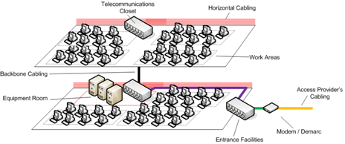
Structured Cabling System
Horizontal cabling - connects work areas to horizontal cross-connect
Backbone cabling - connects horizontal cross-connects
Work area - network/telephony ports
Telecommunications/equipment room - secure, climate controlled space for network equipment
Entrance facilities/demarc
Administration

Slide 5
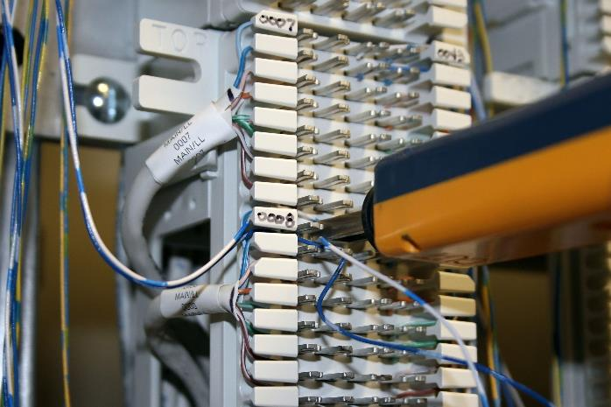
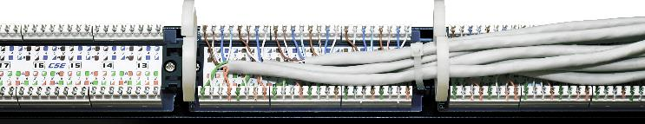
Distribution Frames
Main Distribution Frame (MDF)
Intermediate Distribution Frame (IDF)
Punch down blocks
  66 block
  110 block
Image by Gregg Williams © 123rf.com
Image by plus69 © 123rf.com

Slide 6
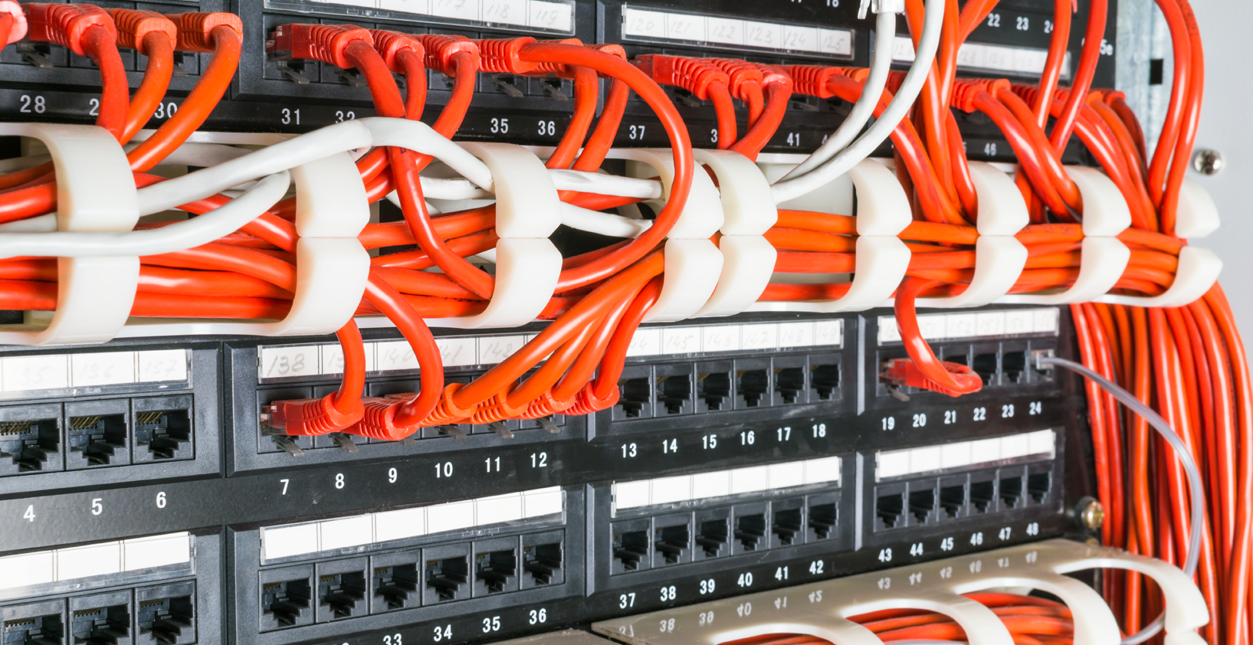

Patch and Fiber Distribution Panels
Image by Svetlana Kurochkina © 123rf.com
Cross-connect with modular jacks on one side
Use prefabricated patch cords to make interconnects
  More reliable
  Less chance of damaging difficult to replace cabling
RJ-45 version for copper
Fiber versions
Image by Aleh Datskevich © 123rf.com

Slide 7
Configuration Management (1)
ITIL (IT Infrastructure Library) configuration management model
  Service asset
  Configuration Item (CI)
  Configuration Management Database (CMDB)
  Baseline
    Configuration
    Performance
Configuration Management System (CMS)

Slide 8
Configuration Management (2)
Change management documentation
  Reactive or proactive (reasons)
  Potential impact
  Request For Change (RFC)
  Notification/approval (Change Advisory Board)
Implementing configuration procedures
  Moves, Adds, Changes (MAC) and job logs
  Standard Operating Procedures (SOP) and work instructions
Implementing change
  Rollback procedures
  Maintenance window
  Documentation/review

Slide 9
Inventory Management
Network documentation (TIA 606 “administration” requirement)
Inventory
  Network appliance
  Servers and workstations
  Passive network infrastructure
Asset identification and tracking
  Asset labels and database
  Radio Frequency ID (RFID) tags
Vendor documentation

Slide 10
Network Diagrams
Relationships between network elements
Physical versus logical topology
Blueprints
  Wiring/port locations in IDF/MDF
  WAN circuits
Wiring diagrams

Slide 11
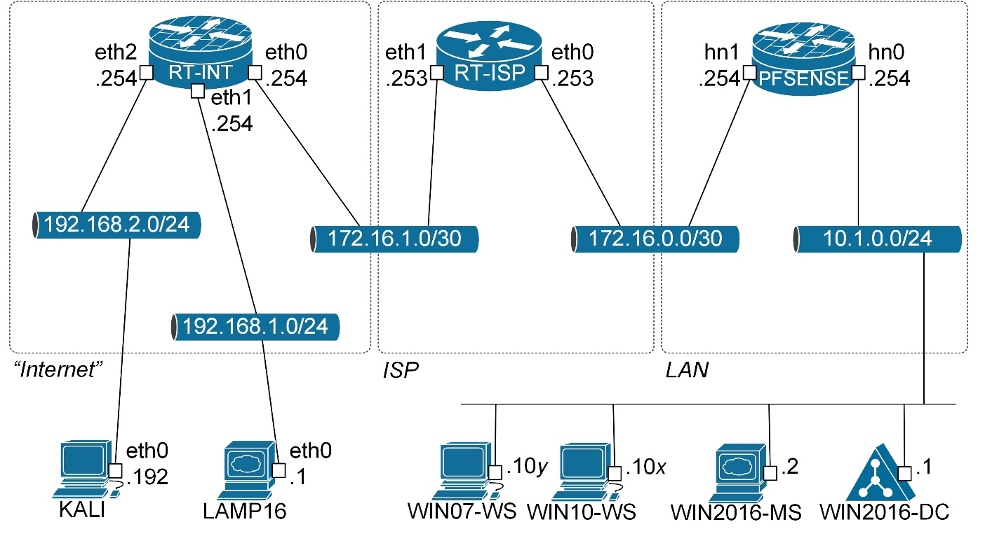
Schematic/Block Diagrams
Simplified network layout (physical or logical)
Use separate diagrams at each OSI layer
  PHY (Physical layer) - asset IDs and cable links
  Data-link (layer 2) - interconnections between switches and routers, with asset IDs, interface IDs, and link-layer protocol and bandwidth
  Logical (IP/layer 3) - IP addresses of router interfaces (plus any other static IP assignments) and firewalls plus links showing the IP network ID and netmask, VLAN ID, and DHCP scopes
  Application - server instances and TCP/UDP ports in use

Slide 12
Network Diagram Symbols
Images © and Courtesy of Cisco Systems, Inc. Unauthorized use not permitted

Slide 13
Rack Diagrams
Racks are secure, dense storage systems for servers and network appliances
Standard 19” width
Variable heights measured in 1.75” U units
Rack diagrams
  Position of appliances
  Label network and power ports
  Configuration and asset information

Slide 14
Labeling
TIA/EIA 606 Administration Standard
Naming conventions
  Location and ID of data port
  Identify circuit with labels at both ends of cable
  Network appliances and servers
Cable color coding

Slide 15
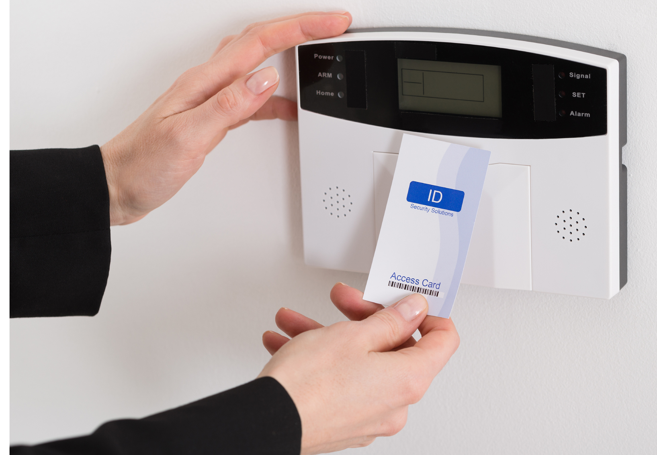
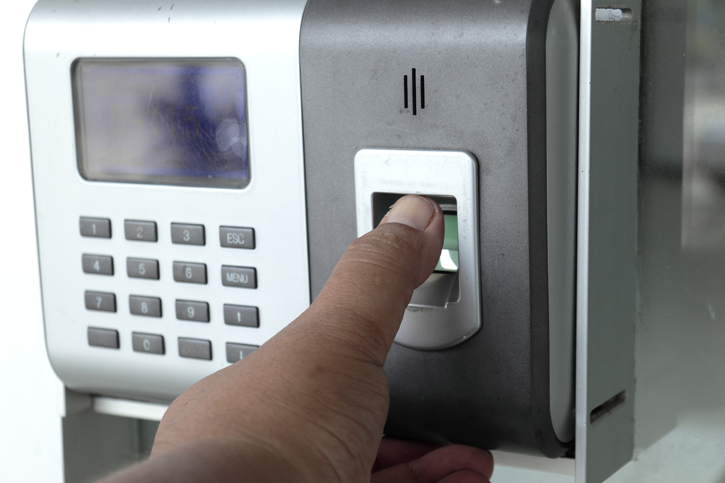
Physical Security Devices
Badges and smart cards
  Identification badge
  Smart card ID – authentication information stored on chip
  Contact or contactless
Door access controls
  Conventional and deadbolt locks
  Electronic (keypad/cipher) lock
  Token-based (proximity readers/key fob) locks
  Biometric lock
Image by Andriy Popov © 123rf.com
Image by Narinthon Phaiboonsombat © 123rf.com

Slide 16

Detection and Alarms
Surveillance
Video monitoring
  Camera types and controls
  CCTV (Closed Circuit Television)
  IP cameras (PoE)
Alarms
  Circuit
  Motion detection
  Duress
Tamper detection and protected distribution
Asset tags/RFID
Image by Dario Lo Presti © 123rf.com

Slide 17
Business Continuity
Continuity of Operations (COOP)/Business Continuity Planning (BCP)
Contrast with Disaster Recovery Plans (DRP)
Identify the critical functions or processes of the business or organization
Identify the assets and resources on which the organization depends
Identify threats to the organization's functions and assets
Assess the risk to each function or asset, given the threats

Slide 18
IT Contingency Planning
Eliminate single points of failure
  Critical nodes
  Critical assets
High availability
Fault tolerance
Redundancy (spares)
Resilience versus reliability

Slide 19
Failover and Alternate Processing Sites
Redundancy on system/component level
  Network links, building power
  Spare systems and components
Redundancy on site level (failover)
  Hot site – bring online straightaway
  Warm site – less available than a hot site
  Cold site – means a longer period of downtime
Provisioning options

Slide 20
Disaster Recovery Planning
Identify scenarios
  Risk and cost assessment
  Threat modeling
Identify tasks, resources, and responsibilities for response
Train staff in disaster recovery and change management

Slide 21
SLA and KPI
Service Level Agreement (SLA)
  Legal contract of service items and standards
  Commitments to restrict downtime to an agreed duration per cycle
Key Performance Indicators (KPI)
  Metrics to measure SLA performance (or resiliency generally)
  Response time
  Mean Time to Failure (MTTF)/Mean Time Between Failures (MTBF)
  Mean Time to Repair (MTTR)
  Mean Time Between Service Incidents (MTBSI)

Slide 22
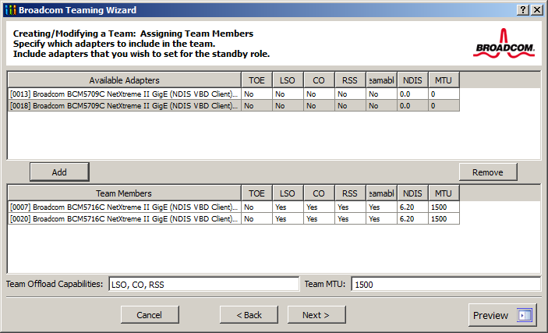
Network Link Management (1)
Port bonding/adapter teaming
  Aggregate two or more ports to a single link
  Combine bandwidth (4 x 1 Gbps ports = 4 Gbps link
  Redundancy and failover
Link Aggregation Control Protocol (LACP)

Slide 23
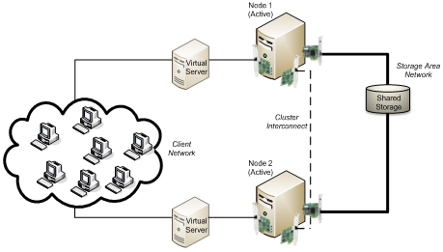
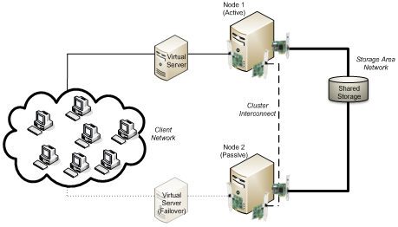
Network Link Management (2)
Load balancing
Clustering
Provides stateful fault tolerance
Configured on back-end servers with shared data access
Configure nodes for failover
  Active/Active
  Active/Passive

Slide 24
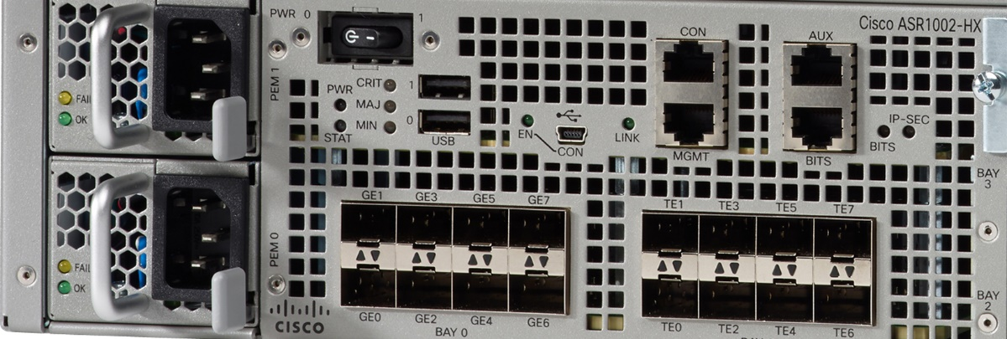
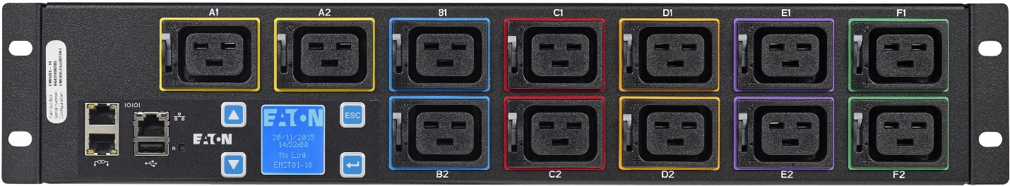
Power Management (1)
Dual power supply/hot plug power supply
Power Distribution Unit (PDU)
  Power circuit (high amp for data centers/equipment rooms)
  PDUs provide line filtering
  Monitoring functions
Redundant power circuits
Images © and Courtesy of Cisco Systems, Inc. Unauthorized use not permitted

Slide 25
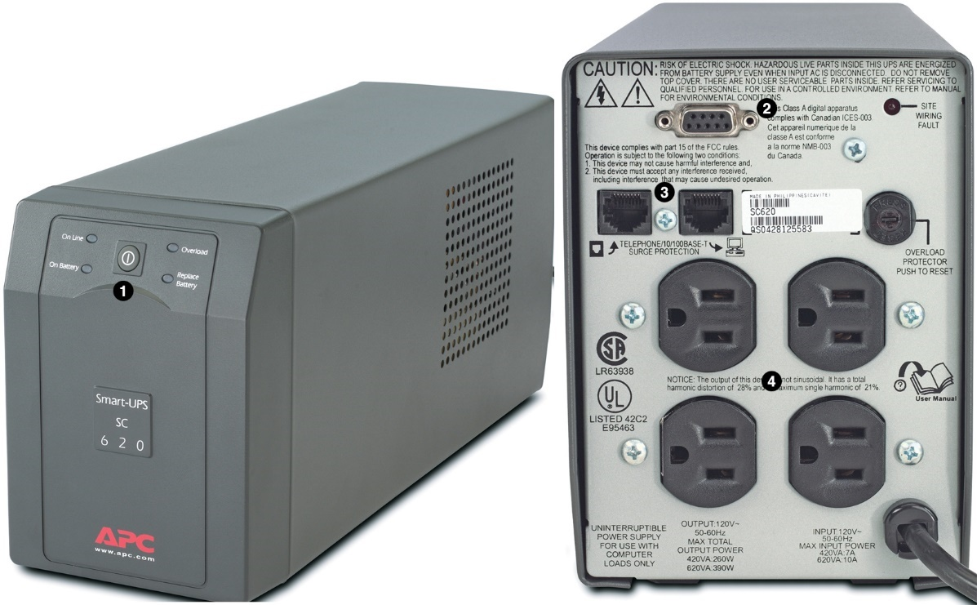
Power Management (2)
Battery-backed cache
Uninterruptible Power Supply (UPS)
  Inverter converts DC battery power to AC
  Provides failover to allow standby generator to activate
Backup power generator
Images © and Courtesy of Schneider Electric

Slide 26
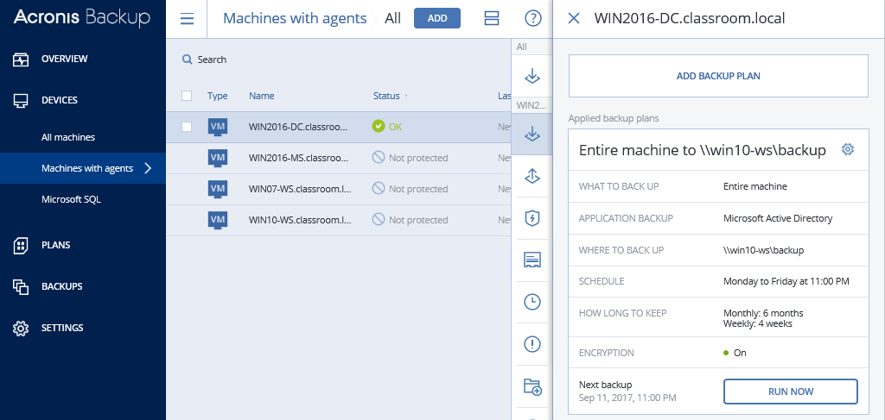
Backup Management
Retention policy
  Short-term copies for version rollback
  Long-term retention
Recovery window
Recovery Point Objective (RPO)

Slide 27
Backup Types

Slide 28
Snapshots
File system-maintained copy of data
Used by backups to avoid file locking issues
NTFS, ZFS, various Linux distributions
Virtual machine snapshots

Slide 29
Wiring standards provide a framework for installing network infrastructure that will provide ROI over 10-15 years.
Structured cabling uses main and horizontal cross-connects with backbone and work area cabling wired in a hierarchical star. Cross-connects (distribution frames) come in various formats with 110 block patch panels being the most popular for LANs.
Configuration and change management ensures that network installation and maintenance is well-planned and documented. Up-to-date schematics and logical network diagrams are essential parts of a well-administered network.
Physical security means controlling access to premises and ensuring a safe and stable operating environment for computer and network systems. Sites can be protected through gateways, locks, and alarms and through surveillance methods, such as CCTV.
Business continuity planning, disaster recovery planning, and IT contingency planning, reduce risk by making systems fault tolerant and resilient.
Effective backup procedures are essential for protecting business data.
Notes:
What would be a typical use of an IDF? To cross-connect backbone cabling in a multi-building (campus) network. The Intermediate Distribution Frame introduces a hierarchy of cable organization between the Main Distribution Frame and horizontal cross-connects.
What is a 110 block? A particular type of Insulation Displacement Connector (IDC) used to terminate solid cabling at the back of a wall port or patch panel.
What types of baseline are useful when performing configuration management? A configuration baseline records the initial setup of software or appliance. A performance baseline records the initial throughput or general performance of a network (or part of a network). These baselines allow changes in the future to be evaluated.
In terms of day-to-day tasks, what demonstrates that effective configuration management procedures are in place? Job logs and Standard Operating Procedures (SOPs) to control and document configuration and troubleshooting work.
What is the difference between physical and logical schematics? A logical schematic shows the topology of the network in abstract (such as IP networks); a physical schematic shows the locations of components and their IDs.
You are analyzing a network schematic and notice the following icon <img border=0 width=49 height=33 src='http://launcher.gtslearning-courses.net/images/g525eng/exhibits/n10-5u5q5.jpg'>. What does it represent? A router.
True or false? Rack units are sold in models of varying width. False - 19" width is standard while the height varies in "U" units of 1.75".
You are working at a telecommunications point and notice that the cables in one patch panel are all red while the ones in another are all blue. What, if anything, does this represent? The TIA 606 Administration standard recommends the use of red color-coding for telephone links and blue for data links to the work area (horizontal cabling).
What type of door access control would allow entry based on the possession of a cryptographic smart card? Proximity reader.
What technology could be used to provision security cameras without having to provide a separate circuit for electrical power? IP cameras could be powered over data cabling using Power over Ethernet (PoE).
What type of security control provisions resources and procedures to cope with major incidents? A Disaster Recovery Plan (DRP).
What is MTBF and why is it associated with a "bathtub curve"? Mean Time Between Failures - the bathtub curve is a plot of instances of failure over time and tends towards a "bathtub" shape because failures are more likely early or late in the service life of an appliance than in the middle.
A server is equipped with 4 Ethernet interfaces and you want to aggregate them to a single interface. What feature must the switch support? Port bonding/Link Aggregation Control Protocol (LACP [IEEE 802.3ad/802.1ax]).
What technologies can be used to make network infrastructure fault tolerant? Redundancy and failover needs to be provided at all levels: power, cabling/adapter teaming, switching, routing, and name services/addressing. Cluster services and load balancers can be deployed to make application and database servers fault tolerant.
What rack-mountable device can provide line filtering and power monitoring features? A Power Distribution Unit (PDU).

Slide 30
Lab 14 / Network Inventory Management

