Slide 1
CompTIA Network+ Certification
5.4 Installing WAN Links

Slide 2
Understand the provision of telecoms networks and the Internet
Identify technologies used to implement WANs and Wireless WANs
Install and configure dial-up and broadband modems/multifunction network devices and components for WAN links
Summarize technologies that provide IoT connectivity
Notes:
The number in the bottom right corner of the slides refers back to the page where this topic starts in the course book.

Slide 3
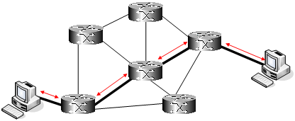
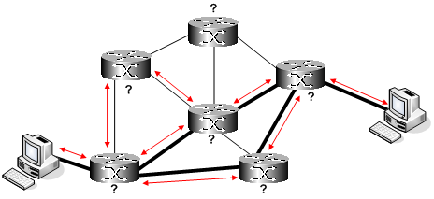
Wide Area Networks (WAN)
Public networks
Enterprise WAN
Circuit switched
Packet switched
  Connectionless
  Connection-oriented

Slide 4
WAN Topologies
Point-to-point
Mesh
Hub and spoke

Slide 5
Telecommunications Networks

Slide 6
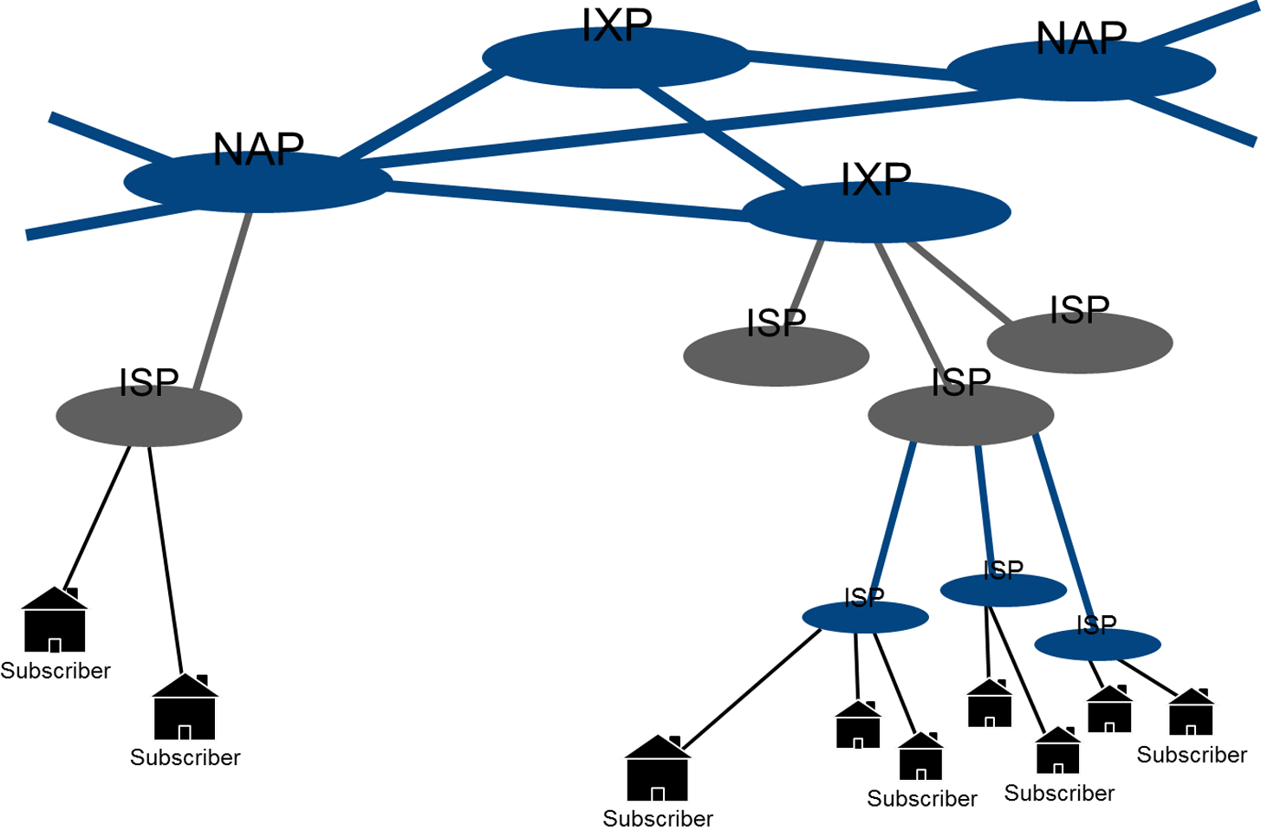
The Internet

Slide 7
PDH/T-carrier
Plesiochronous Digital Hierarchy (PDH)
Time Division Multiplexing (TDM)
DS0/narrowband circuits (64 Kbps)
DS1/T1/wideband (1.544 Mbps)
E1 (2.048 Mbps)
T3 and E3

Slide 8
SDH/SONET
Synchronous Digital Hierarchy (SDH)
Synchronous Optical Network (SONET)
Optical Carrier (OCx)
  OC-3
  OC-12
Mesh or ring topology
Add/Drop Multiplexers

Slide 9
10GbE WAN PHY and Metro Ethernet
Ethernet over SONET
  10GbE WAN PHY
  10GBASE-SW/LW/EW
Metro Ethernet
  Using Ethernet to connect to an access provider’s network
  Access provider can provision different service levels

Slide 10
Dial-up
Analog link established by modems
33.3 Kbps (56 Kbps downlink with some ISPs)

Slide 11
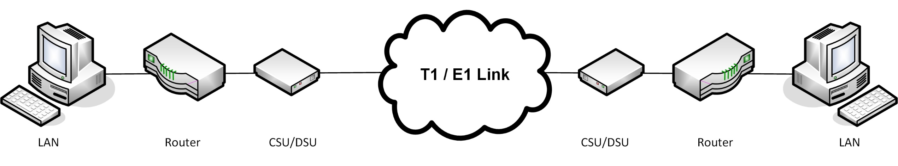
Dedicated/Leased Line
Permanent circuit over digital line
Termination provided by a Channel Service Unit/Data Service Unit (CSU/DSU)
T-carrier/E-carrier/Fractional

Slide 12
ISDN (Integrated Services Digital Network)
Digital line billed for by line rental and usage
BRI (2x64 Kbps + 16 Kbps)
PRI (T1/E1 equivalent)

Slide 13
DSL (Digital Subscriber Line)
“Broadband” over existing telephone cabling
SDSL (Symmetrical DSL)
ADSL (Asymmetrical DSL)
  Asymmetric service (uplink up to 1 Mbps while downlink can be up to 24 Mbps)
VDSL (Very High Bitrate DSL)
  Up to 100 Mbps at short range (100m/300ft)
  Used with Fiber to the Curb (FTTC)

Slide 14
HFC and FTTx
Broadband cable/HFC (Hybrid Fiber Coax)
  Data Over Cable Service Interface Specification (DOCSIS)
  38 Mbps (US) or 50 Mbps (Europe)
FTTx (Fiber to the Premises/Home/Curb/Node)

Slide 15
Installing Remote Access Links
Access provider network
Demarc
Customer Premises Equipment (CPE)
Demarc extension/Minimum Point of Entry
Installing leased lines
  Channel Service Unit/Data Service Unit (CSU/DSU) – normally a WAN interface plug-in card for a router
  Smart Jack/Network Interface Unit
  Line drivers/repeaters

Slide 16
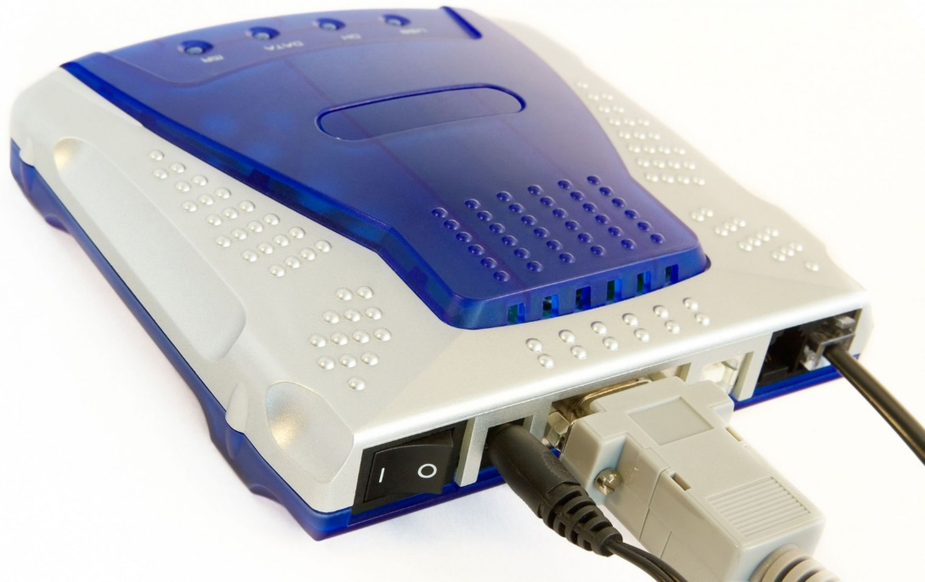
Installing Modems
Analog modem
  Internal or external (USB or serial) device
  RJ-11 port to connect to phone point
ISDN adapter
  Terminal Adapter (TA)
  Network Terminator (NT1)
  Terminal Equipment
Image by OlgaLIS © 123rf.com

Slide 17
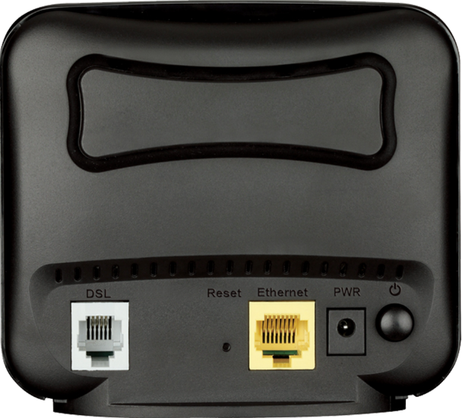
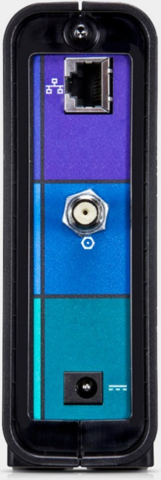
DSL and Cable Modems
DSL modem
  Adapter or multifunction SOHO “DSL router”
  RJ-11 to phone point
  Microfilter on all phone points
Cable modem
  Ethernet or USB to PC
  Coax to access provider’s network
Image © D-Link Corporation/D-Link Systems, Inc
Image © ARRIS Enterprises, Inc.

Slide 18
Wireless WAN Services (1)
2G cellular radio
  Global System for Mobile Communication (GSM)
    Initially used Time Division Multiple Access (TDMA)
    Subscriber Identity Module (SIM) allows number portability between handsets
  Code Division Multiple Access (CDMA)/IS-95
  Circuit Switched Data (CSD)
3G packet radio for cellular networks
  GPRS/EDGE (General Packet Radio Services/Enhanced Data Rates for GSM Evolution) for 2.5G on GSM
  Universal Mobile Telecommunications System (UMTS)/Evolved High Speed Packet Access (HSPA+) for 3G on GSM networks (now using a form of CDMA)
  CDMA2000 Evolution Data Optimized (EV-DO) for 3G on CDMA networks

Slide 19
Wireless WAN Services (2)
Long Term Evolution (LTE) for 4G
  Convergence between the GSM and “CDMA” camps – uses Orthogonal Frequency Division Multiple Access (OFDMA)
  150 Mbps downlink (nominally)
  20 Mbps more typical of actual conditions
Long Term Evolution (Advanced) (LTE-A)
  300 Mbps downlink (nominally)
  40 Mbps more typical of actual conditions
Microwave satellite

Slide 20
Internet of Things (1)
Global network of personal devices, home appliances, home control systems, vehicles, etc equipped with sensors, software, and network connectivity
Machine to Machine (M2M)
Requires low power communications
Security issues
802.11 Wi-Fi direct and tethering
Low power 802.11 versions
  IEEE 802.11ah (HaLow) – sub 1 GHz
  IEEE 802.11af (White-Fi) – 700 MHz and below
Bluetooth and Bluetooth Low Energy (LE) - 2.4 GHz
ANT+ - 2.4 GHz
Z-Wave – sub 1 GHz
ZigBee - 2.4 GHz

Slide 21
Internet of Things (2)
Radio Frequency ID (RFID)
  Powered or unpowered tags
  Reader activates tag to initiate data transfer
Near Field Communications (NFC)
  “Peer-to-peer” RFID
Infrared (IR)
  IR blaster
  IR sensor

Slide 22
Public WANs make more use of circuit switching technologies than LANs.
Telecoms core infrastructure and the Internet is supported by fiber optic trunk links, mostly using SDH/SONET, WDM, or Metro Ethernet.
T-carrier and E-carrier describe a number of service levels for providing leased or dedicated access lines to subscribers. Other subscriber access technologies include ISDN, DSL, and cable access.
The demarc represents the end of an access provider's cabling. WAN links can be implemented using a number of devices, from CSU/DSUs for leased lines, though dial-up modems, to DSL/Cable/Satellite adapters and routers.
Wireless WANs are implemented using cellular radio and satellite links.
Notes:
What is the main advantage of circuit switched networks? They can provide a guaranteed level of bandwidth.
What is an Internet Exchange Point? A data center and network access point where several ISPs interconnect their networks to save costs.
What bandwidth are T1 and E1 links and why are they different? T1s are 1.544 Mbps and E1s are 2.048 Mbps; E-carrier uses 30 channels compared to T-carrier's 24.
Which 10GbE Ethernet and SONET standards are interoperable? The 10GbE WAN PHY (10GBASE-SW, -LW, and -EW) are interoperable with OC-192.
What is the upper limit of a dialup modem's connection speed? 56 Kbps for the downlink and 33.3 Kbps for the uplink. A 48 Kbps uplink is possible with V.92 but only by reducing the downlink rate.
What function does a smart jack serve? A smart jack is a means of terminating a T1 digital leased line. The smart jack typically provides a loopback facility for the access provider to test the line.
Why would you use a T1 extender? If Customer Premises Equipment (CPE) cannot be installed at the minimum point of entry, it may be necessary to extend the T1 leased line to another point in the premises. This can be achieved using an extender or a line driver.
What place does VDSL have in terms of access to public networks? Very High Bitrate DSL (VDSL) supports high data rates over a limited distance. In this respect, it supports Fiber to the Curb (providing the final link from the fiber distribution frame to customer premises).
What standard(s) are intended to support 4G mobile wireless services? Long Term Evolution (LTE) and LTE Advanced (LTE-A).
Assuming that sufficient bandwidth can be provided, what factor limits the usefulness of a microwave satellite internet link? The link will be subject to high latency, which will impact real-time data services.
What type of network topology is used by IoT technologies such as ANT+ and Z-Wave? Mesh topology.
What is a principal requirement of IoT technologies, as demonstrated by the latest version of Bluetooth? Low power consumption.

