Slide 1
CompTIA Network+ Certification
5.5 Configuring Remote Access

Slide 2
Describe the characteristics of WAN services and protocols
Configure a remote access VPN server
Use secure interfaces and file transfer protocols to manage hosts and network devices remotely
Notes:
The number in the bottom right corner of the slides refers back to the page where this topic starts in the course book.

Slide 3
Remote Access Services
Connectivity between different sites
Mobile access to corporate data
Sharing data with customers and suppliers (an extranet)
Remote administration of servers and workstations

Slide 4
Frame Relay
Packet-switched
Connection-oriented circuits
Congestion control/Quality of Service (QoS)

Slide 5
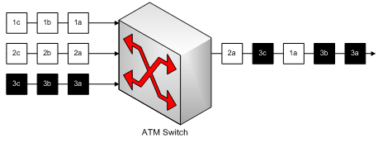
Asynchronous Transfer Mode (ATM)
Fixed-length packet (cell) switched
Traffic shaping and QoS

Slide 6
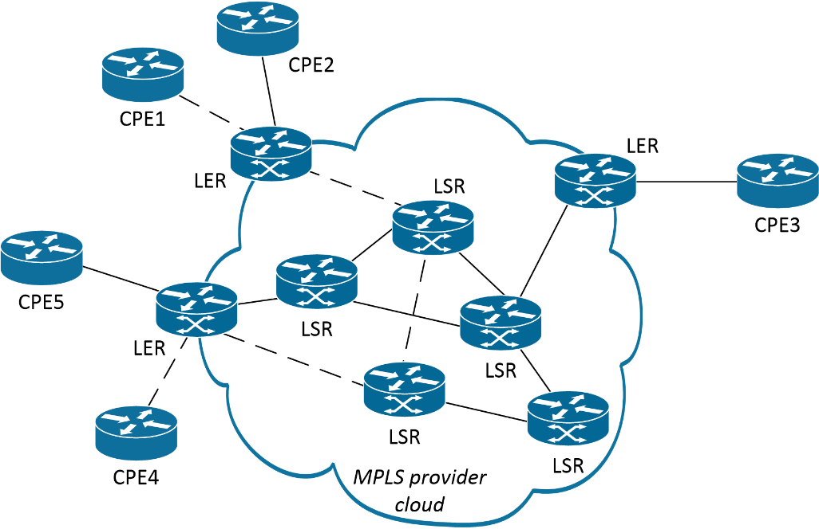
Multiprotocol Label Switching (MPLS)
Traffic integrator
Packet-switched
Packet tagging (label or shim)
Label Edge Routers (LER) on border of MPLS cloud containing Label Switched Routers (LSR)
Label Switched Path (LSP) for packet through the cloud
Constraint-based routing

Slide 7
Point-to-Point Protocol (PPP)
Data link transport for network protocols over WAN links
Used for dial-up/residential Internet access
PPP over Ethernet/ATM (PPPoE/PPPoA)

Slide 8
SIP Trunks
Session Initiation Protocol (SIP) used for VoIP
Provide a low-latency channel for organization’s VoIP/video conferencing traffic
Often provisioned using MPLS
Security issues

Slide 9
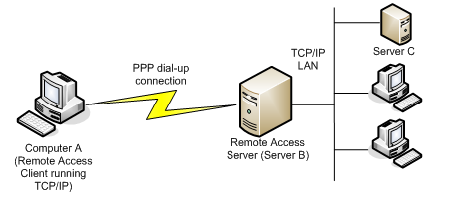
Tunneling/Encapsulation
Establish a host on the same logical network over a connection through a different network

Slide 10
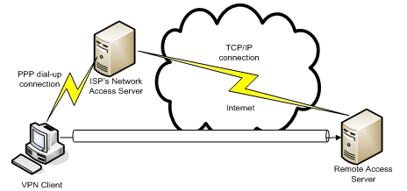
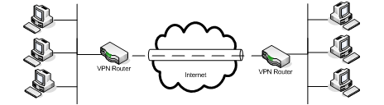
Virtual Private Network (VPN) Topologies
Client-to-site
Site-to-site
Host-to-host

Slide 11
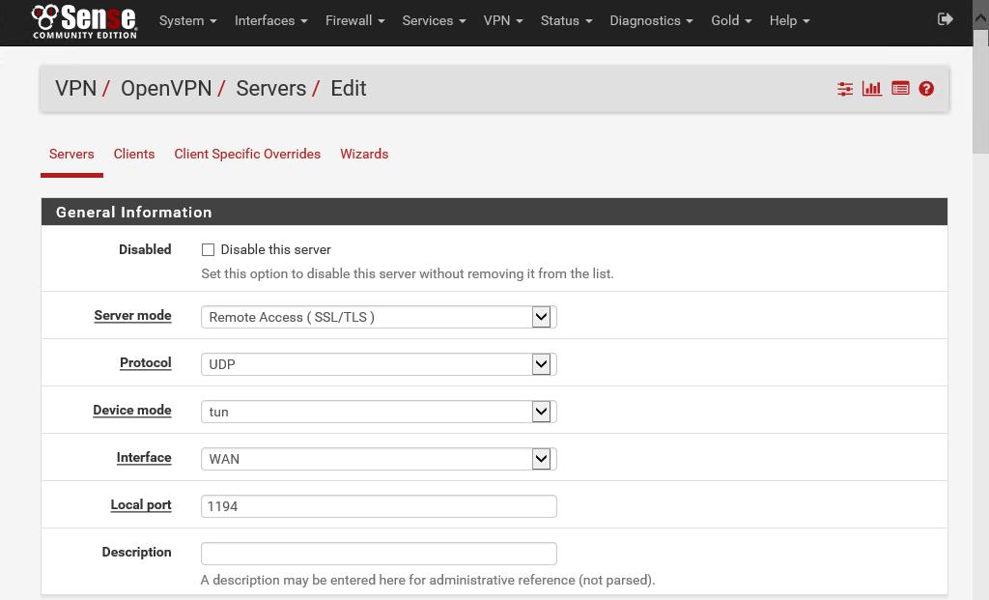
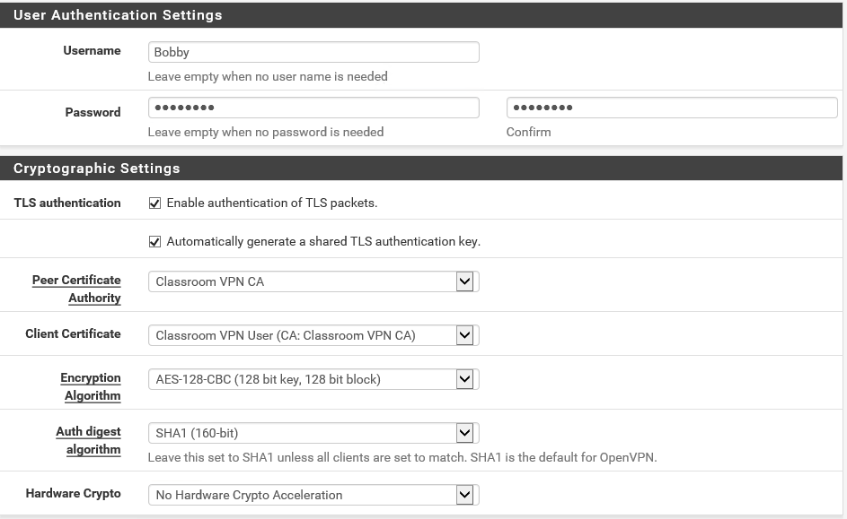
SSL/TLS/DTLS VPN
Use SSL/TLS to authenticate and encrypt tunnel
  Can work over UDP (Datagram TLS [DTLS]) by establishing a control channel to mitigate for UDP’s connectionless, unreliable data transfer
  Multiplexes network traffic over single secured port
  Can work in bridged mode to tunnel Ethernet frames or router mode to tunnel IP packets
Secure Sockets Tunneling Protocol (SSTP)
  Use machine certificates to protect user authentication and session setup

Slide 12
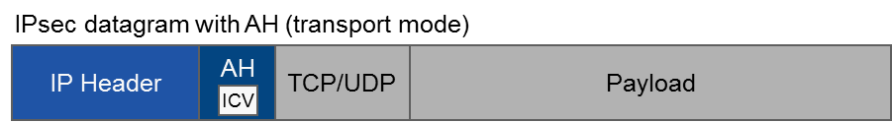
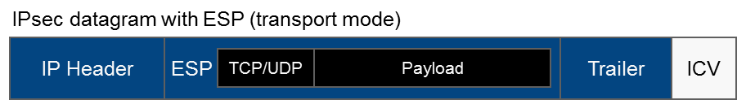
IP Security (IPsec)
Layer 3 encryption protocol suite
IPsec provides confidentiality and/or integrity
Authentication Header (AH) protocol provides authentication/integrity only
Encapsulating Security Payload (ESP) protocol can provide confidentiality and authentication/integrity

Slide 13
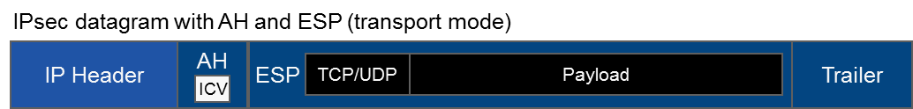
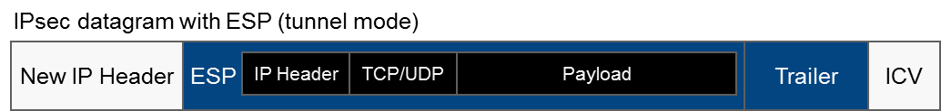
IPsec Transport and Tunnel Modes
Transport mode
  IP header is unencrypted
  Used for end-to-end communication over the same network
  Client to server
Tunnel mode
  Encapsulates encrypted packet within new unencrypted header
  Used when traffic must pass over an intermediate network (VPN)
  Gateway-to-gateway
  Server-to-gateway
  Server-to-server

Slide 14
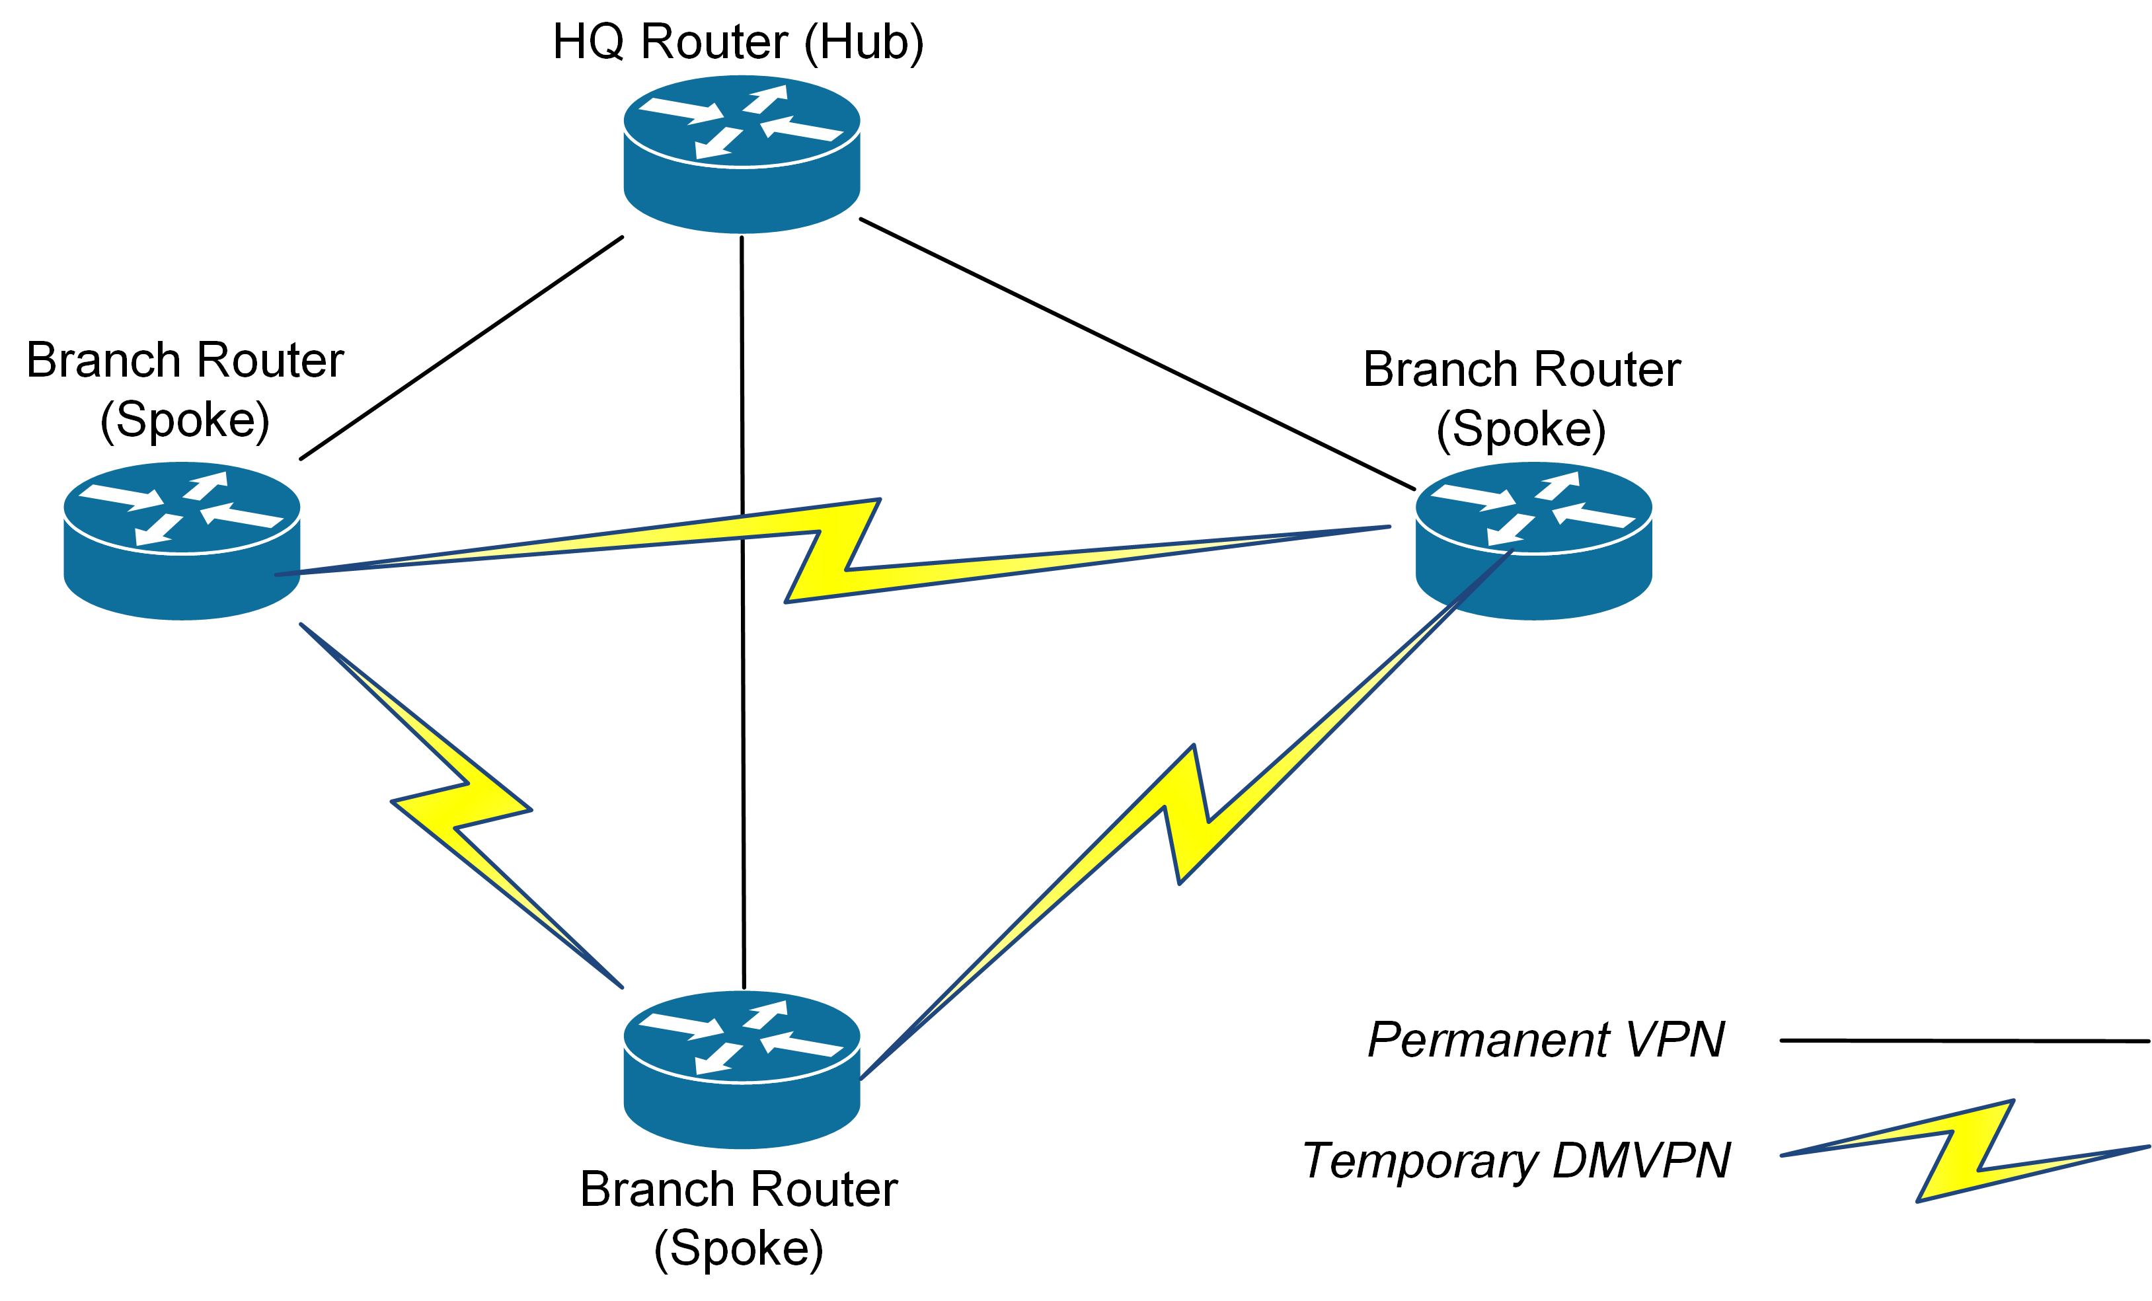
Dynamic Multipoint VPN (DMVPN)

Slide 15
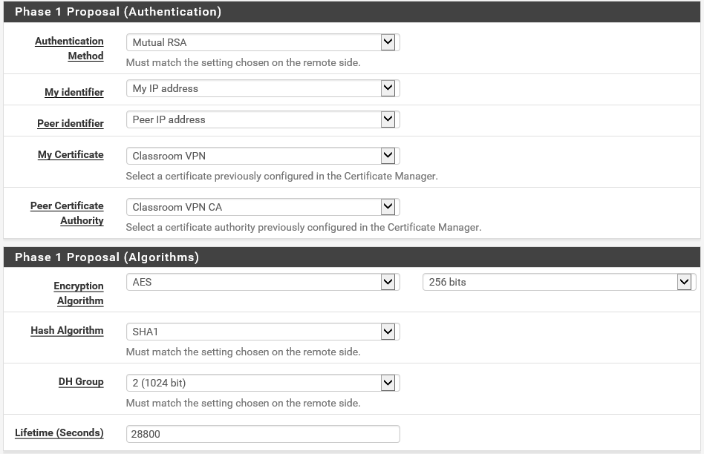
Internet Key Exchange (IKE)
Protocol that establishes IPsec connection parameters and authenticates host
Security Association (SA)
IKEv2 improves usability as a VPN solution

Slide 16
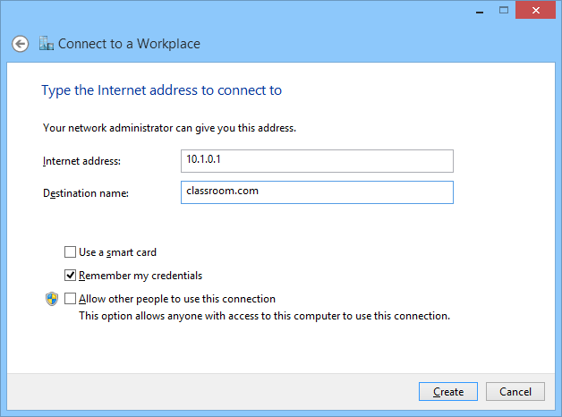
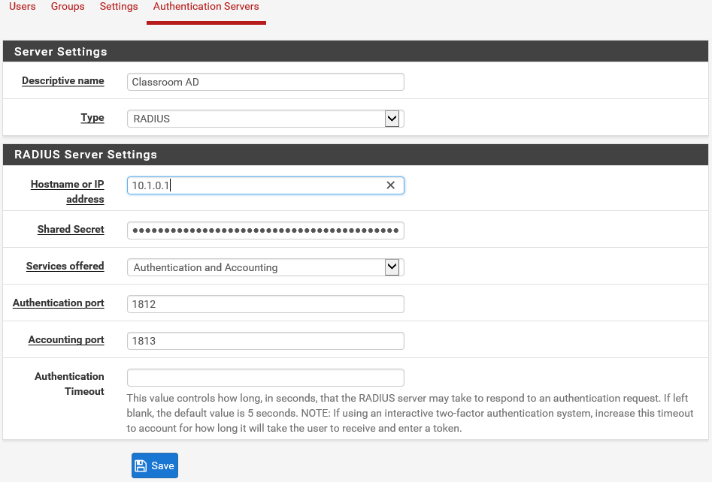
Remote Access Servers
VPN RAS
VPN concentrators

Slide 17
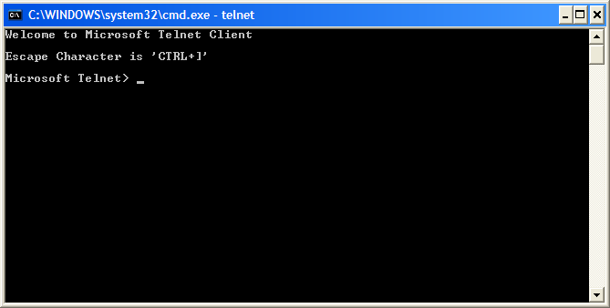
Telnet
Command line terminal emulation
Connect client to remote server (daemon)
TCP port 23
Plaintext protocol – no security

Slide 18
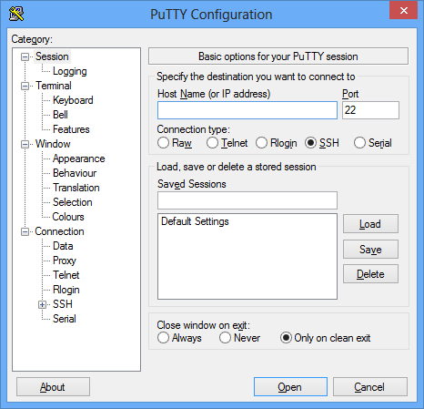
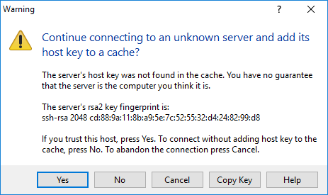
Secure Shell (SSH)
Secure terminal emulation
TCP port 22
Tunnel other traffic over SSH
  Telnet
  SFTP
  Port forwarding
Server authenticated by a host key
Windows Remote Host (WinRM and WinRS)

Slide 19
SSH Client Authentication
User name/password
Kerberos
Host-based authentication
Public key authentication
Ensure secure management of keys used for non-interactive logon

Slide 20
Remote Desktop Protocol and VNC
Remote Desktop Protocol (RDP)
  GUI remote administration for Windows hosts
  TCP port 3389
  Session can be encrypted
  Network Level Authentication prevents abuse of remote sessions
  RDP Restricted Admin (RDPRA) mode/Remote Credential Guard try to abuse of credentials from RDP server
  Range of clients for different PC and mobile operating systems
Virtual Network Computing (VNC)

Slide 21
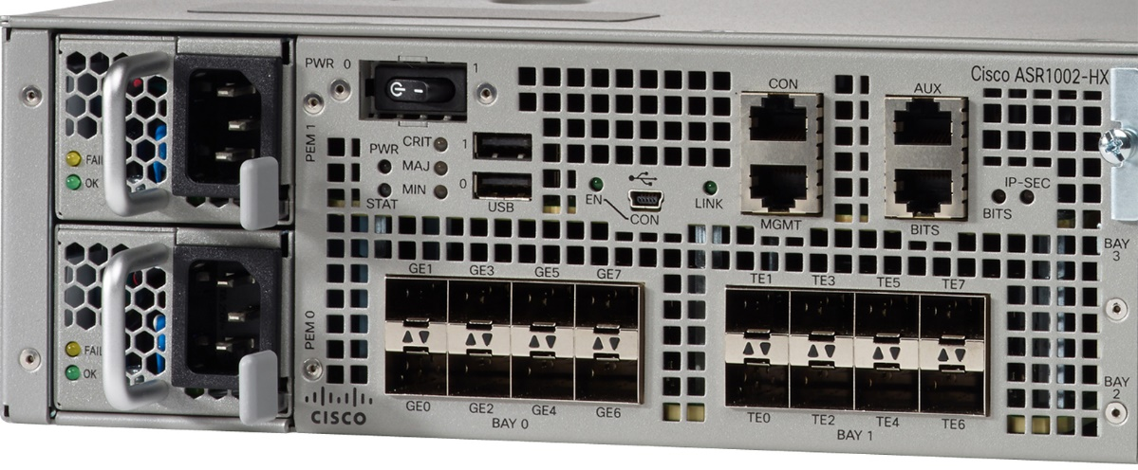
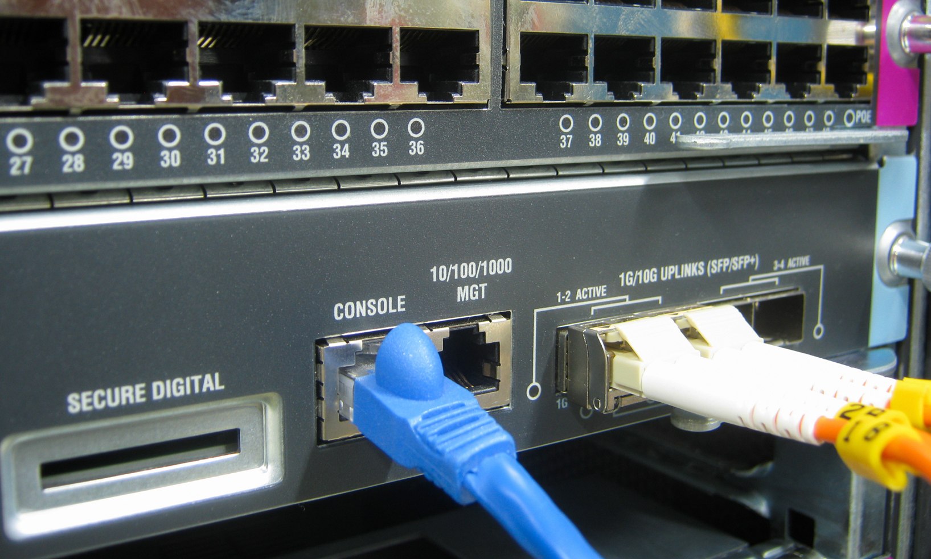
Managing Network Appliances
Image © and Courtesy of Cisco Systems, Inc. Unauthorized use not permitted
Managed vs unmanaged
In-band vs out-of-band
Management interface
  Console port/Command Line Interface (CLI)
  Management port (connect over IP network)
    Web interface using HTTP/HTTPS
    Virtual terminal over Telnet/SSH (CLI)
Console port
Console router
Management URL
Image by Sorapop Udomsri © 123rf.com

Slide 22
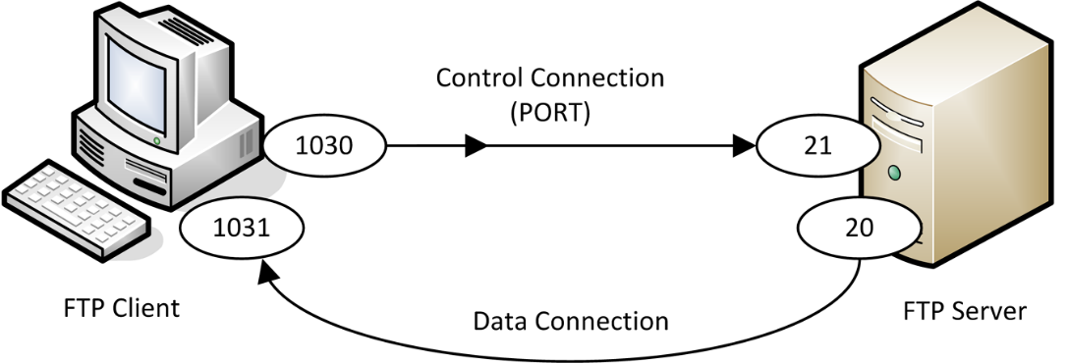
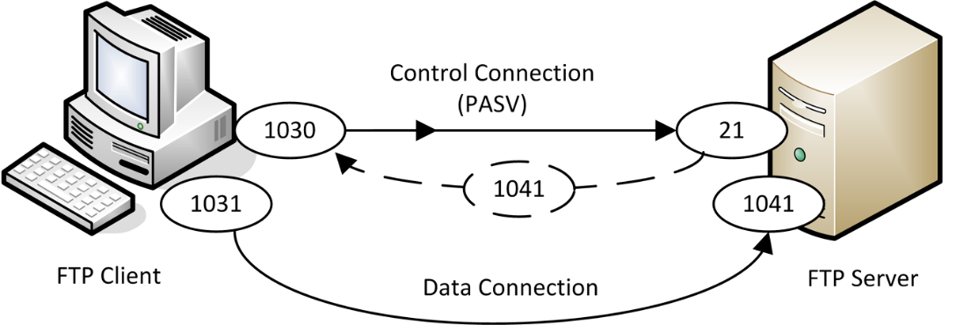
File Transfer Protocol (FTP)
Bidirectional, platform-independent file transfer
GUI/command clients
Active/passive transfer modes
  Port 21 + Port 20
  Port 21 + Ephemeral

Slide 23
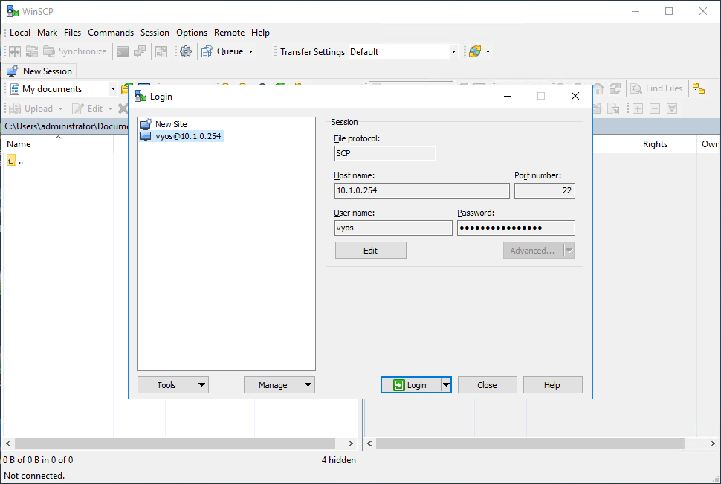
SFTP, FTPS, and TFTP
SFTP – using FTP over SSH (port 22)
FTP over SSL (FTPS)
  Explicit TLS (FTPES) - use the AUTH TLS command to upgrade an unsecure connection established over port 21
  Implicit TLS (FTPS) - negotiate an SSL/TLS tunnel before the exchange of any FTP commands
  Uses the secure port 990 for the control connection
Trivial File Transfer Protocol (TFTP)

Slide 24
WAN links can be used to run a number of packet switched data services, including Frame Relay, ATM, MPLS, and PPP.
SSL/TLS and IPsec enable the creation of secure VPNs by encrypting traffic (secure tunneling). VPNs can be used in different topologies, such as host-to-site or site-to-site.
Remote access protocols can be used for administration and file transfer but care must be taken to distinguish secure and unsecure protocols.
Notes:
What distinguishes ATM from Ethernet? ATM uses fixed size cells compared to Ethernet's variable size frames.
What is the difference between IP and MPLS routing? IP routing is "best effort" while MPLS allows for constraint-based routing, enabling traffic shaping.
How does PPP work to allow a computer with a dialup modem to connect to the Internet? The Point-to-Point Protocol (PPP) is a layer 2 protocol. IP packets are encapsulated within PPP frames to be transported to the ISP's router via the dialup link.
What are the three main topologies for implementing a VPN? Many Virtual Private Networks (VPN) use a client-to-site topology, where one or more hosts connect to a site (a remote access VPN). Other options include site-to-site and host-to-host topologies.
How does TLS improve the security of a VPN connection compared to PPTP? Transport Layer Security (TLS) uses a digital certificate on the VPN gateway to authenticate the remote host and encrypt the setup of the VPN session, providing better protection for the exchange of user credentials.
What IPsec mode would you use for data confidentiality on a private network? Transport mode with Encapsulation Security Payload (ESP). Tunnel mode encrypts the IP header information, but this is unnecessary on a private network. Authentication Header only provides authentication and integrity validation, not confidentiality.
What step can you take to prevent unauthorized use of a remote access server? Define which user accounts have dial-in rights and ensure each user protects their authentication credentials.
What TCP/IP application protocol is associated with TCP port 23? Telnet.
What are the main uses of SSH? Typically to provide a secure terminal to a remote Linux or UNIX host (or any other host with an SSH server installed). SSH can also be used as a type of VPN.
What type of attack is RDP Remote Credential Guard designed to protect against? Pass-the-Hash (PtH) attacks. In PtH, the attacker obtains credentials from an RDP session from the RDP server and tries to re-use them. Credential Guard is designed to prevent the RDP server from storing or processing the password hash.
What is a virtual terminal? Configuring a management IP address on a switch to connect to its command line interface over the network (rather than via a serial port).
What distinguishes TFTP from FTP? T(rivial)FTP only supports GET and PUT commands (not directory browsing, file deletion, and so on).

Slide 25
Lab 15 / Configuring Secure Access Channels
Lab 16 / Configuring a Virtual Private Network
Notes:
Note that there are three sets of labs available to use with this course:
Classroom labs that you set up and run yourself (refer to the separate "Labs" book and setup guide on the instructor resource support site).
Learn On Demand (LOD) hosted classroom labs accessed via a browser but following the same general sequence and steps as the classroom lab book.
Self-study Online Labs from Practice Labs accessed by students online - these labs are intended for use by students studying independently and are different from the classroom and hosted classroom labs. If you are using Practice Labs online labs in the classroom, you must specify this at the time of purchase so that the appropriate bandwidth is provisioned in advance. Please ensure that the student PCs meet the requirements for accessing the Self-study Online Labs series. You can obtain a setup guide at gtsgo.to/nf1rc
The sequence of classroom and hosted classroom labs is shown on this slide and in the margins of your instructor edition and in the course timetable. You should guide the students to complete each lab.
If you are not using the classroom or LOD hosted classroom labs you should delete this slide.

